Slide 1
Water Management History
Relating to Santa Fe, New Mexico

Slide 2
Earliest evidence of Humans in NM
made between 23,000 and 21,000 years ago along the shores of an ice age lake that once filled the Tularosa Basin in south-central New Mexico, in what is now White Sands National Park. This finding fundamentally changes the timeline on North American human habitation – turning back the clock of human arrival in the Americas nearly 10,000 years.

Slide 3
The arrival of Corn (and water management)
was first introduced into the southwestern U.S. from Mexico through highland corridors along the Sierra Madre Mountains and first appeared in New Mexico or Arizona(Mogollon Highlands and Rim some 4,000 years ago (2500 BC).
Although there is clear evidence of farming little is known about prehistoric irrigation and water management practices in NM. Current archaeological research is helping define pre-historic agricultural practices including identifying grid gardens, gravel/ mulch fields, and early irrigation canals. There is also evidence from Arizona that the Hohokom were building large earth works and canals between 600 and 700 AD.
Coincides with the beginning of the Pueblo Period.

Slide 4
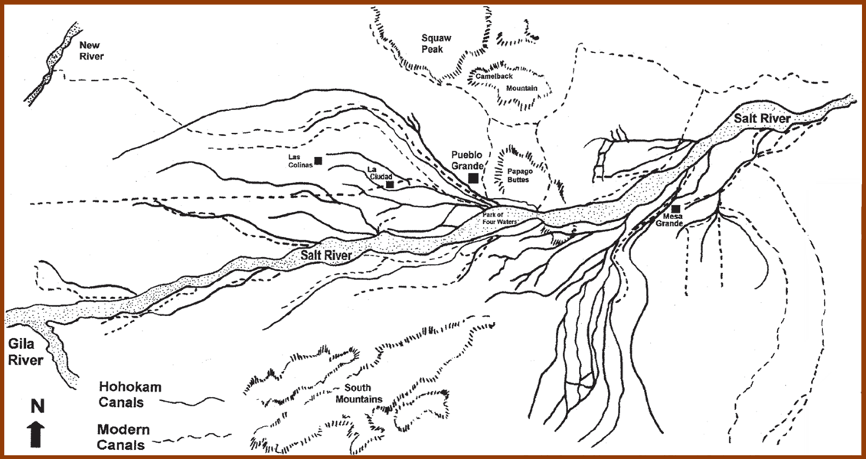

Slide 5
Classical Pueblo and the Spanish
There is some evidence from the Spanish records that give us a picture of prehistoric water management. The earliest of these descriptions come from the Coronado expedition of 1540-41. "many irrigated corn fields with canals and dams, built as if by the Spaniards." At Acoma he saw that "these people have their fields two leagues distant from the pueblo, near a medium sized river, and irrigate their farms by little streams of water diverted from a marsh near the [San Jose] river.“ ll Gaspar Castano de Sosa, visiting San Ildefonso in 1591, noted that that pueblo had a very large area under irrigation. Bandelier, investigating the old Piro district at the end of the nineteenth century, declared that these Indians had "once irrigated the bottoms along the Rio Grande, and that the number and extent of [their] fields and of the irrigating ditches connected with them, attracted the attention of the Spanish explorers at an early day.“ (Simmons 1974)

Slide 6
USES OF WATER under Spanish law

Slide 7
Acequia Agriculture
In 1609 the provincial capital was moved to Santa Fe under Governor Pedro de Peralta and the Palace of the Governors was built.
Originally there were only a two main acequias serving the residents of the Villa of Santa Fe.

Slide 8
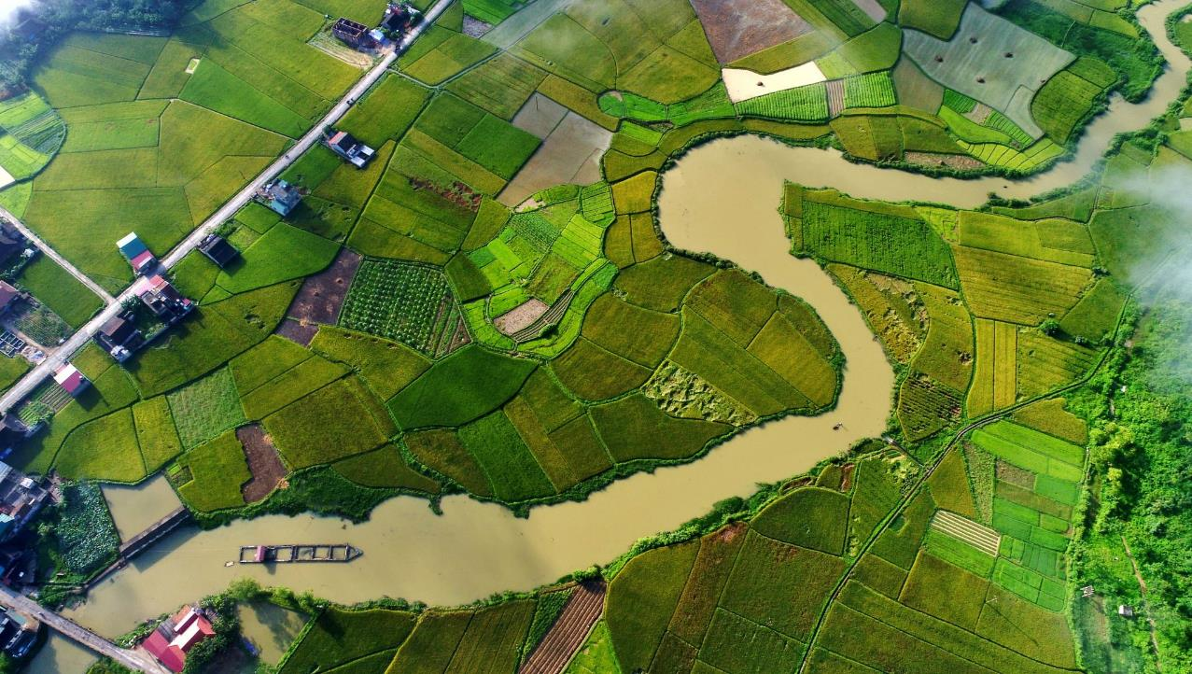
Lets jump ahead!
Spanish and Native Irrigation continued until roughly the 1770s when the growing community began to see the limited availability of water from the river. This led to the appointment of two water “judges” who were tasked with adjudicating who had the most need and redistributing the water to residents. This resulted in some of the earliest water ordinances in what would eventually be the US. July 16, 1722.
Also during this time we see many court cases relating to who owns what water or water conveyance.
In 1846 United States forces occupied Santa Fe during the Mexican- American war.
The following year two US Army Engineers explored the river to its headwaters and suggested a dam be built
In 1847 a sawmill was built down stream from Granite Point dam with the purpose of providing fort Marcy with lumber
In 1861 the NM territorial legislature passed an act to investigate increasing water flow in the river

Slide 9
Early Mapping
We also see some of the earliest maps of Santa fe depicting acequias and water ways

Slide 10
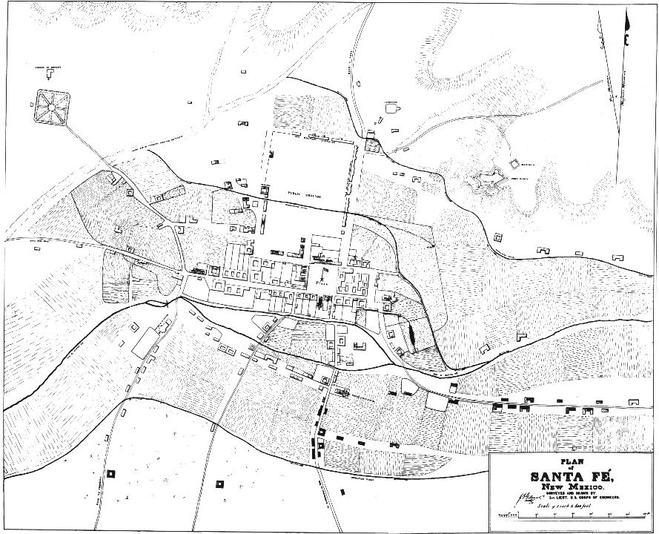

Slide 11
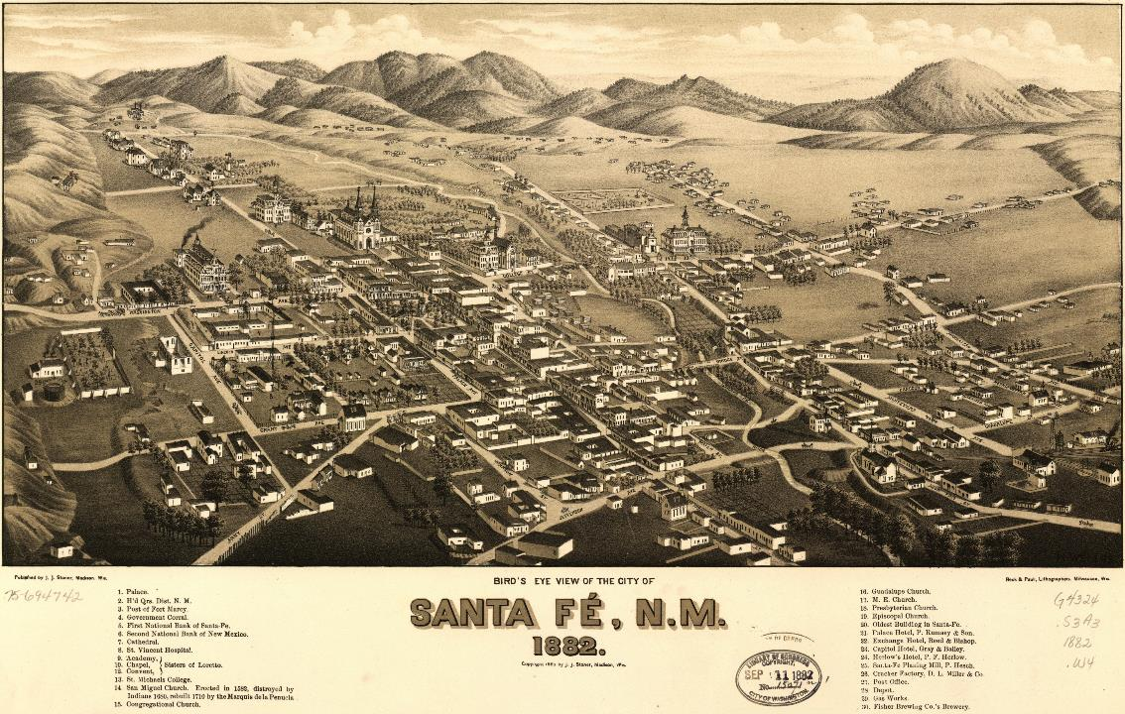

Slide 12
Then we start worrying about fire
In 1861 a large fire swept through Las Vegas leaving Santa Feans to deal with the fact that without water they could face the same fate.

Slide 13
December 29, 1879 it all changes
On this day in 1879 the very first water company in Santa Fe was incorporated. The company intended to supply water to Santa Fe and its vicinity. The Santa Fe Commissioners gave the new water co. “exclusive right… of erecting dams, reservoirs and impounding” Santa Fe River Water.
Pop: 6,635
The following year the company failed, and the SF City Water Works Corp bought the assets. This is interestingly enough the same year that the railroad arrives in greater Santa Fe. AT&SF 1879 Lamy.

Slide 14
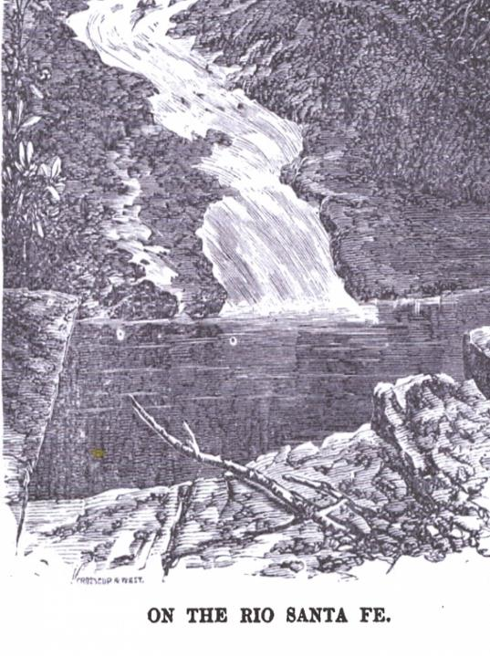
OLD Stone Dam
The new City Water Works builds first dam roughly two miles upstream from the plaza
The dam held about 25 acre feet of water and was transported to the city via a 10-inch cast pipe (1881).
It filled with sediment in a single storm in 1904, and never again stored water. Two-Mile Dam (named for its distance from the plaza) was constructed in 1893 and stored 387 acre-feet. It was decommissioned and breached in 1994 due to safety concerns.

Slide 15
Water
In June 1881 the Daily New Mexican reported that Hispanics in town had stopped the pipe laying work and had to be disarmed by the sheriff.
This is the first transition from water being public to being private.
Protests continued until at least 1883 when protesters reportedly smashed pipes and diverted water to the river

Slide 16
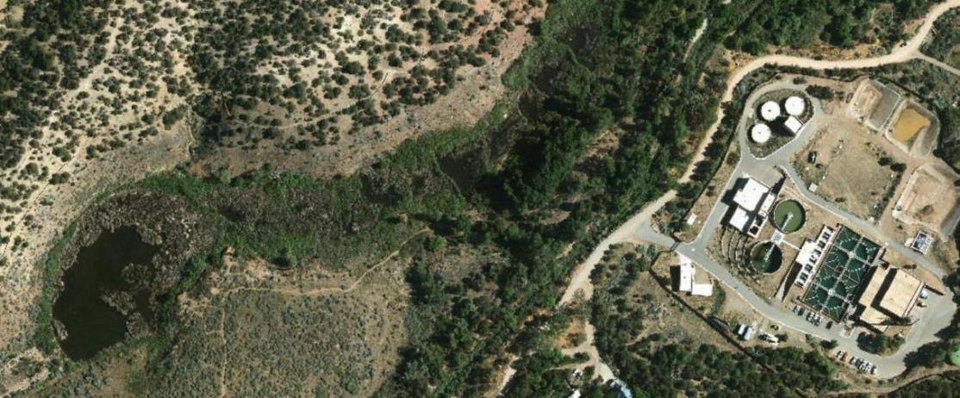

Slide 17
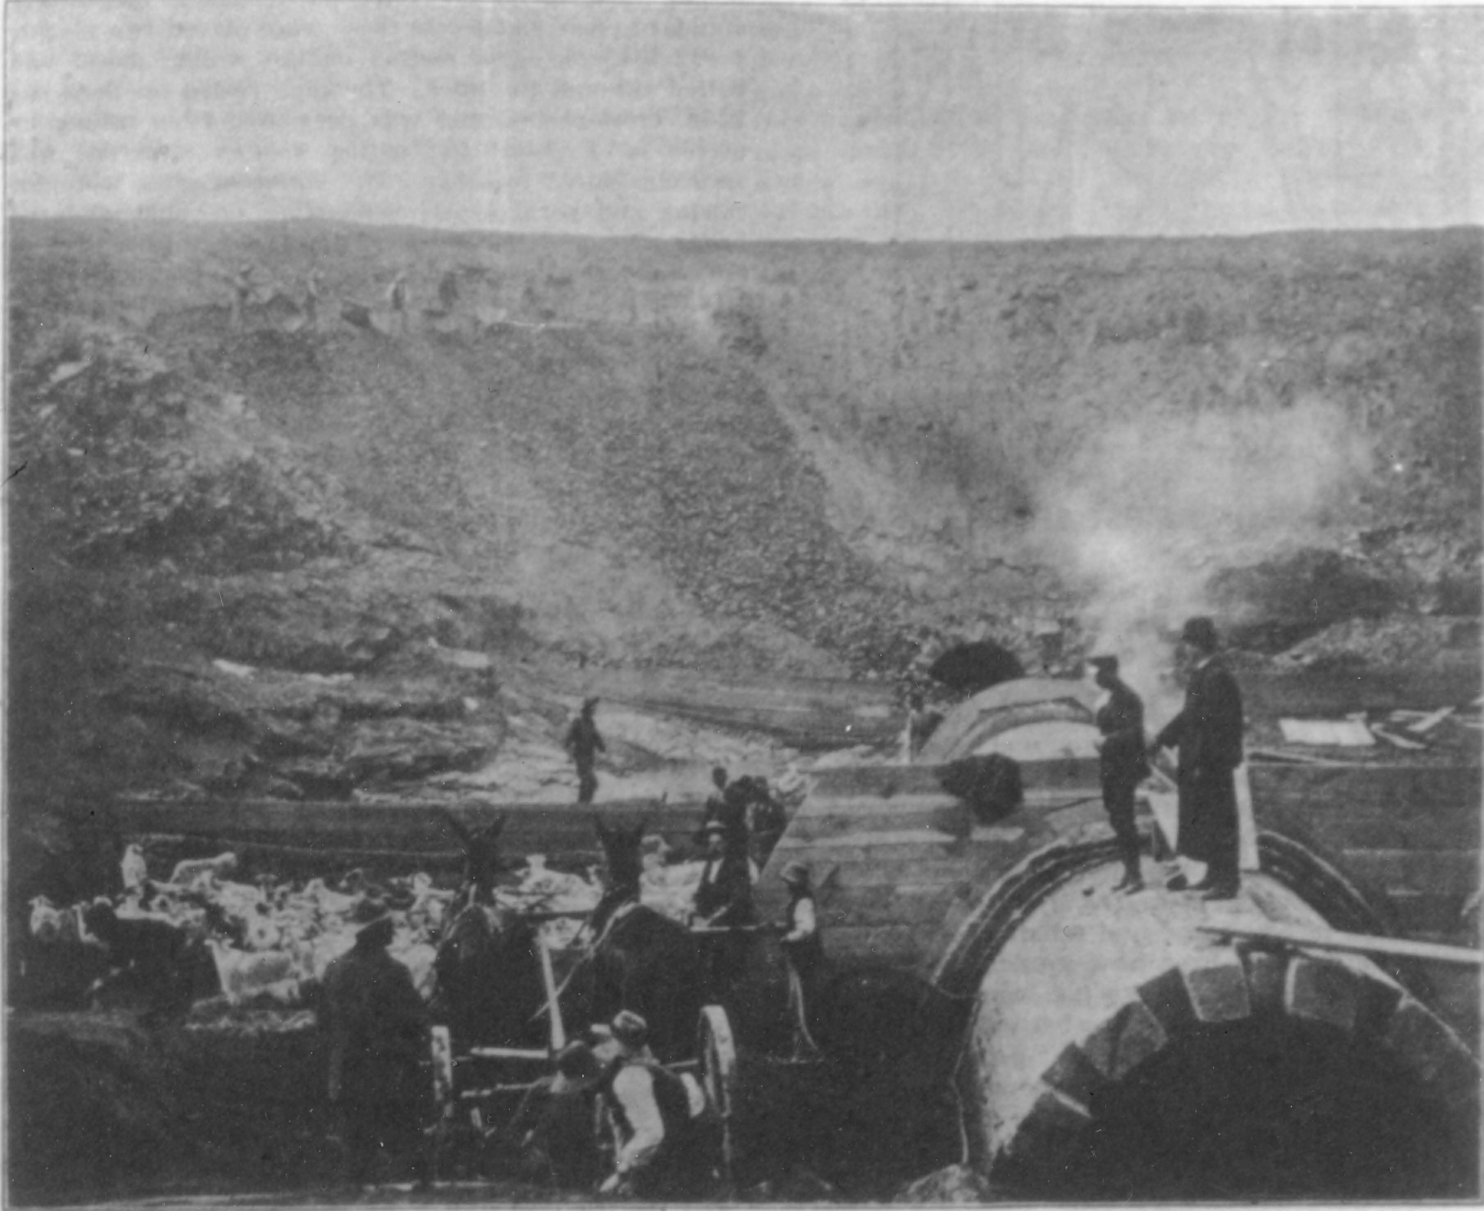
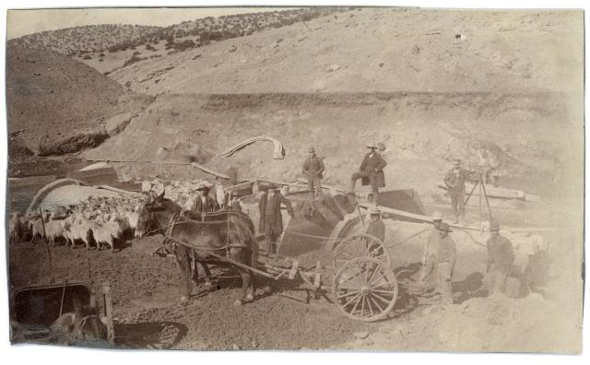

Slide 18
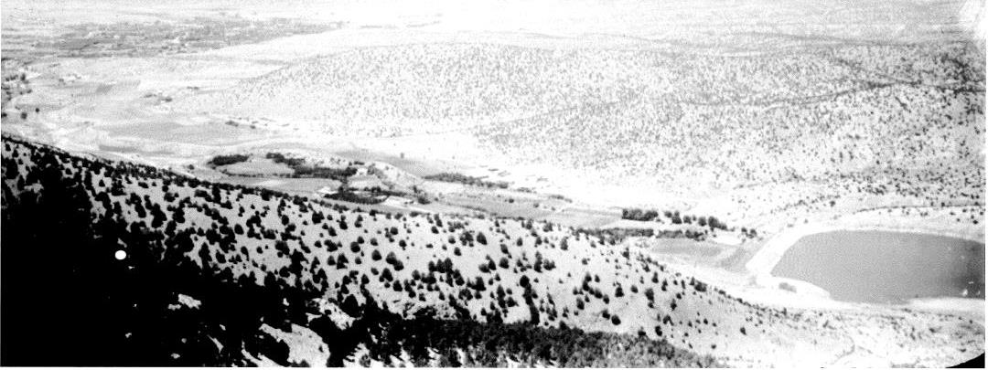
Two-Mile from Atayala Peak

Slide 19
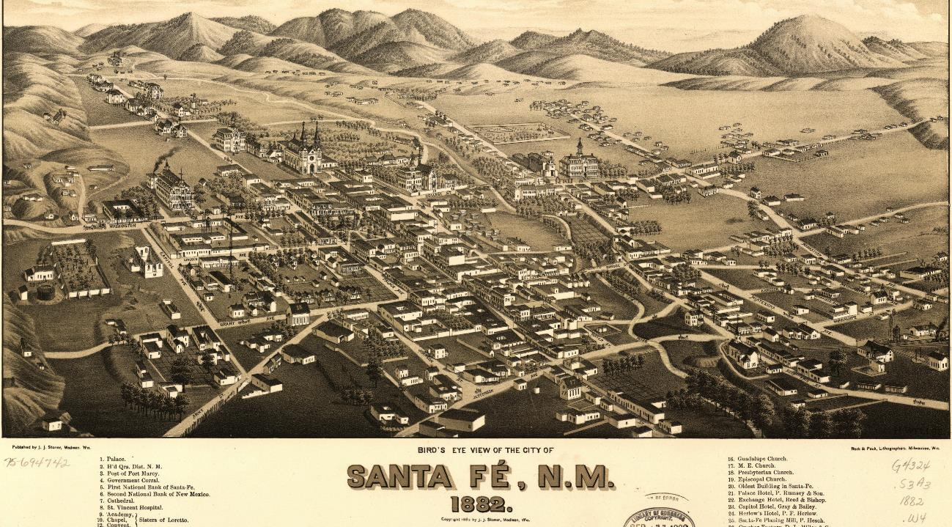

Slide 20
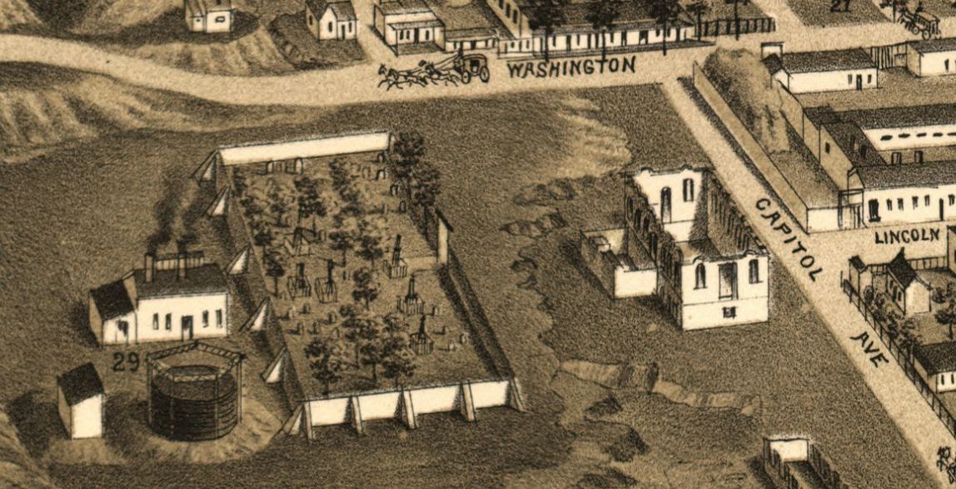

Slide 21
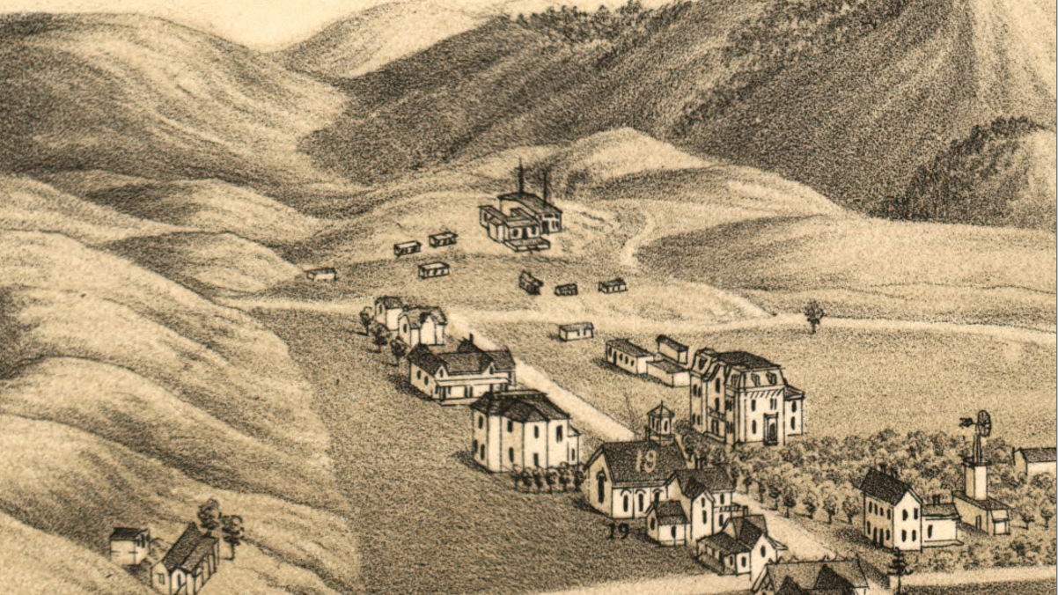

Slide 22
Things Really start rolling
1880 a coal gas works built and gas company (incorporated 1894
Dismantled 1897)
1882 original water company buys assets back
1891 Municipal Investment company of Chicago buys all water assets.
The water company builds Two-mile dam (compacted by goats)
SF Gas and electric in 1894 starts supplying 25kw steam generated of electricity to downtown businesses.
The Same year the Hydroelectric plant was built

Slide 23
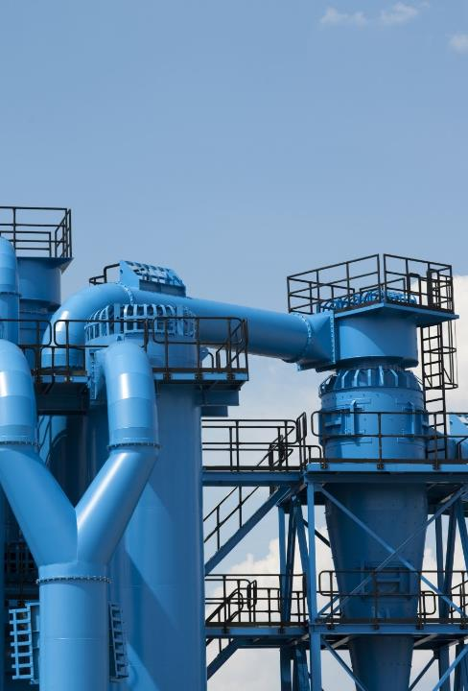
Water works
1894 hydro plant is completed
Two peloton water wheels drive a belt drive electric generator putting out 100kw
Water was discharged into settling reservoirs that still exist today
A small reservoir was built, Tayala Hill, to provide head pressure to the plant an was fed via pipe from two-mile.
Power the following Year

Slide 24
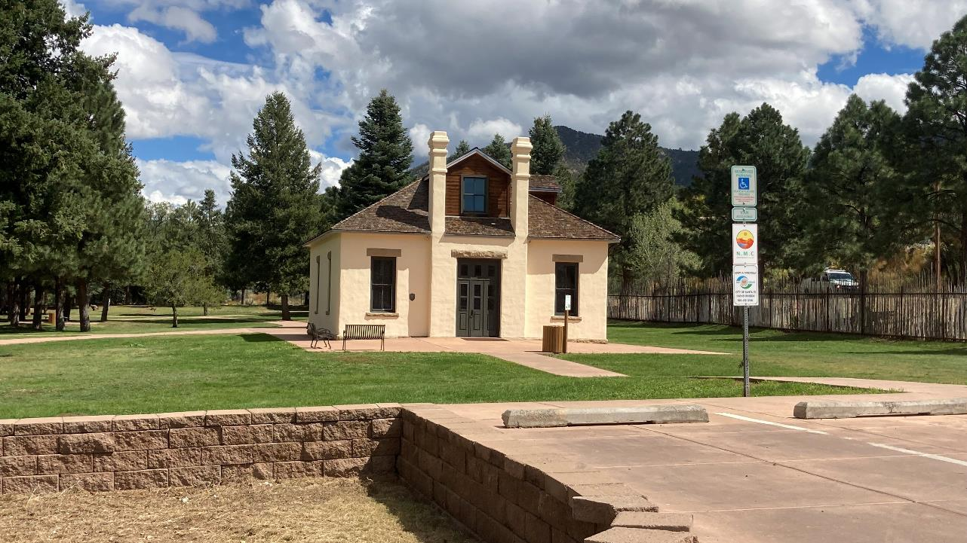

Slide 25
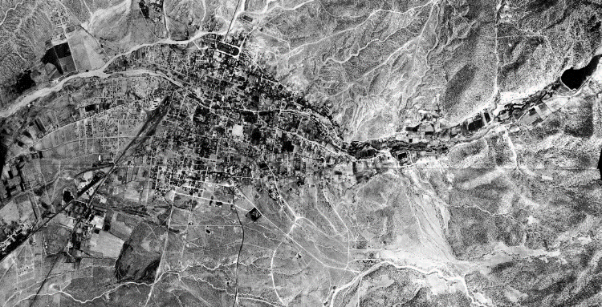

Slide 26
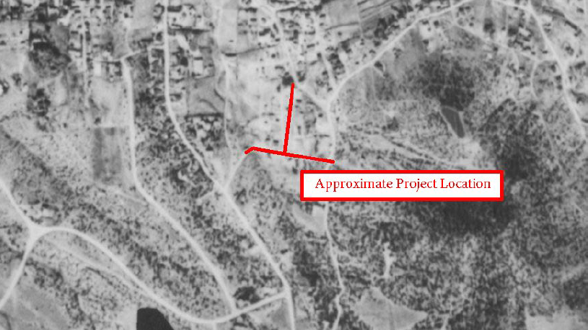
Showing Tayala Hill reservoir

Slide 27
Early to mid- Nineteenth Century
1900 Santa Fe Water and Light Company formed. Takes over franchise from troubled Santa Fe Water & Improvement Co.
1914 2961 AF municipal diversion = 222 gpcd
1913 - 1918 Average SF River flow of 7987 AF/yr
1918 38 ditches serving 2262 acres irrigable. 1267 actually irrigated.
1925 First water meters installed due to dry year
1926 Federal Light & Traction Co. of New York takes over system and incorporates New Mexico Power Co. as new Utility.
1926 Granit Point Dam completed. 561 AF Capacity
1926 NM Power Company filed formal application for 3500 AF from SF River. No protests!
1935 Granite Point Dam expanded to 651 AF.
1942 Four Mile Dam (Nichols) completed. Capacity 776.4 AF
1946 Granite Point Dam expanded to 2908 AF and renamed McClure.

Slide 28
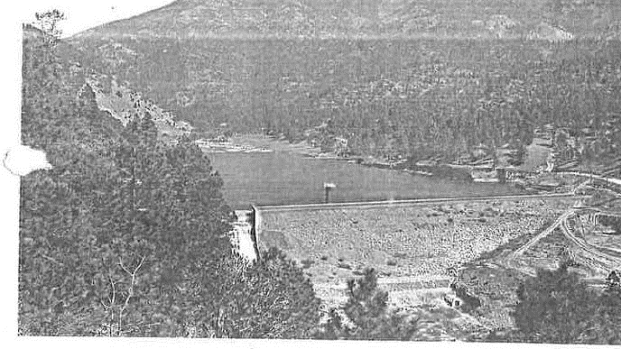
Granite Point, 1929

Slide 29
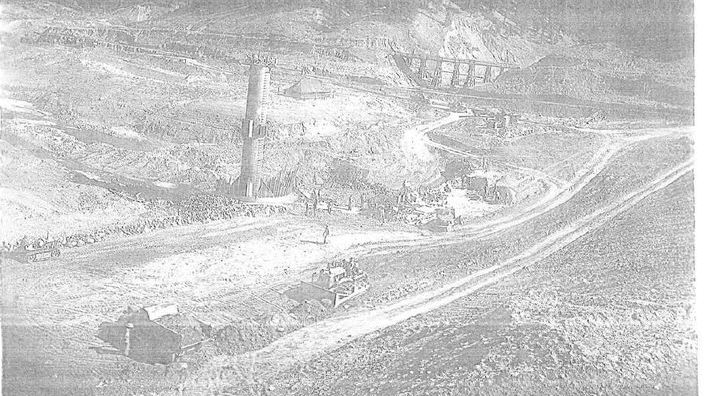
Granite Point/ McClure Renovations, 1947

Slide 30
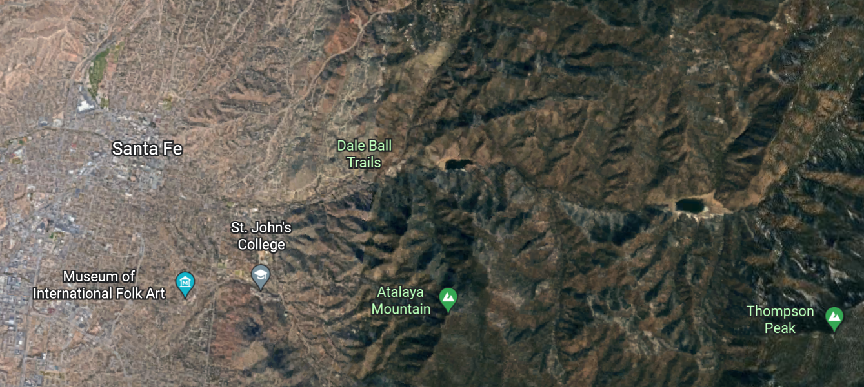

Slide 31
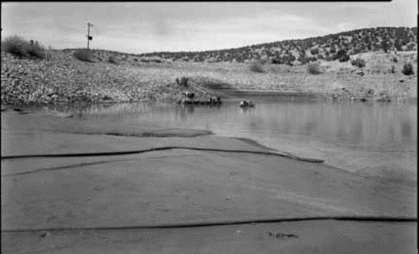
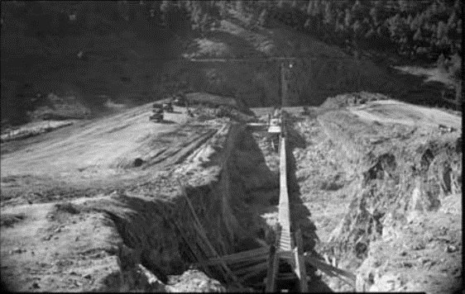
Construction of Nichols or Four Mile Dam, 1942

Slide 32
City WellField
1946 NM Power Company, Las Vegas Light and Power, Deming Ice and Electric merged w Albuquerque Gas & Electric to form PNM.
1946 First well in City Wellfield completed (RG-1113)
1950 Second well in City Wellfield completed (RG-1114)
1951 Third, fourth, fifth, and sixth wells in City Wellfield completed (RG-1115-1118)

Slide 33
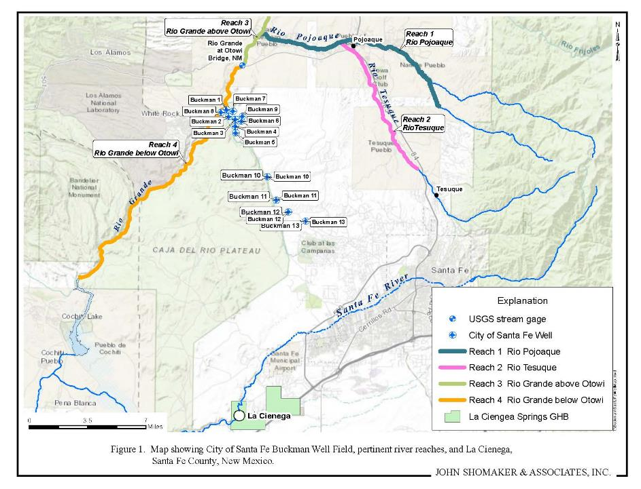
Buckman Wellfield
1972 – temporary permit for 5,000 afy from BW 3-6
1976 – permit for 10,000 afy from BW 1-6 with required offsets
1989 – add BW-7 & BW-8
2002 – add BW-9
2003 – add BW10-13 with required monitoring plan

Slide 34
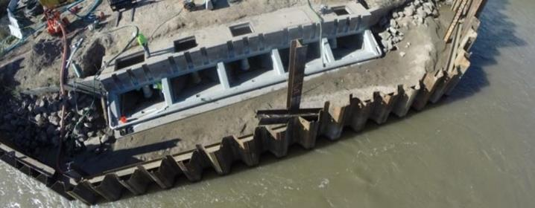
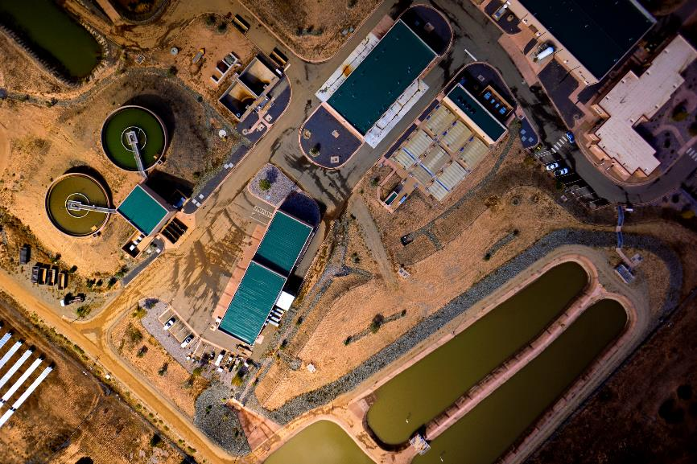
Buckman Direct Diversion: 2011

Slide 35
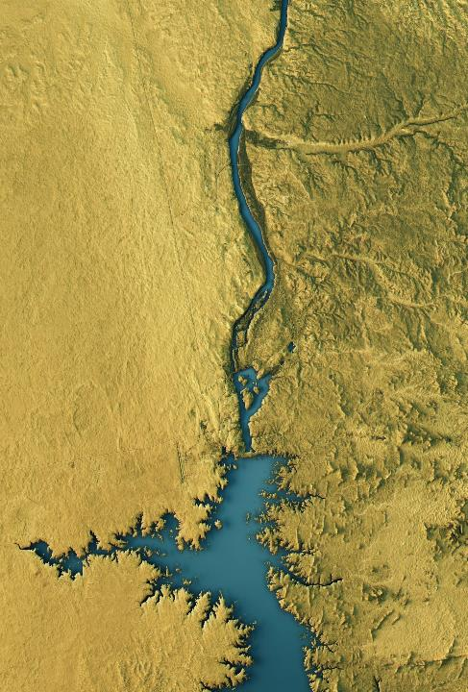
How Many Acre Feet
1951 PNM files claim to additional 1540 AF of SF River bringing total claimed sw right to 5040 AF.
1951 PNM notice of intent to apply for a portion of NM's share of Colorado River Water
1956 OSE Declares Rio Grande Underground Water Basin
1958 Permit granted to add St. Mike's Well as additional POD for SF River rights.
1968 OSE approves application for 4865 AF rights from City Wellfield
1968 PNM proves out full 5040 AF SF River use and gets Permit 1677 including 3500 AF with priority date of 1926
1971 Santa Fe River adjudication begins (Reynolds vs. Anaya)
1976 PNM obtains 5605 AF SJC water

Slide 36
Water Production and use

Slide 38
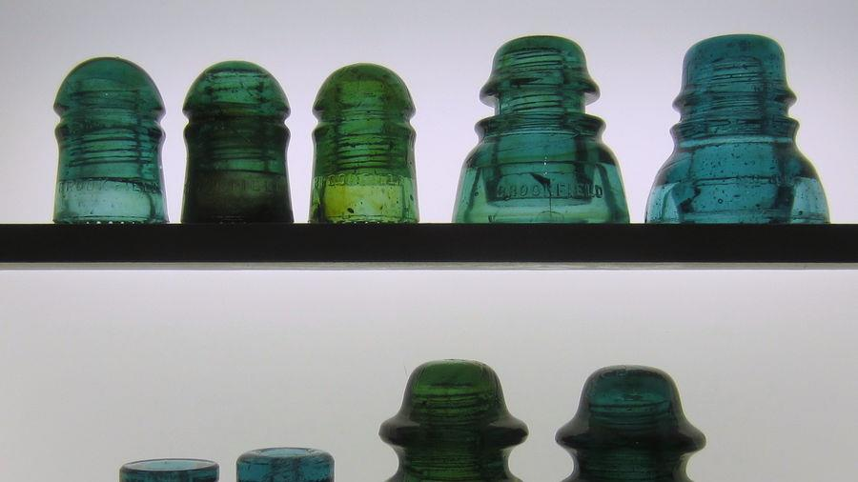
qUESTIONS

