Slide 1
Lesson One Cooling Our Communities and Capturing Water
What are some simple ways to cool our urban environments and help save water?
Notes:
Connect to the Unit
In this Rainwater Harvesting unit, students will:
Apply the Engineering Design Process (EDP) to construct ideas and design a solution for using rainwater in place of potable water.
Ask questions and discover new technology and methods for saving drinking water and mitigating urban heat.
Develop and demonstrate a mathematical and/or physical model to manage runoff in the schoolyard watershed.
Analyze and interpret mathematical data to support decision-making and planning of a passive rainwater harvesting system.
Understand the cause and effect relationships of the heat island effect and learn how passive rainwater can be used to help cool our communities and supplement potable water supplies.

Slide 2
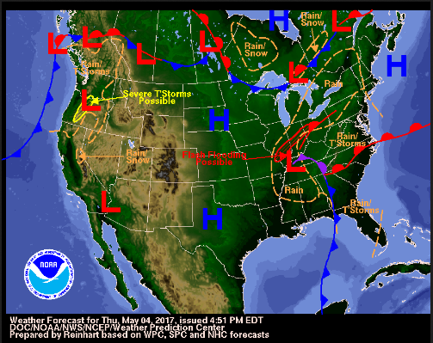
DISTINGUISH:
What is weather?
What is weather not?
Notes:
DISTINGUISH
What is weather?
When we think of weather, we think of what it is currently like outside. Students may say: rain, clouds, sunny, hot, monsoon storm, etc.
What is weather not?
It is not always the same. It is not always predictable. It is not always pleasant. Weather is not a long term look at atmospheric conditions.

Slide 3
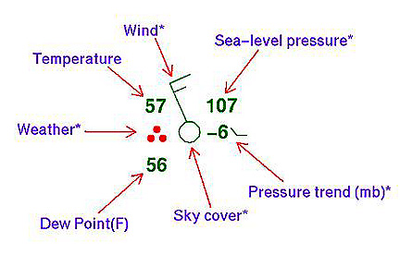
BUILD THE SYSTEM:
What are the parts of our weather system?
What is our weather system part of?
https://www.weatherwizkids.com/weather-forecasting.htm
Notes:
BUILD THE SYSTEM
What are the parts of our weather system?
Parts of our weather includes temperature, wind (speed and direction), cloud cover, precipitation, dew point (related to humidity), barometric pressure. If students don’t mention humidity, ask them how the air feels when a monsoon storm is building.
What is our weather system a part of?
Weather is part of the earths system; part of a regional pattern (why we have deserts vs tropical rain forests; seasons; weather front; part of our daily lives.
Ask students to work in their table groups to write a definition of weather based on the above thinking. It should be something like: Weather is the daily state of the atmosphere, or air, in any given place.
Image Source: https://www.weatherwizkids.com/weather-forecasting.htm

Slide 4
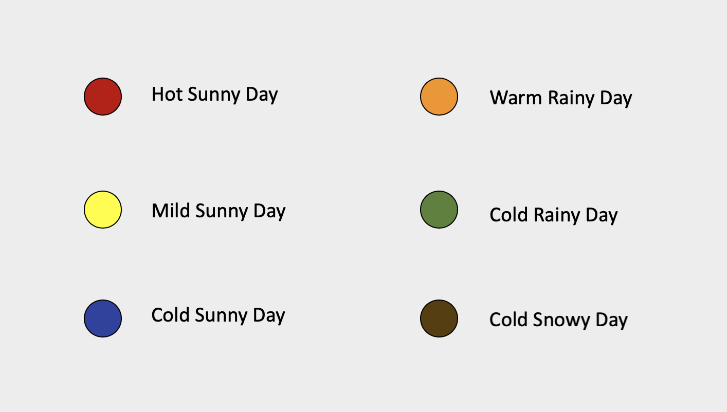
View sample M & M data form: https://forms.office.com/r/up3h7ygALp
Sample whole class climate-weather data: https://bit.ly/samplem-mdata
Activity: What’s the Difference Between Weather and Climate?
Notes:
Climate Simulation
Simplified Option
1. Pass out a “fun size” bag of M&Ms and the Weather Data Table.xlsx to every student. Tell them they will be using the M&Ms to model or simulate the difference between weather and climate.
The M&Ms will be counted and recorded by color and will represent daily weather conditions for the month of February in the calendar year that is assigned to each student. Each M&M represents one day in the month of February for their assigned year.
2. Assign each student a calendar year, starting with 1981 and ending with 2010 – our current Climate Normal Period. The Climate Normal Period is a three-decade average of climatological variables including temperature and precipitation. This product is produced once every 10 years. The current Climate Normal Period is the weather for the years 1981 – 2010.
If you have fewer than 30 students, just assign one year for every student that you have, i.e., if you have 24 students only do years 1981 through 2004. If you have more than 30 students, simply repeat some of the years to keep things simple.
3. Once all students have a worksheet, instruct them to remove one M&M from their bag. Explain to them that this represents weather for the first day of February in their assigned year.
Quickly compare Day 1 results for the students.
How many hot sunny days? _____
How many cold rainy days? ______
Make sure they understand that their M&M represents weather on February 1st for their assigned year. For the whole class, all the M&M’s collectively represent the Climate Normal Period from 1981 to 2010.
Is everyone’s weather the same? Have them explain why or why not. Weather on the same day each year can vary.
4. Have them empty their bag of M&Ms and record the number of colors of each M&M corresponding to the type of weather as shown on the worksheet. Make sure they write down the year that was assigned to them in the space on the left-hand side of the worksheet.
5. To simplify creating a class average for each weather condition for all your students, have them work in their groups of four to compute their average results together.
6. Using the averages from each student group, input the data into the spreadsheet Weather Data Table_Teacher.xlxs to generate a bar chart which now simulates climate. Display the bar chart to the students.
Climate is the average weather in a location over many years. Your weather pattern is for the Climate Normal Period of 1981-2010.
7. While your inputting each group’s average data into the spreadsheet, instruct the students use their individual (not group) results to create a simple bar chart in the space provided at the bottom of their worksheet.
8. Have the students write down the class average results on their worksheets and compare to the class average bar graph.
How does their data compare to the class average?
What trends do they see?
What types of weather occurred more than average?
What types of weather occurred less than average?
Inform the students that their combined class data over time represents climatic conditions but their individual data for the month of February in their assigned year represents weather conditions. Make sure they understand that weather is the daily state of atmospheric conditions whereas climate is long-term.
Advanced Option
If you have student computers with access to Google forms, then you may opt to use the optional resource lesson “What’s the Difference Between Weather and Climate” found in the Difference Between Weather and Climate.docx file.
Follow Steps 1 -7 of the Student Procedures activity and display the results on screen. Follow the same line of questioning as above.
For an even deeper look at student data, complete the rest of the lesson, referring to Analyzing W-C data Excel.pdf for directions on how to manipulate the data in Excel.

Slide 5
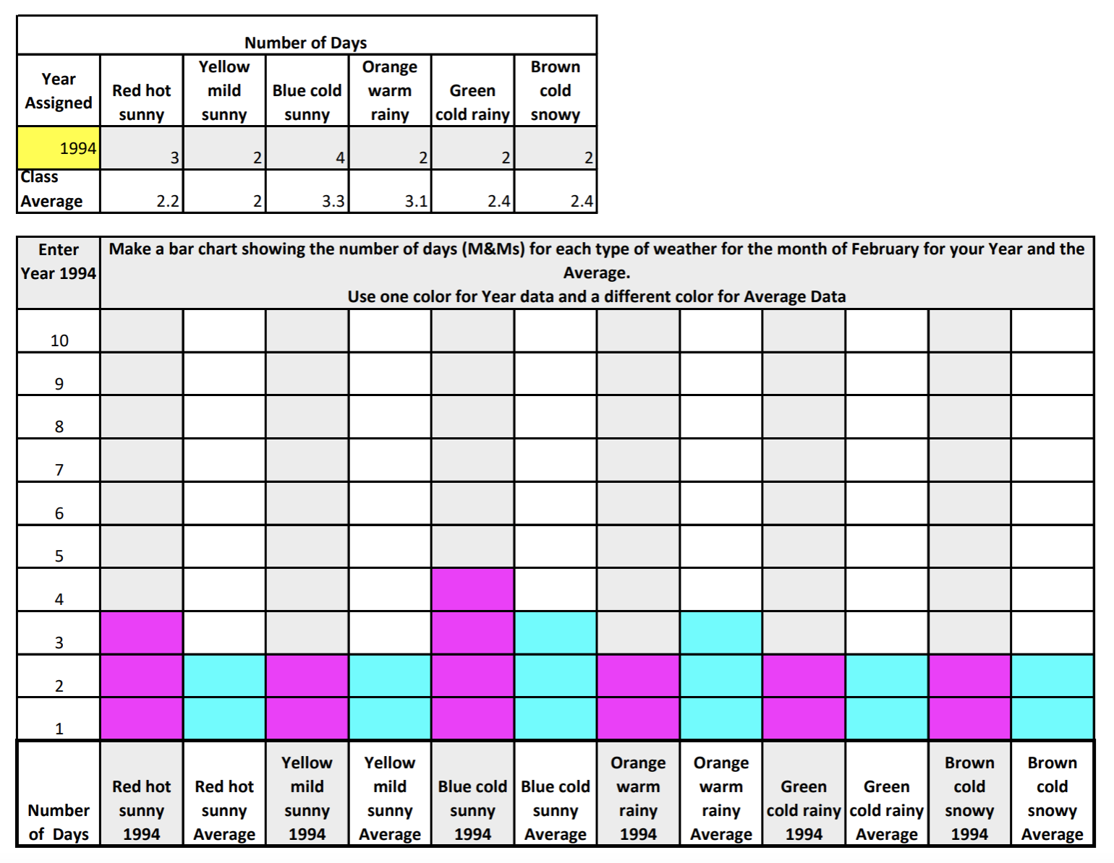
Activity: What’s the Difference Between Weather and Climate?
Notes:
Climate Simulation
Simplified Option
1. Pass out a “fun size” bag of M&Ms and the Weather Data Table.xlsx to every student. Tell them they will be using the M&Ms to model or simulate the difference between weather and climate.
The M&Ms will be counted and recorded by color and will represent daily weather conditions for the month of February in the calendar year that is assigned to each student. Each M&M represents one day in the month of February for their assigned year.
2. Assign each student a calendar year, starting with 1981 and ending with 2010 – our current Climate Normal Period. The Climate Normal Period is a three-decade average of climatological variables including temperature and precipitation. This product is produced once every 10 years. The current Climate Normal Period is the weather for the years 1981 – 2010.
If you have fewer than 30 students, just assign one year for every student that you have, i.e., if you have 24 students only do years 1981 through 2004. If you have more than 30 students, simply repeat some of the years to keep things simple.
3. Once all students have a worksheet, instruct them to remove one M&M from their bag. Explain to them that this represents weather for the first day of February in their assigned year.
Quickly compare Day 1 results for the students.
How many hot sunny days? _____
How many cold rainy days? ______
Make sure they understand that their M&M represents weather on February 1st for their assigned year. For the whole class, all the M&M’s collectively represent the Climate Normal Period from 1981 to 2010.
Is everyone’s weather the same? Have them explain why or why not. Weather on the same day each year can vary.
4. Have them empty their bag of M&Ms and record the number of colors of each M&M corresponding to the type of weather as shown on the worksheet. Make sure they write down the year that was assigned to them in the space on the left-hand side of the worksheet.
5. To simplify creating a class average for each weather condition for all your students, have them work in their groups of four to compute their average results together.
6. Using the averages from each student group, input the data into the spreadsheet Weather Data Table_Teacher.xlxs to generate a bar chart which now simulates climate. Display the bar chart to the students.
Climate is the average weather in a location over many years. Your weather pattern is for the Climate Normal Period of 1981-2010.
7. While your inputting each group’s average data into the spreadsheet, instruct the students use their individual (not group) results to create a simple bar chart in the space provided at the bottom of their worksheet.
8. Have the students write down the class average results on their worksheets and compare to the class average bar graph.
How does their data compare to the class average?
What trends do they see?
What types of weather occurred more than average?
What types of weather occurred less than average?
Inform the students that their combined class data over time represents climatic conditions but their individual data for the month of February in their assigned year represents weather conditions. Make sure they understand that weather is the daily state of atmospheric conditions whereas climate is long-term.
Advanced Option
If you have student computers with access to Google forms, then you may opt to use the optional resource lesson “What’s the Difference Between Weather and Climate” found in the Difference Between Weather and Climate.docx file.
Follow Steps 1 -7 of the Student Procedures activity and display the results on screen. Follow the same line of questioning as above.
For an even deeper look at student data, complete the rest of the lesson, referring to Analyzing W-C data Excel.pdf for directions on how to manipulate the data in Excel.

Slide 6
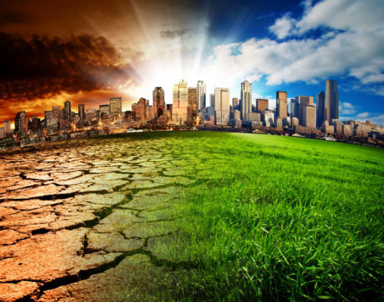
DISTINGUISH:
What is climate?
What is climate not?
Notes:
DISTINGUISH
What is climate?
Climate is long term averages (30-years) in weather.
What is climate not?
The may not know but climate is not static. It is changing as can be seen by the following slides

Slide 7
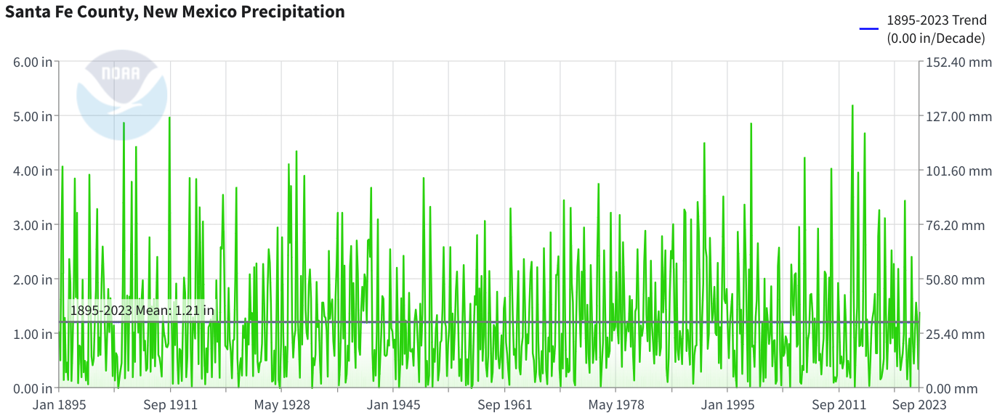
Santa Fe Precipitation 1895-2023
Notes:
What claims can you make based upon this evidence?
Dark Blue Line is yearly precipitation (inches)
Dotted Red is 10 year averages
Green is Normals based on a 30-year climate record.
A 30-year climate Normal is recalculated every decade using the most recent 30 years of data. This current climate Normal is based on 1980-2010.
The new climate Normal will be calculated in 2020 for years 1990-2020.
Where do you think the new climate normal line will be?

Slide 8
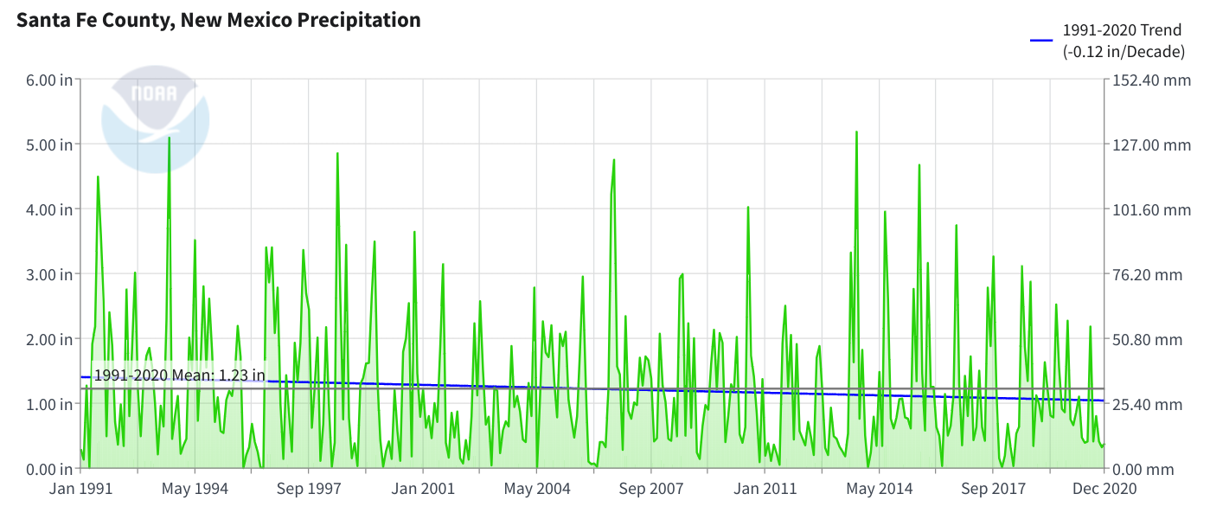
Santa Fe Precipitation 1991-2020
Notes:
What claims can you make based upon this evidence?
Dark Blue Line is yearly precipitation (inches)
Dotted Red is 10 year averages
Green is Normals based on a 30-year climate record.
A 30-year climate Normal is recalculated every decade using the most recent 30 years of data. This current climate Normal is based on 1980-2010.
The new climate Normal will be calculated in 2020 for years 1990-2020.
Where do you think the new climate normal line will be?

Slide 9
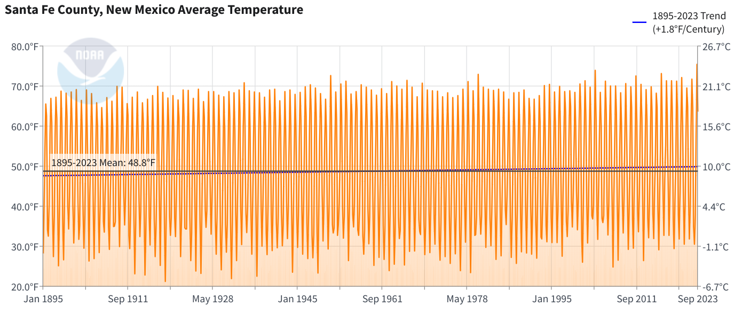
Santa Fe Temperature 1895-2023
Notes:
What claims can you make based upon this evidence?
Dark Blue Line is yearly precipitation (inches)
Dotted Red is 10 year averages
Green is Normals based on a 30-year climate record.
A 30-year climate Normal is recalculated every decade using the most recent 30 years of data. This current climate Normal is based on 1980-2010.
The new climate Normal will be calculated in 2020 for years 1990-2020.
Where do you think the new climate normal line will be?

Slide 10
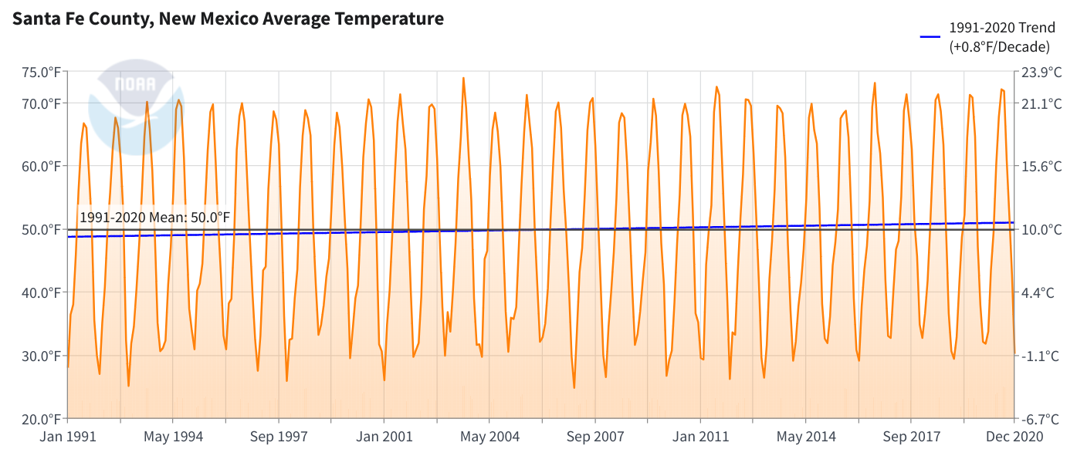
Santa Fe Temperature 1991-2020
Notes:
What claims can you make based upon this evidence?
Dark Blue Line is yearly precipitation (inches)
Dotted Red is 10 year averages
Green is Normals based on a 30-year climate record.
A 30-year climate Normal is recalculated every decade using the most recent 30 years of data. This current climate Normal is based on 1980-2010.
The new climate Normal will be calculated in 2020 for years 1990-2020.
Where do you think the new climate normal line will be?

Slide 11
What can you conclude about Santa Fe’s Climate?
It’s getting significantly warmer
30-year temperature average will be higher
Rainfall varies a little over time, 30 – year average could be slightly lower
What doesn’t our annual precipitation data show us?
Notes:
The annual precipitation data does not show us large storm events that can lead to flooding

Slide 12
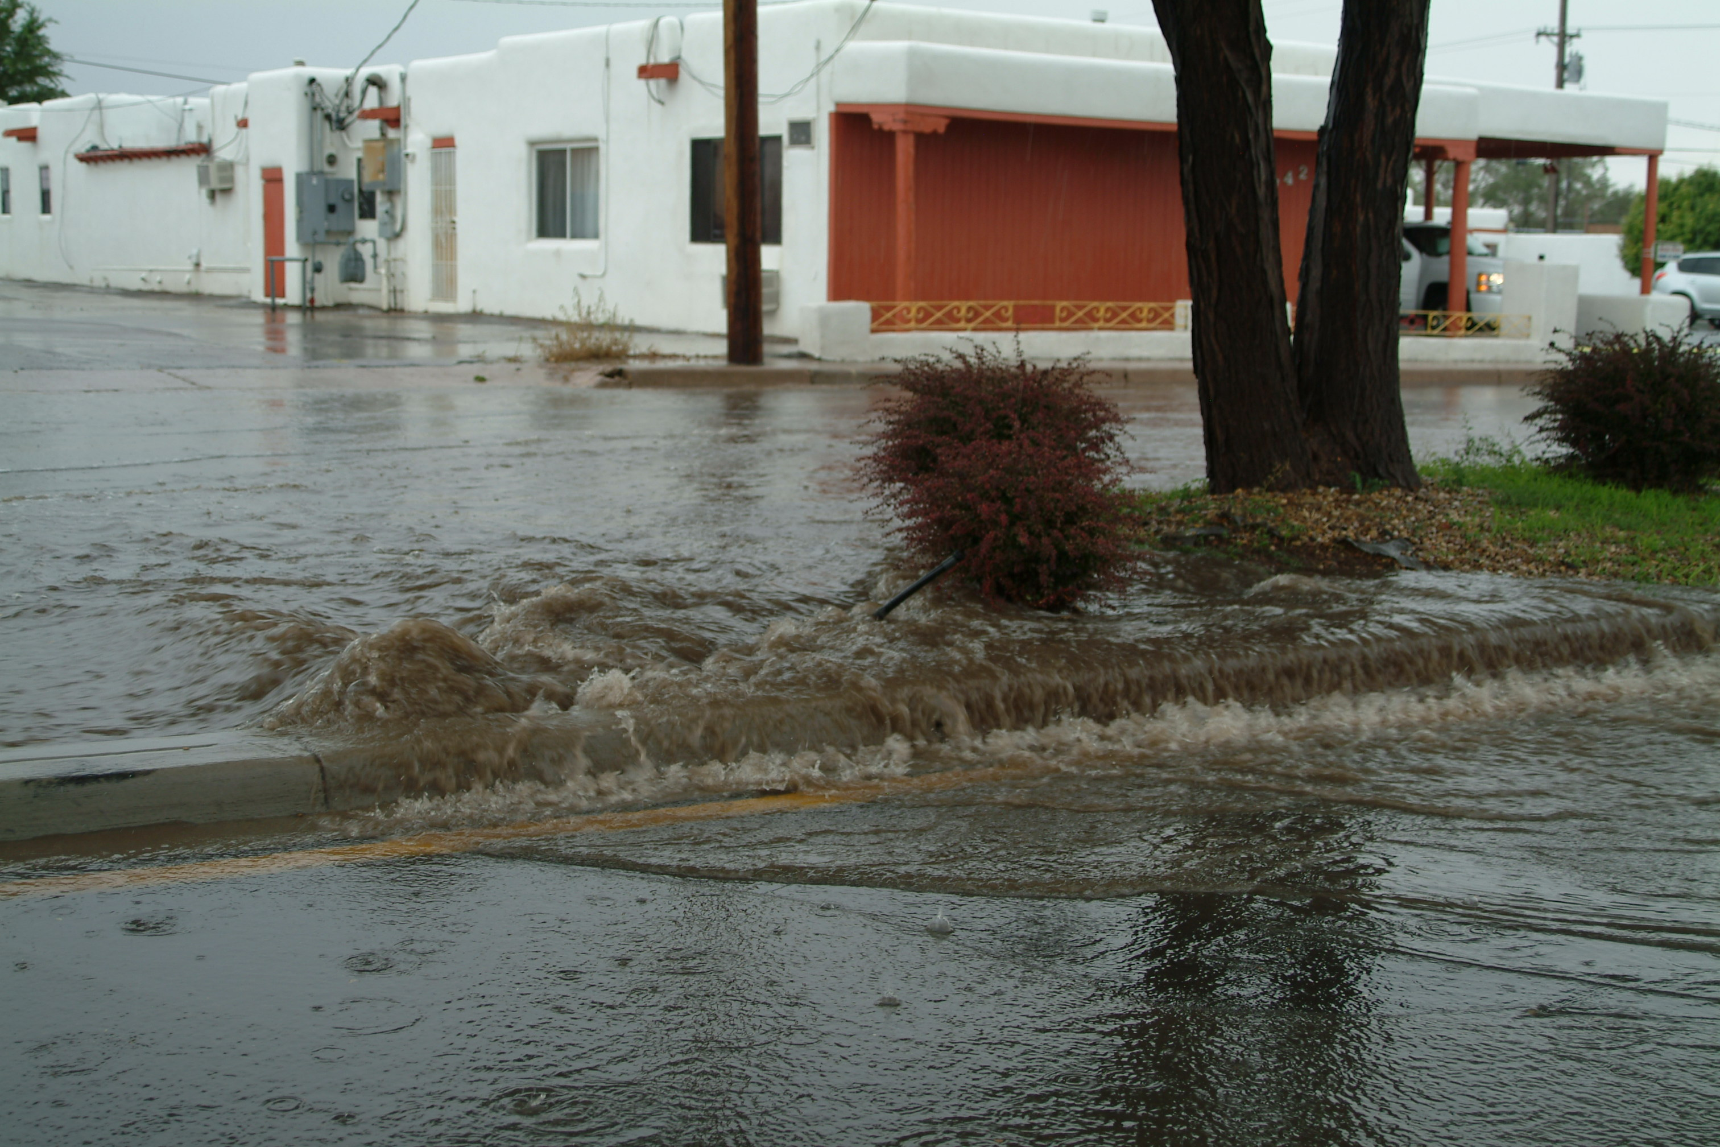
Cerrillos Road Flooding 2012
Notes:
Here is an example of a large storm event that flooded the football field at Tucson High School. It was from a large storm event in July 2017. Rain that fell in the nearby neighborhoods ran off the properties and streets and overflowed a wash that flooded the football field. The artificial turf field closed until graduation the following May.

Slide 13
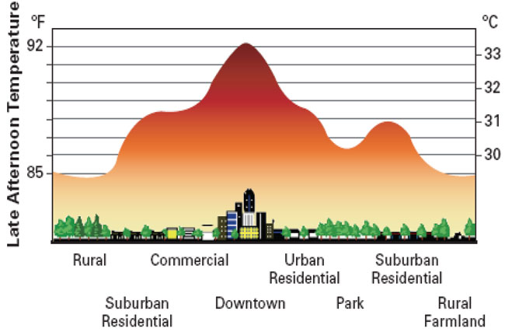
What does this graph show?
It is hotter where we have more concrete
Notes:
Local Climate Issues
Ask, “What does this graph show?” Have students analyze and interpret it in table groups.
An Urban Heat Island, or UHI, occurs in metropolitan or urban areas. Heat energy from the sun, as well as human activities, gets absorbed by pavement, buildings and other structures which increases the temperature of that area. Cities are congested with little open space for air circulation which prevents heat from escaping easily. So, the urban area holds the heat in to the night hours.

Slide 14
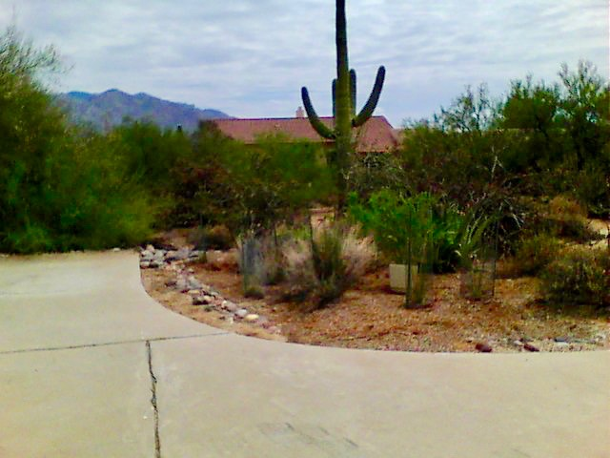
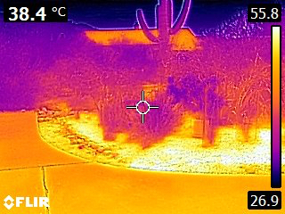
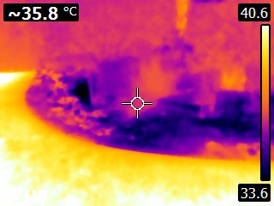
RELATE: What might be some relationships between natural and built environment, time of day, and heat?
Daytime
Nighttime
Notes:
RELATIONSHIP
This image shows an rain garden off to the side of a concrete driveway. The image on the bottom left is taken in the daytime and the image on the bottom right is taken at night with an Infrared camera. The landscape is radiating heat out to the atmosphere and this radiation can be seen in the infrared spectrum. A temperature gauge is on the right.
The wood mulch in the garden is the hottest spot during the day, but it is the coolest spot at night. The concrete driveway remains hot even after the sun goes down.

Slide 15
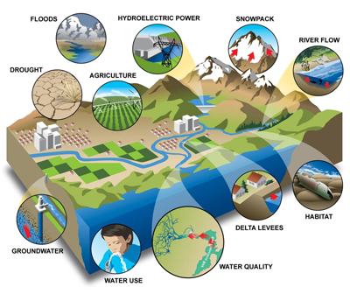
RELATE:
• What are the relationships between Santa Fe’s climate and our water supplies?
• What changes could we make to reduce heat and capture more water in our urban areas?
Notes:
What are the relationships between Tucson’s climate and our water supplies?
Tucson’s average precipitation has been decreasing, but Tucson still has extreme rain events that can lead to flooding. Rain basins can decrease that flooding.
What changes could we make to reduce heat in our urban areas?
Plant trees – they cool an area by producing shade! Adding plants of any kind will help reduce heat.

Slide 16
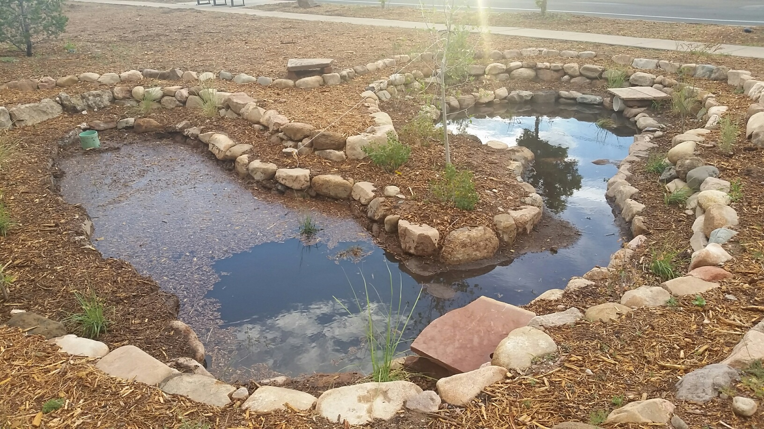
Perspective:
From the perspective of a community leader, design a strategy to encourage residents to build raingardens with native plants and trees at their homes.
Notes:
PERSPECTIVE:
From the perspective of a community leader, design a strategy to encourage residents to plant trees at their homes.
Ask students, “What simple actions could we take at a local level to help reduce heat in our neighborhoods?” Planting trees will produce shade that reduces heat. Planting native or desert-adapted shade trees require less water than nonnative trees. Tell the students, they’ll be learning about rainwater harvesting over the next several lessons.

Slide 17
What did you learn?
DISTINGUISH:
What is weather?
What is weather not?
BUILD THE SYSTEM:
What are the parts of our weather system?
What is our weather system part of?
DISTINGUISH:
What is climate?
What is climate not?
Notes:
What did you learn?
Discuss with students or have them write in their science notebooks the answers to these questions:
DISTINGUISH:
What is weather? What is weather not?
BUILD THE SYSTEM:
What are the parts of our weather system?
What is our weather system part of?
DISTINGUISH:
What is climate? What is climate not?

Slide 18
What did you learn?
RELATE:
• What are some relationships between weather and climate?
• What are the relationships between Santa Fe’s climate and our water supplies?
• What changes could we make to reduce heat and capture more water in our urban areas?
Notes:
RELATE:
What are some relationships between weather and climate?
• What are the relationships between Tucson’s climate and our water supplies?
• What changes could we make to reduce heat in our urban areas?

Slide 19
What did you learn?
PERSPECTIVE: From the perspective of a community leader, how might we encourage residents to build raingardens with native plants and trees at their homes?
Notes:
PERSPECTIVE:
From the perspective of a community leader, how might we encourage residents to reduce heat by planting trees at their homes?

