Slide 1
Lesson Two What is rainwater harvesting?
How can rainwater harvesting impact the system of water resources and supply?
Notes:
Connect to the Unit
In this Rainwater Harvesting unit, students will:
Apply the Engineering Design Process (EDP) to construct ideas and design a solution for using rainwater in place of potable water.
Ask questions and discover new technology and methods for saving drinking water and mitigating urban heat.
Develop and demonstrate a mathematical and/or physical model to manage runoff in the schoolyard watershed.
Analyze and interpret mathematical data to support decision-making and planning of a passive rainwater harvesting system.
Understand the cause and effect relationships of the heat island effect and learn how passive rainwater can be used to help cool our communities and supplement potable water supplies.

Slide 2
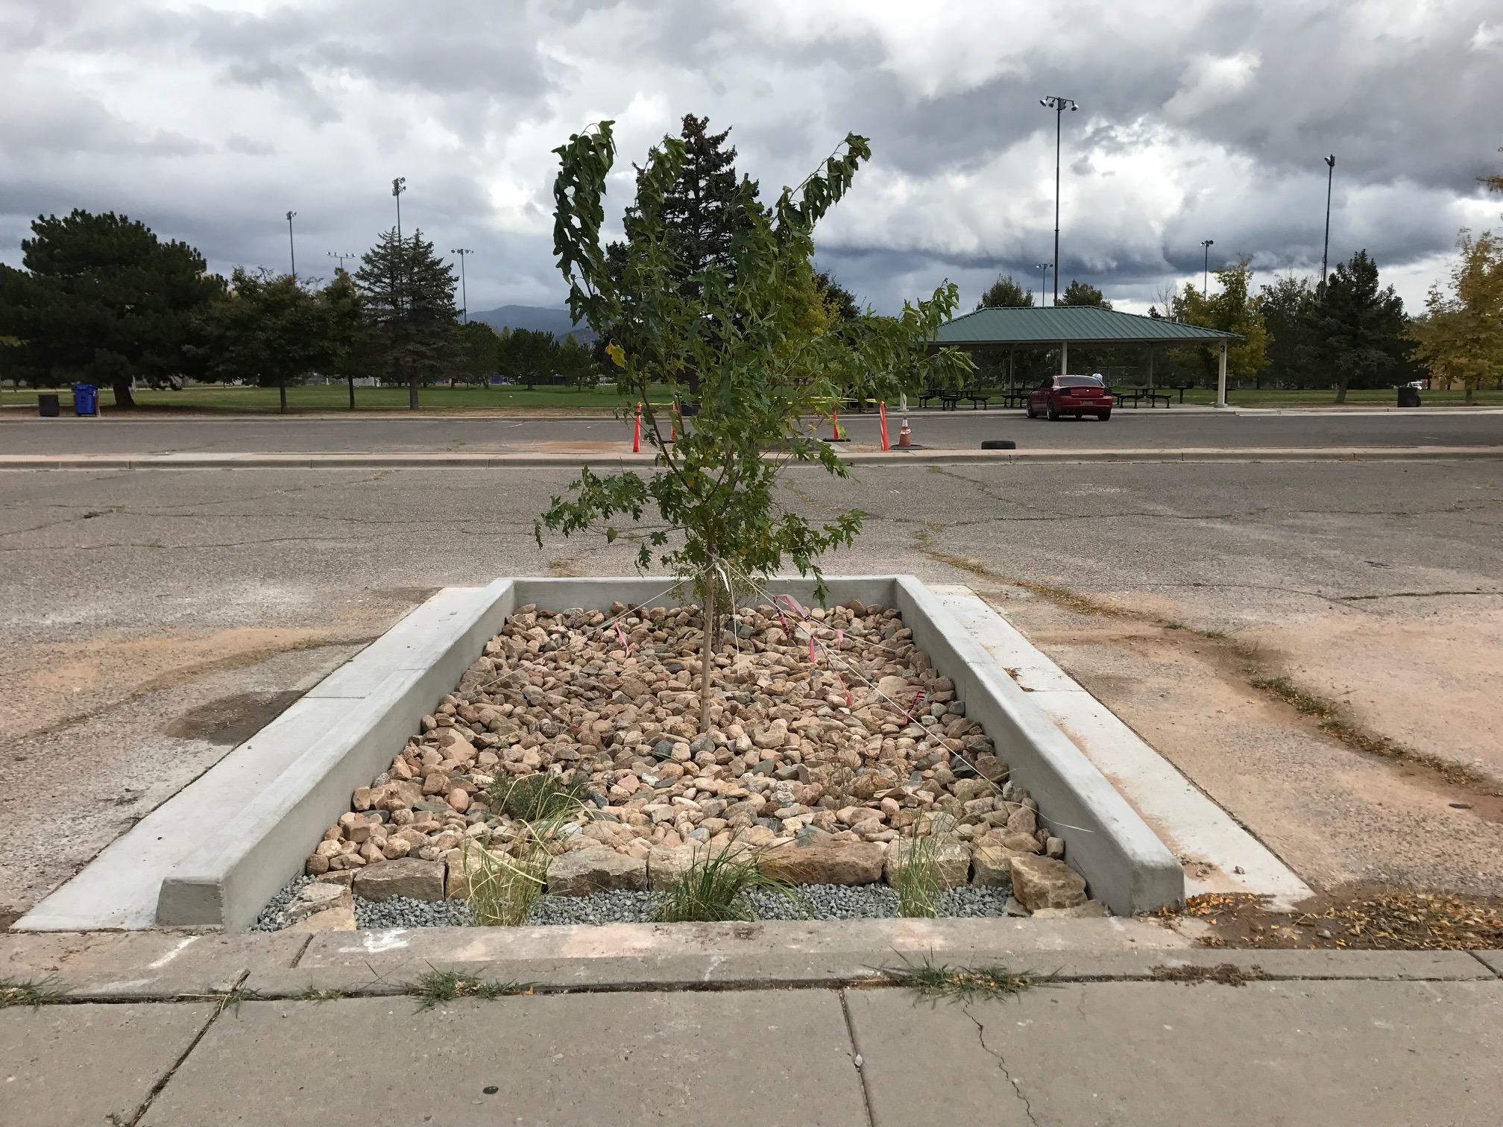
DISTINGUISH: What is rainwater harvesting? What is rainwater harvesting not? Why would we want to harvest rain?
Notes:
Launch this lesson
This lesson introduces students to the idea of rainwater harvesting by using basic DSRP questions used to deepen thinking on any topic. Begin a “Rainwater Harvesting” mental map.
DISTINGUISH
What is rainwater harvesting?
Write student ideas under the question. These may or may not come up: Collecting water. Storing water. Infiltrating water for plants. Moving water to where it is needed. If necessary, distinguish the two words one by one, e.g. What does it mean to harvest something?
What is rainwater harvesting not?
Again, record student ideas. They may or may not include thoughts like: just collecting water alone; collecting water from any other source except for the rain; difficult.
Why would we want to harvest rain?
Discuss why it might be beneficial to harvest rain in our area. How can we grow shade in a sustainable manner?

Slide 3
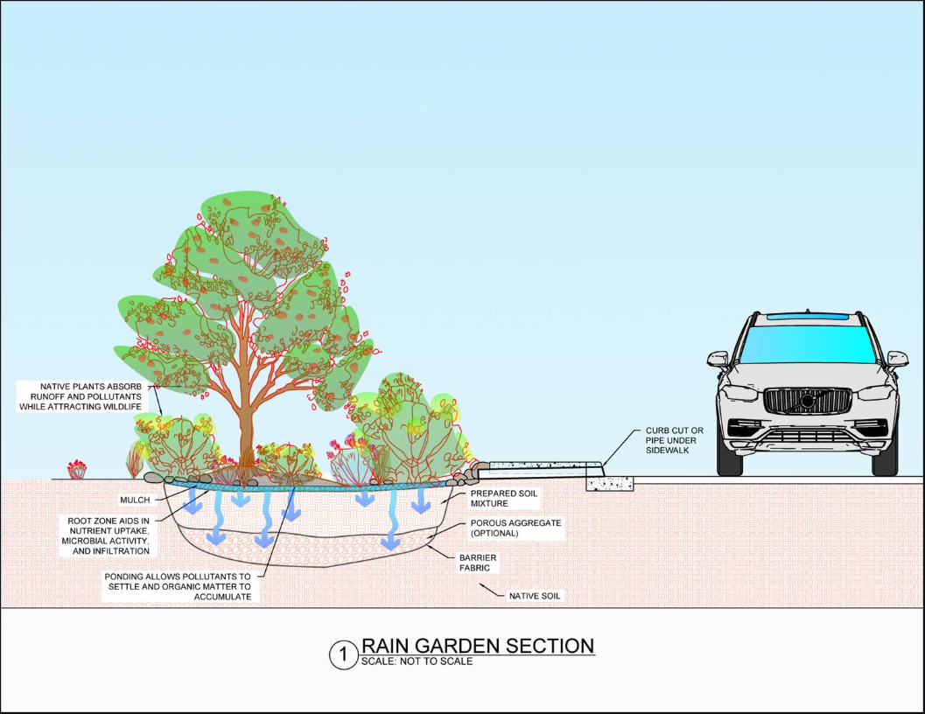
BUILD THE SYSTEM:
•What are the parts of a passive rainwater harvesting system?
Notes:
Ask students if they can define what a system is. A system is a set of connected parts that work together to make a complex whole. Lead students through a “roof to soil” or “top to bottom” discussion of where water might flow during a rainstorm. Where might they be able to capture flowing water?
BUILD THE SYSTEM
What are the parts of a passive rainwater harvesting system?
Write student ideas under the question. At this point they will be listing words like the ones in parentheses below. We will revisit these later in the unit to group them in these 4 categories:
Collection areas (roof, street, parking lot, patio, etc.),
Conveyance equipment (gutters, downspout, piping, curb cuts, swales),
Infiltration areas (basin, berms, overflow),
Storage (plants: grasses, shrubs, trees, cactus or tanks).

Slide 4
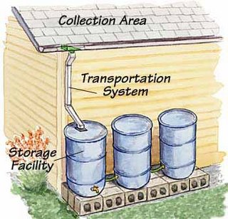
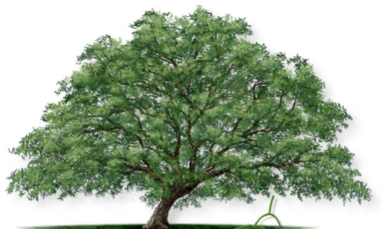
Active or Passive System?
Notes:
There are two main types of rainwater harvesting systems. One is called an “Active” system and one is called a “Passive” system.
Ask students what type of system they think is depicted in the slide and why they think so. Ask them, “What structures do you see and what are the structures’ functions?” Go through all components depicted on the slide.
An active rainwater harvesting system requires a person, switch, or valve to actively turn it on or off. It requires energy to operate it. For example, getting the water from the storage containers to the tree may require a pump to move the water to the tree or manually turning a valve or spigot if the system is set up to run by gravity. Thus, it’s called an active system.

Slide 5
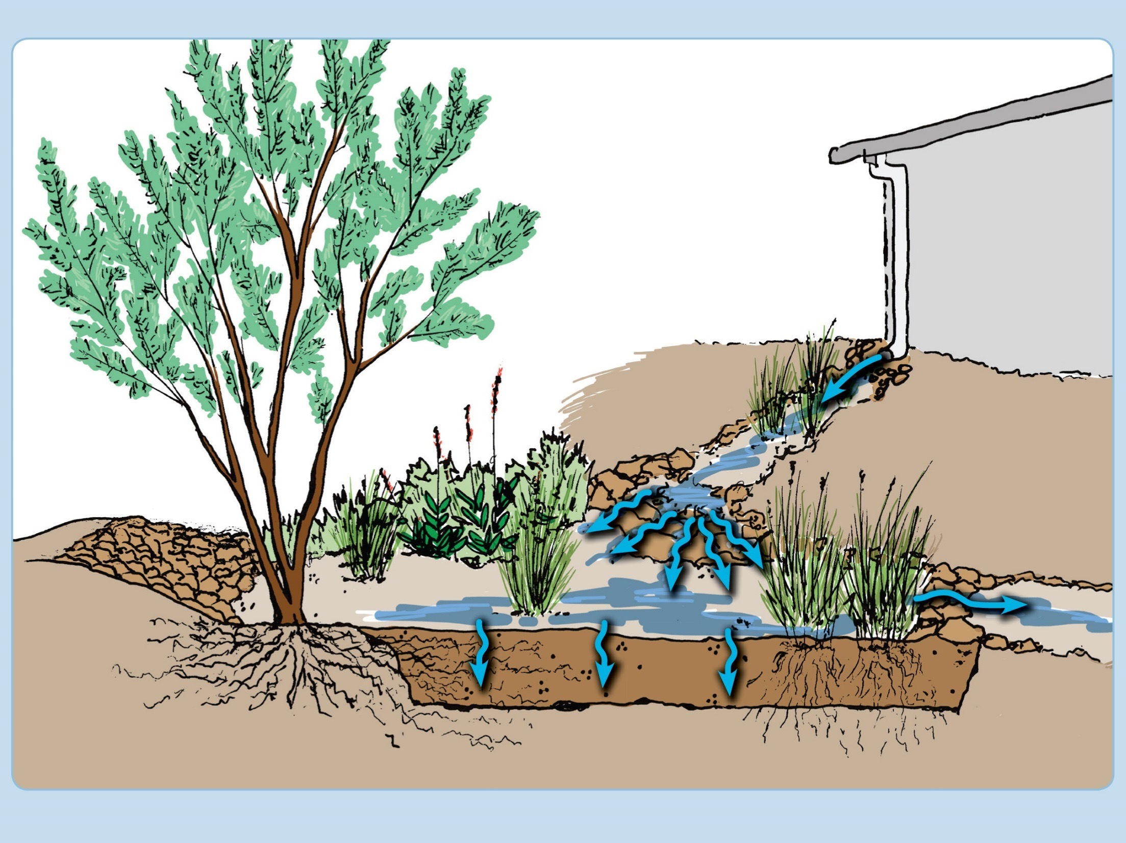
Passive Rainwater Harvesting System
Notes:
A passive rainwater harvesting system is a system that freely works without the need of any person, switch, or valve. The more passive a system is, the less energy it requires.
In this image, the landscape has been contoured to create a basin or depression for water to soak into the ground as a form of infiltration for plants to store water. Such applications are called “earthworks” which function to help speed up infiltration and augment soil moisture.
Native plants are especially well adapted to finding water in the ground and can benefit greatly from this simple technique.
Tell students that in this unit, we are going to focus on passive rainwater harvesting systems.

Slide 6
1. Collection
2. Conveyance
3. Infiltration
4. Storage
Notes:
BUILD THE SYSTEM:
What are the four main processes involved in rainwater harvesting?
Have students group the parts of rainwater harvesting that they identified earlier into categories. They should begin to identify these four main categories.
Impermeable or less permeable collection surfaces (roof, street, parking lot, patio, etc.),
Conveyance equipment (gutters, downspout, piping, curb cuts, swales),
Infiltration areas (basin, berms, overflow),
Storage (plants: grasses, shrubs, trees, cactus or tanks).
They many not yet think of the storage in the ground as part of the system yet, but we’ll come back to it.

Slide 7
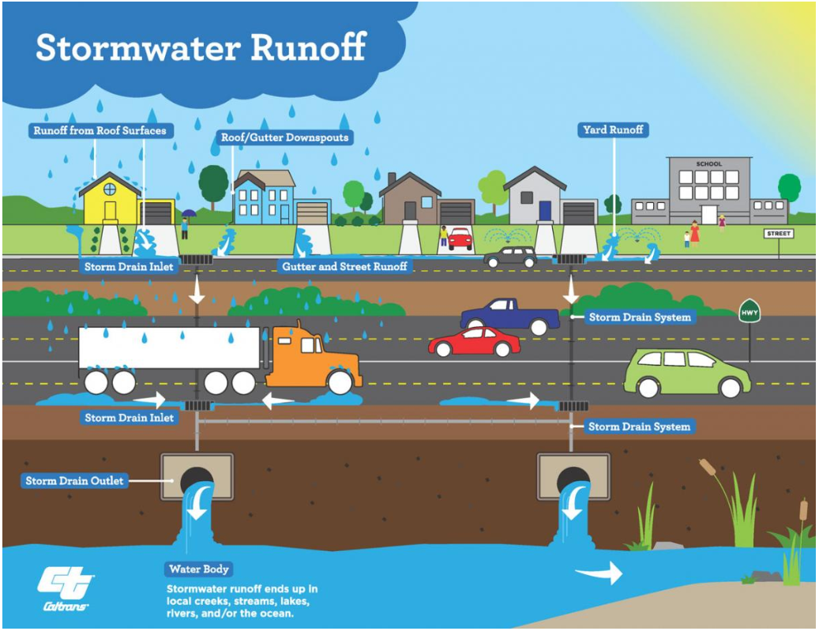
DISTINGUISH: What is stormwater runoff?
In Santa Fe, stormwater will end up in our arroyo system.
Notes:
DISTINGUISH:
What is stormwater runoff?
Students are likely to be familiar with stormwater but may not know that water managers consider it a valuable source of water for reuse. In the next exercise, they will learn about Best Management Practices or BMPs to keep stormwater from flowing down our streets and into storm drains but rather to put it to use.

Slide 8
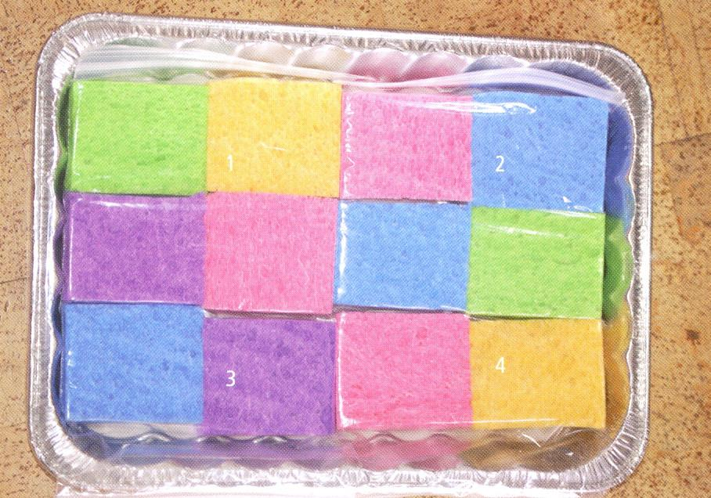
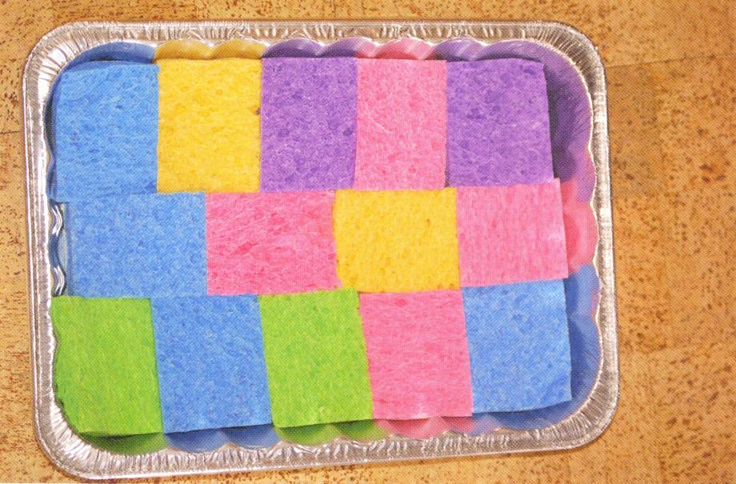
Storm Water (Project WET Guide, page 395)
Before drawing cards
After drawing cards
Notes:
The Storm Water lesson in the Project WET Curriculum Guide 2.0 will demonstrate and quantify the effect different surfaces have on the flow of water. Distribute the materials and demonstrate how to set it up.
Have the students look at their model. If the sponges represent the natural land, ask them what they think the plastic bags represent? Be sure they notice where the storm drain is located in the pan that is propped at a slope on another pan. The storm drain should be on the lowest side.
Ask the students, “Do the sponges in the bag represent an impermeable surface or permeable surface?” Let them figure it out in the investigation.
The goal of this experiment is to discover and explore ways to manage rainwater by experimenting with runoff.

Slide 9
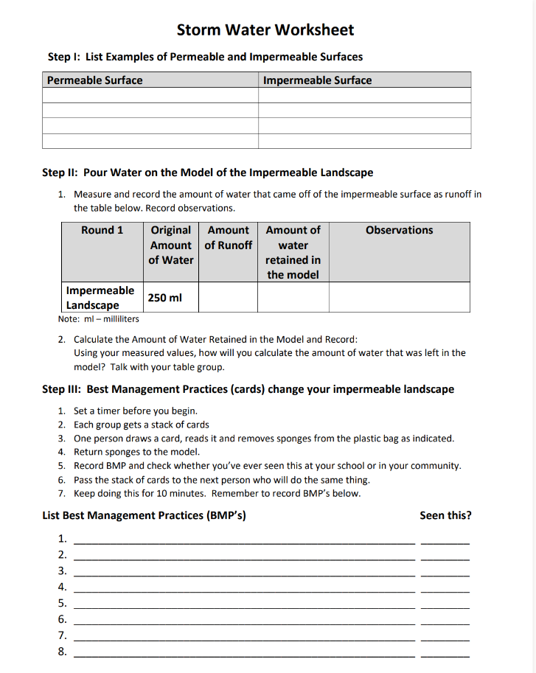
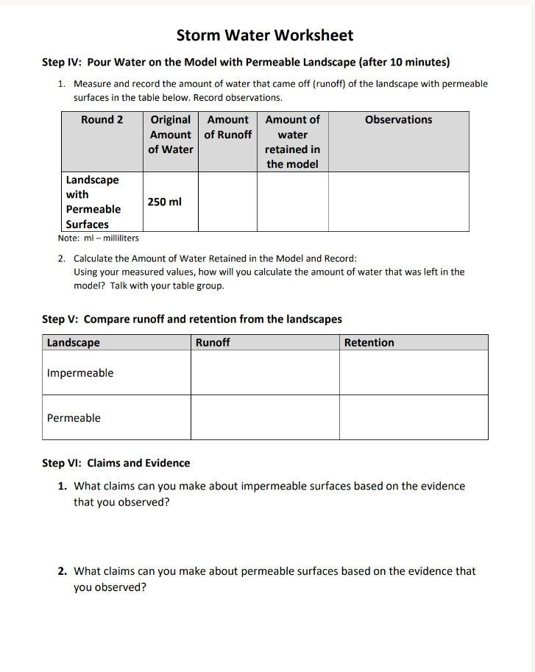
Storm Water (WET Guide, p. 395)
Notes:
Have the students work through the worksheet. First, they pour 250 mL of water on the top portion of the tray. Let the pan drain and collect into the second tray for one minute and then measure and record amount. This is runoff.
Some ways of managing stormwater are better than others. During the next part of this activity they’re going to learn about Best Management Practices (BMPs) for managing stormwater. Each student group gets a stack of cards which describe different Best Management Practices (BMP). Each card will describe the practice and then tell them to remove a certain number of sponges from the bag and place it back in the tray. Once a plastic bag is empty, they can take it out of the tray.
Start all the student groups at the same time. Students take turns drawing a card randomly from the stack and read the card. Have them discuss the card and record the BMP type in the appropriate section of their worksheet (Step III). Then, have them follow the directions for removing sponges. Do NOT let them move on to Step IV until the timer goes off after 10 minutes.
Then they move on to Step IV: Pour 250 mL of water on the top portion of the tray. Let the pan drain and collect into the second tray for one minute and then measure and record amount. They subtract that amount from the amount that they poured on the model (250 mL ) to calculate the amount of water retained in the model.
In Step V, students compare the runoff and retention for the permeable and impermeable surfaces. Discuss their data.

Slide 10
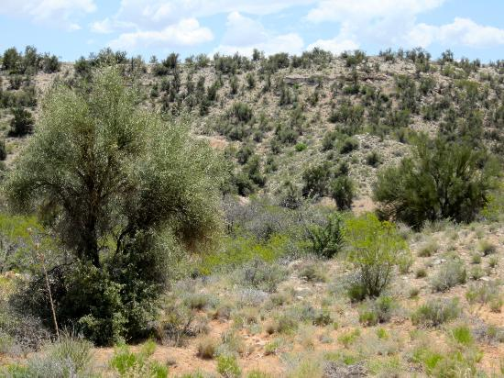
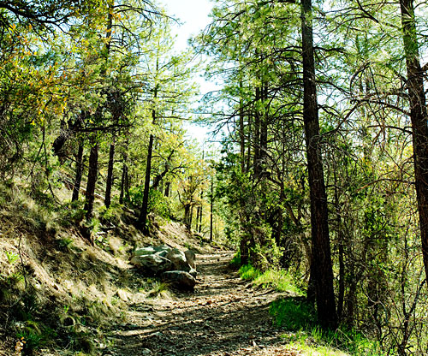
MAKE A DISTINCTION: What is a permeable surface?
Notes:
DISTINGUISH
What is a permeable surface?
Have students go back to their list of permeable surfaces on the data collection sheet. Ask them if there are other permeable landscapes they can add to their list. Were any mentioned in the BMP exercise?

Slide 11
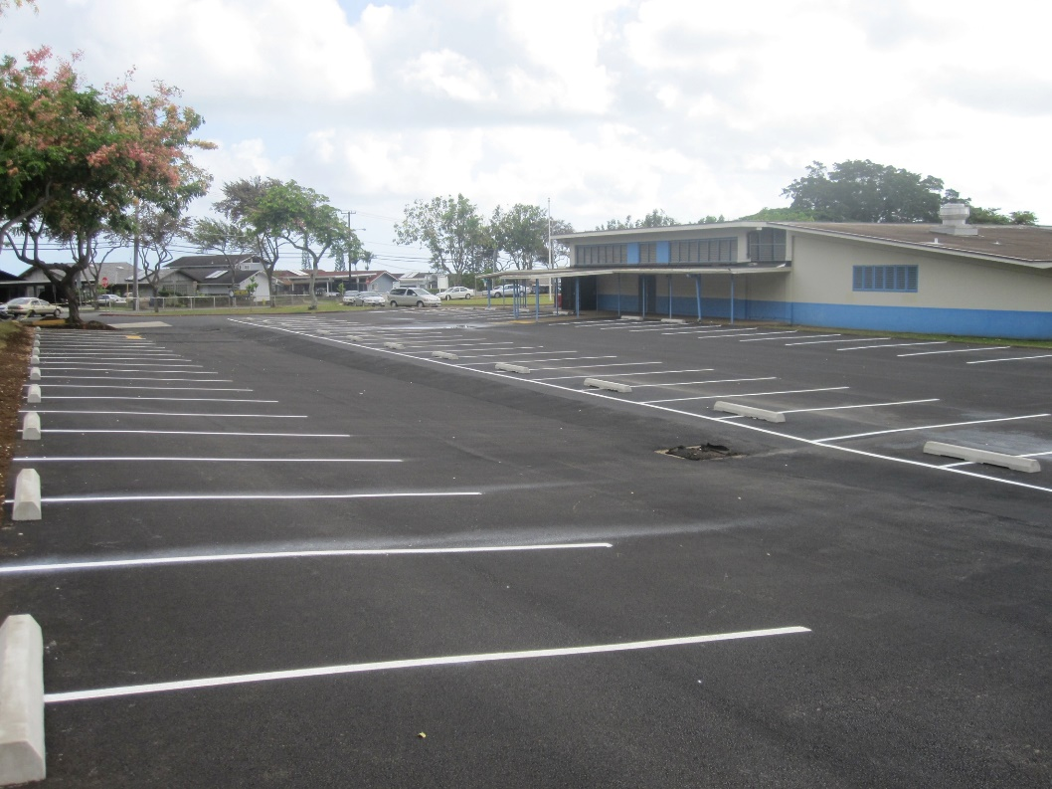
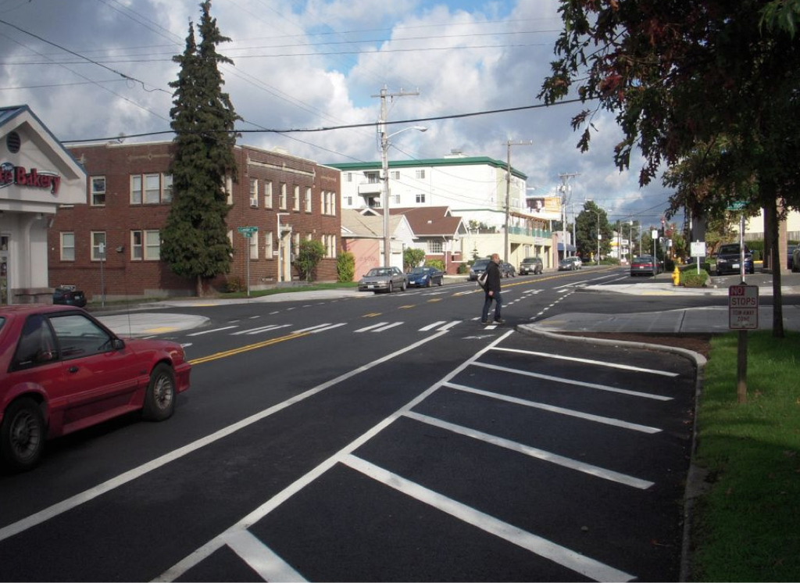
MAKE A DISTINCTION: What is an impermeable surface?
Notes:
DISTINGUISH
What is an impermeable surface?
Have students also add to their lists of impermeable surfaces on the data collection sheet. Ask them if there are other impermeable landscapes they can add to their list. For example, what impermeable surface might be a good one to harvest rain from? (roof) Why the roof?

Slide 12
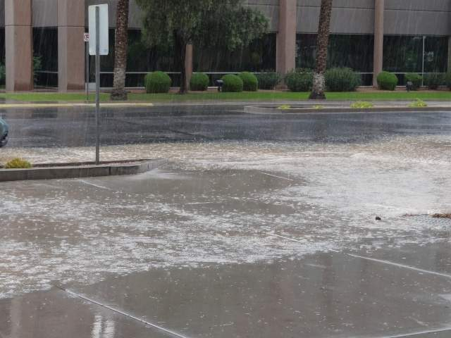
RELATE:
How are permeable and impermeable surfaces related to one another?
Notes:
RELATE:
How are permeable and impermeable surfaces related to one another?
Connect their observations back to the Storm Water experiment and the BMPs. What did they learn from the experiment? What might be some better ways to handle this excess of water?
Engage the students in a discussion of how water moves through our cities. Why does water pool in some areas? Where does it end up? (low lying areas, water flows to it by gravity) Ask them if this is a good thing or a bad thing? (it could be both) Have they seen this happen in their neighborhood or at the school? Are there places in your school/community where it floods?
Discuss where this water goes after it “disappears.” What do they think happens to it? (depends – it could evaporate, go into a storm drain, infiltrate through cracks in pavement)

Slide 13
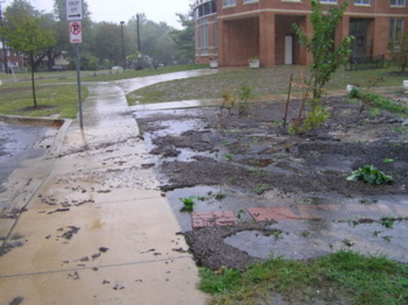
Where does water flow during a storm on your school grounds?
Notes:
Ask students to construct an explanation of where water flows during a storm on their school grounds. Get them to think about: Where does water collect? Where is water conveyed? Where can water infiltrate? Where is water stored? What does their schoolyard watershed look like?

Slide 14
What did you learn?
DISTINGUISH:
What is a passive rainwater harvesting system?
BUILD THE SYSTEM:
What are the parts of a passive rainwater harvesting system?
Notes:
Conclusion
Discuss with students or have them write in their science notebooks the answers to these questions:
DISTINGUISH:
What is an “passive” rainwater harvesting system?
BUILD THE SYSTEM:
What are the parts of a passive rainwater harvesting system?

Slide 15
What did you learn?
BUILD THE SYSTEM:
What are the four main processes involved in rainwater harvesting?
RELATE:
How are permeable and impermeable surfaces related to one another?
TAKE A PERSPECTIVE:
From a cause-and-effect perspective, how are the parts of rainwater harvesting related to one another?
Notes:
What did you learn?
BUILD THE SYSTEM:
What are the four main processes involved in rainwater harvesting?
RELATE:
How are permeable and impermeable surfaces related to one another?
TAKE A PERSPECTIVE:
From a cause and effect perspective, how are the parts of rainwater harvesting related to one another?

