Slide 1
Lesson Three Rainwater Harvesting and the EDP
How can engineering support rainwater harvesting and our water resource systems and supplies?
Notes:
Launch the Lesson
Students will:
Apply the engineering design process to help construct and explanation for the best rainwater harvesting design.
Ask questions to help define problems that new technology may provide for saving drinking water.
Develop a model to manage runoff in the schoolyard watershed.
Analyze and interpret data to support decision-making and planning.

Slide 2
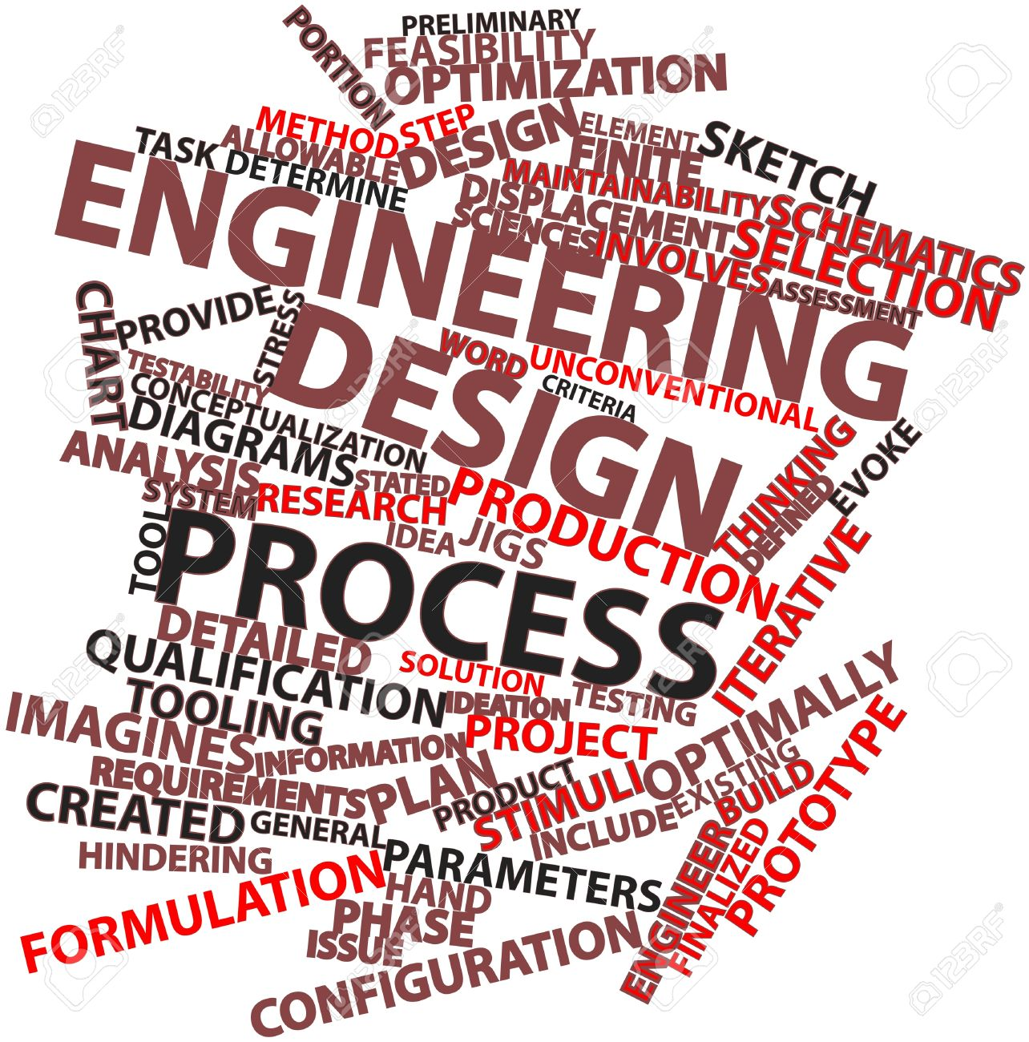
DISTINGUISH: What is the engineering design process?
What is the engineering design process not?
Notes:
In this lesson, we will start to apply the engineering design process (EDP) to design our rainwater harvesting system.
DISTINGUISH:
What is the engineering design process?
Students might say building something, making something .. to which you might ask, “How do they build something or make something?” Get only students’ ideas down at this point.
We will work towards this definition: The engineering design process is a way to think through a problem to find the best solution given measurable criteria and constraints.
What is the engineering design process not?
The scientific process, theory, boring, hard to use. Only produces one solution.

Slide 3
Engineering Design Process
IMAGINE
Brainstorm ideas
Pros ? Cons?
Choose a starting point
EXPLORE
What have others done?
Explore options
Explore materials
ASK
What is the problem?
What are the constraints?
What are the criteria?
Keep in Mind:
Address the problem
Satisfy constraints
Meet the criteria
Think Trade-offs
Be creative
Consider everyone’s ideas
Failure is an important part of the process
Engineering Design is an adaptable and open process.
PLAN
Refine best idea
List materials & tools
Make a plan for building
& testing
IMPROVE
Analyze your data
Can you make it better?
Redesign?
CREATE
TEST
PRODUCTION
Follow plan & build
Document changes
Does design meet criteria & constraints?
Present your design
Get feedback
Reflect
Try it out!
Collect data
Record observations
Adapted from University of Arizona College of Engineering
Notes:
This is a diagram of the Engineering Design Process (EDP).
BUILD THE SYSTEM
What are the parts of the engineering design process?
Ask students to add to the distinctions they made on what EDP is and isn’t. Ask them, “What do you think the EDP is used for?” They may say things like; to figure something out, to make something well, or to solve a problem.
The EDP is an effective way to ask questions to help define a problem to be solved. EDP has many steps and can take several weeks to complete the entire process leading to the development of a successful design or model.
By using the EDP effective designs that meet the criteria and constraints are developed and produced. Design solutions created on the fly can be costly and ineffective. The EDP provides a mechanism to continually improve a design or model.

Slide 4
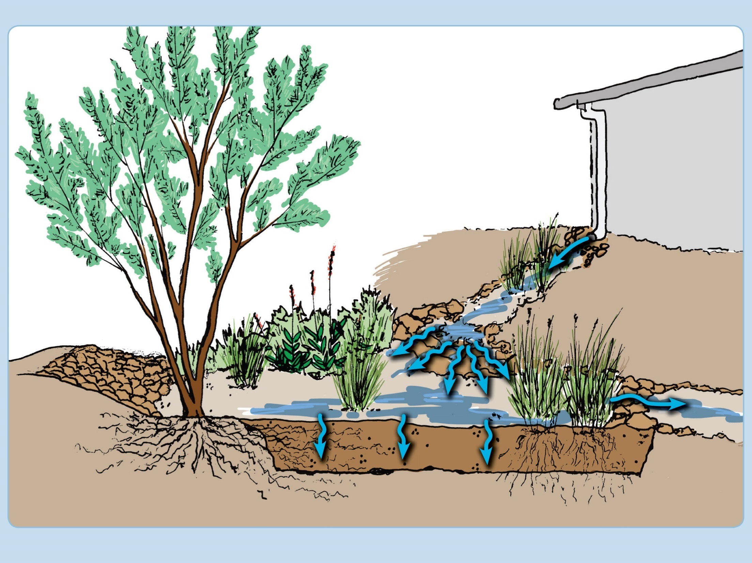
RELATE:
How are the engineering design process and the rainwater harvesting systems related?
Notes:
RELATE:
How are the engineering design process and the rainwater harvesting systems related?
Students may already see that they could use the EDP to design and effective rainwater system.
Rainwater harvesting is a simple system with interacting parts. The engineering design process is also a system. They will use the parts of the EDP system as steps or actions to take to build a rainwater harvesting system that fits their landscape area appropriately.
In order to design a rainwater harvesting system for an area at school, students will ask a question, explore, imagine, plan, create a model, test it, and improve their system based on feedback. Today they will start the project by asking a question.

Slide 5
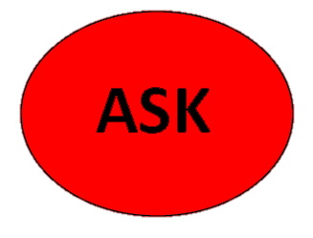
Step 1: Define the Problem you are trying to solve ….
How will you design a passive rainwater harvesting system that will help manage stormwater runoff while providing shade and sustaining plants through the most efficient use of available water?
Unpack the question!
Notes:
When we’re solving problems using engineering, we need to have a clear idea of WHAT the problem is. We do this by asking questions. The solution to the problem not only includes the question itself but considers all the parts of a system. This can include physical structures and surroundings, the people affected by the system, and those involved in designing the solution. Defining the problem includes recognizing anything that limits the kind of solution that you can develop.
Explore with the students what this question is really asking them to do: Design a passive rainwater harvesting system that will provide shade and sustain your plants year-round through the most efficient use of available water? Unpack the driving question. What does sustain mean? What does efficient use mean? Etc..

Slide 6
Principles of Rainwater Harvesting
For a successful Rainwater Harvesting System design:
Begin with thoughtful observation.
Start at the top; the high points.
Start small and simple.
Spread and infiltrate the flow of water.
Always plan for overflow; what will happen in big storms?
Maximize living and organic matter (e.g. mulch).
Maximize beneficial relationships.
Continually reassess and improve your system.
From: Rainwater Harvesting for Drylands by Brad Lancaster
Notes:
Your students will be creating an integrated design using the Principles of Rainwater Harvesting to devise a rainwater harvesting system that will meet the water demands of the plants and provide shade at your school.
Distinction
What is meant by integrated design?
How does it affect plants that are chosen?
What functions do the parts of my design serve?
These will become quantifiable criteria as the students work through the engineering design process.

Slide 7
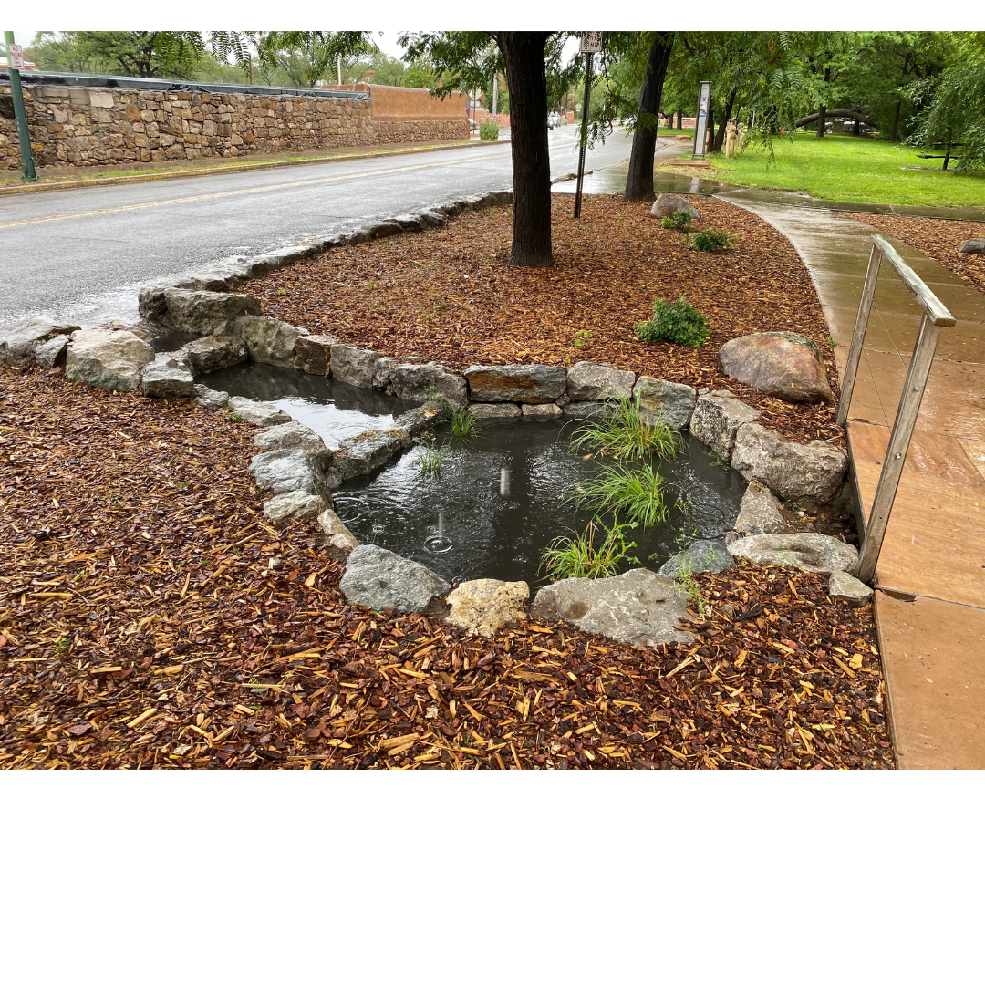
Problem: How will you design a passive rainwater harvesting system that will help manage stormwater runoff while providing shade and sustaining plants through the most efficient use of available water?
Step 2: Criteria
Criteria are requirements or conditions that must be met to solve the problem.
What design criteria should we consider for our systems?
Notes:
Post a list for brainstorming criteria somewhere in the room where you can refer to it throughout the next several lessons. Have students work in small groups to ask questions and develop criteria for this problem. Criteria are requirements that your design must meet. What do you know about the things mentioned in the problem statement? Write questions where there are criteria that need to be clarified. There will be opportunities throughout exploration to refine these.
Criteria might include:
Plants must have enough water to survive. How much?
If it doesn’t rain often, how does that affect plant choice?
What plants provide shade? Are other plants included in the design? What function do they serve?
Location? Where is shade needed? What is proximity to water source?
How much water do we need? How much water is available?
Note that that all of these criteria become questions that must be answered. Many will be answered during the exploration phase of the design process. All must be answered for the design to be successful.

Slide 8
Problem: How will you design a passive rainwater harvesting system that will help manage stormwater runoff while providing shade and sustaining plants through the most efficient use of available water?
Step 2: Criteria
Criteria are requirements or conditions that must be met to solve the problem.
They may come from the customer: the plants must be able to survive the winter.
They may come from what you know: plants need more water when it’s hot, less when it’s cool.
They may need to be clarified by research: different plants need different amounts of water; how much do the plants in this design need?
What design criteria should we consider for our systems?
Notes:
Post a list for brainstorming criteria somewhere in the room where you can refer to it throughout the next several lessons. Have students work in small groups to ask questions and develop criteria for this problem. Criteria are requirements that your design must meet. What do you know about the things mentioned in the problem statement? Write questions where there are criteria that need to be clarified. There will be opportunities throughout exploration to refine these.
Criteria might include:
Plants must have enough water to survive. How much?
If it doesn’t rain often, how does that affect plant choice?
What plants provide shade? Are other plants included in the design? What function do they serve?
Location? Where is shade needed? What is proximity to water source?
How much water do we need? How much water is available?
Note that that all of these criteria become questions that must be answered. Many will be answered during the exploration phase of the design process. All must be answered for the design to be successful.

Slide 9
Problem: How will you design a passive rainwater harvesting system that will help manage stormwater runoff while providing shade and sustaining plants through the most efficient use of available water?
Step 3: Identify Constraints
Constraints are limitations or restrictions.
They may also come from the customer: the project may not cost more than $1000.00.
They may come from what you know: we cannot run a hose across the sidewalk because it would be a trip hazard.
They may have to be clarified through research: we live in an arid place, we get more rain during some months than other months, how much rainfall should we design our system for?
What kinds of constraints will limit our design?
Notes:
Also post a list of constraints in the room. Have students work in small groups again. Constraints must be satisfied. In the real world, we can’t design just anything; there are limitations to what we can and cannot do. These limitations might be natural, i.e. we have no choice but to work with the soil type that our school has. Other limitations are imposed by the customer, i.e. the project cost cannot exceed a given dollar amount. What constraints come to mind when you think about this project? Write questions for constraints that you will want to clarify during exploration. There will be opportunities to expand the list of constraints and to clarify them as exploration happens. Some examples of constraints might be:
Budget: we are not going to specify a specific dollar constraint, but the system should be as simple as possible.
Location of plants. Where do you want to place trees? Where do you want place grasses?
Variability in rainfall patterns– how much rain do we get? When do we get it? When do we not get it??
How much rain is in a 100-year flood event in your area?
What are regulations in your area for the amount of time that water can sit in a basin before infiltrating? (Usually 24 hours)
How do we determine infiltration or percolation rate for my soil?
What are components I can add to my system to help infiltrate the water?
Storage capacity (quantity and scale)– How big does my basin need to be? Is it more than one basin?
Space (structure as well as scale)
How much water can we store in the space we have?
What other structures or barriers do I have to work around?
Are there underground utility lines in this area?
Overflow – What shall we do about rainfall events (patterns) that are out of the ordinary?
Safety (cause and effect) –
What are the rules and regulations of the site and what kinds of limitations will they place on the project?
How deep are my basins?
As with criteria, every constraint becomes a question that will be answered through exploration and ultimately must be answered in order for the design to be successful. Which of these criteria and constraints can be quantified?
Remember to keep both the criteria and constraint list posted or available to refer to in later lessons. You will likely be adding to both lists as you work through the EDP.

Slide 10
Engineering Design Process
Notes:
This video is an overview of the Engineering Design Process. As students watch it, have them try to define the Problem, Criteria, and Constraints in this scenario.
Also on YouTube https://youtu.be/WZOAqjWzvvA

Slide 11
What did you learn?
DISTINGUISH: What is the engineering design process? What is the engineering design process not?
BUILD THE SYSTEM: What are the structures of a rainwater harvesting system that will need to designed?
Notes:
Conclusion
DISTINGUISH:
What is the engineering design process?
What is the engineering design process not?
The engineering design process is several steps that help you find the best solution to a problem. It involves thinking carefully about the problem and improving your design after testing. It is more than building, designing, or creating.
BUILD THE SYSTEM:
What are the structures of a rainwater harvesting system that will need to designed?
See if students have ideas on physical structures which can function to support any of the four processes involved in rainwater harvesting (collection, conveyance, infiltration, storage).

Slide 12
What did you learn?
RELATE: How are the structures related to their functions?
TAKE A PERSPECTIVE: From the perspective of an engineer, what are some important things to consider in designing a rainwater harvesting system?
Notes:
What Did you Learn?
RELATE:
How are the structures related to their functions?
Collection areas: Rooftops have the advantage of being higher than the landscape, but a parking lot, patio, or road could be a collection area too.
Conveyance: Gutters and downspouts are easy ways to convey water. Rock structures slow the water and decrease erosion. Berms and swales direct water.
Infiltration: Plants and mulch assist in infiltrating the water.
Storage: Plants store water.
TAKE A PERSPECTIVE:
From the perspective of an engineer, what are some important things to consider in designing a rainwater harvesting system?

Slide 13
Engineering Design Process
IMAGINE
Brainstorm ideas
Pros ? Cons?
Choose a starting point
EXPLORE
What have others done?
Explore options
Explore materials
ASK
What is the problem?
What are the constraints?
What are the criteria?
Keep in Mind:
Address the problem
Satisfy constraints
Meet the criteria
Think Trade-offs
Be creative
Consider everyone’s ideas
Failure is an important part of the process
Engineering Design is an adaptable and open process.
PLAN
Refine best idea
List materials & tools
Make a plan for building
& testing
IMPROVE
Analyze your data
Can you make it better?
Redesign?
CREATE
TEST
PRODUCTION
Follow plan & build
Document changes
Does design meet criteria & constraints?
Present your design
Get feedback
Reflect
Try it out!
Collect data
Record observations
Adapted from University of Arizona College of Engineering
Notes:
The next step in the engineering design process is EXPLORE. Now that we have asked questions and clearly defined the problem, we can explore our physical site to learn more about what we have to work with. We’ll begin our school yard explorations in the next lesson.

Slide 14
Homework
Notes:
Homework Assignment:
Have students read, review and try to remember the Principles of Rainwater Harvesting – Stacking Function document. Do these principles add anything to your lists of criteria or constraints?

