Slide 1
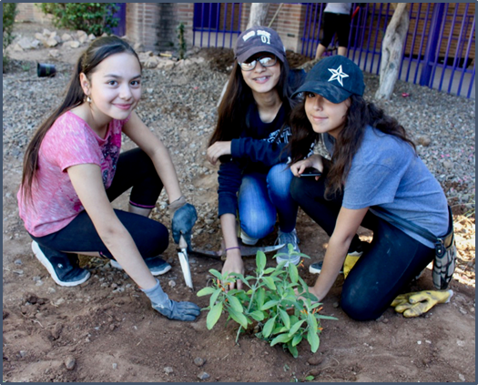

Lesson Four
Schoolyard Site Exploration
Where on our campus should we put rainwater harvesting systems?
Where on our campus should we put rainwater harvesting systems?
Notes:
Connect to the Unit
In the previous Lesson, students were introduced to the Engineering Design Process (EDP) and began to ask questions pertaining the design of a rainwater harvesting system that will provide shade at your school and meet all plants’ watering requirements. Remember that the design should be an integrated design that applies the Principles of Rainwater Harvesting – Stacking Functions.

Slide 2

Notes:
Launch this lesson
In this unit, students will continue using the engineering design process (EDP) to design their rainwater harvesting system. They are still in the “asking” phase of the EDP but will now begin the process of “exploring” by touring the campus. This is how the EDP works! It’s not a linear process. Reminder:
DISTINGUISH
What is the engineering design process? What is it not?
Specifically, remind them EDP is a way of working that has many steps. It will take several weeks to complete the process, but by using this process they will be designing effective solutions; not ones that we just made up on the fly. Using the engineering design process takes time, but it also delivers great results.

Slide 3

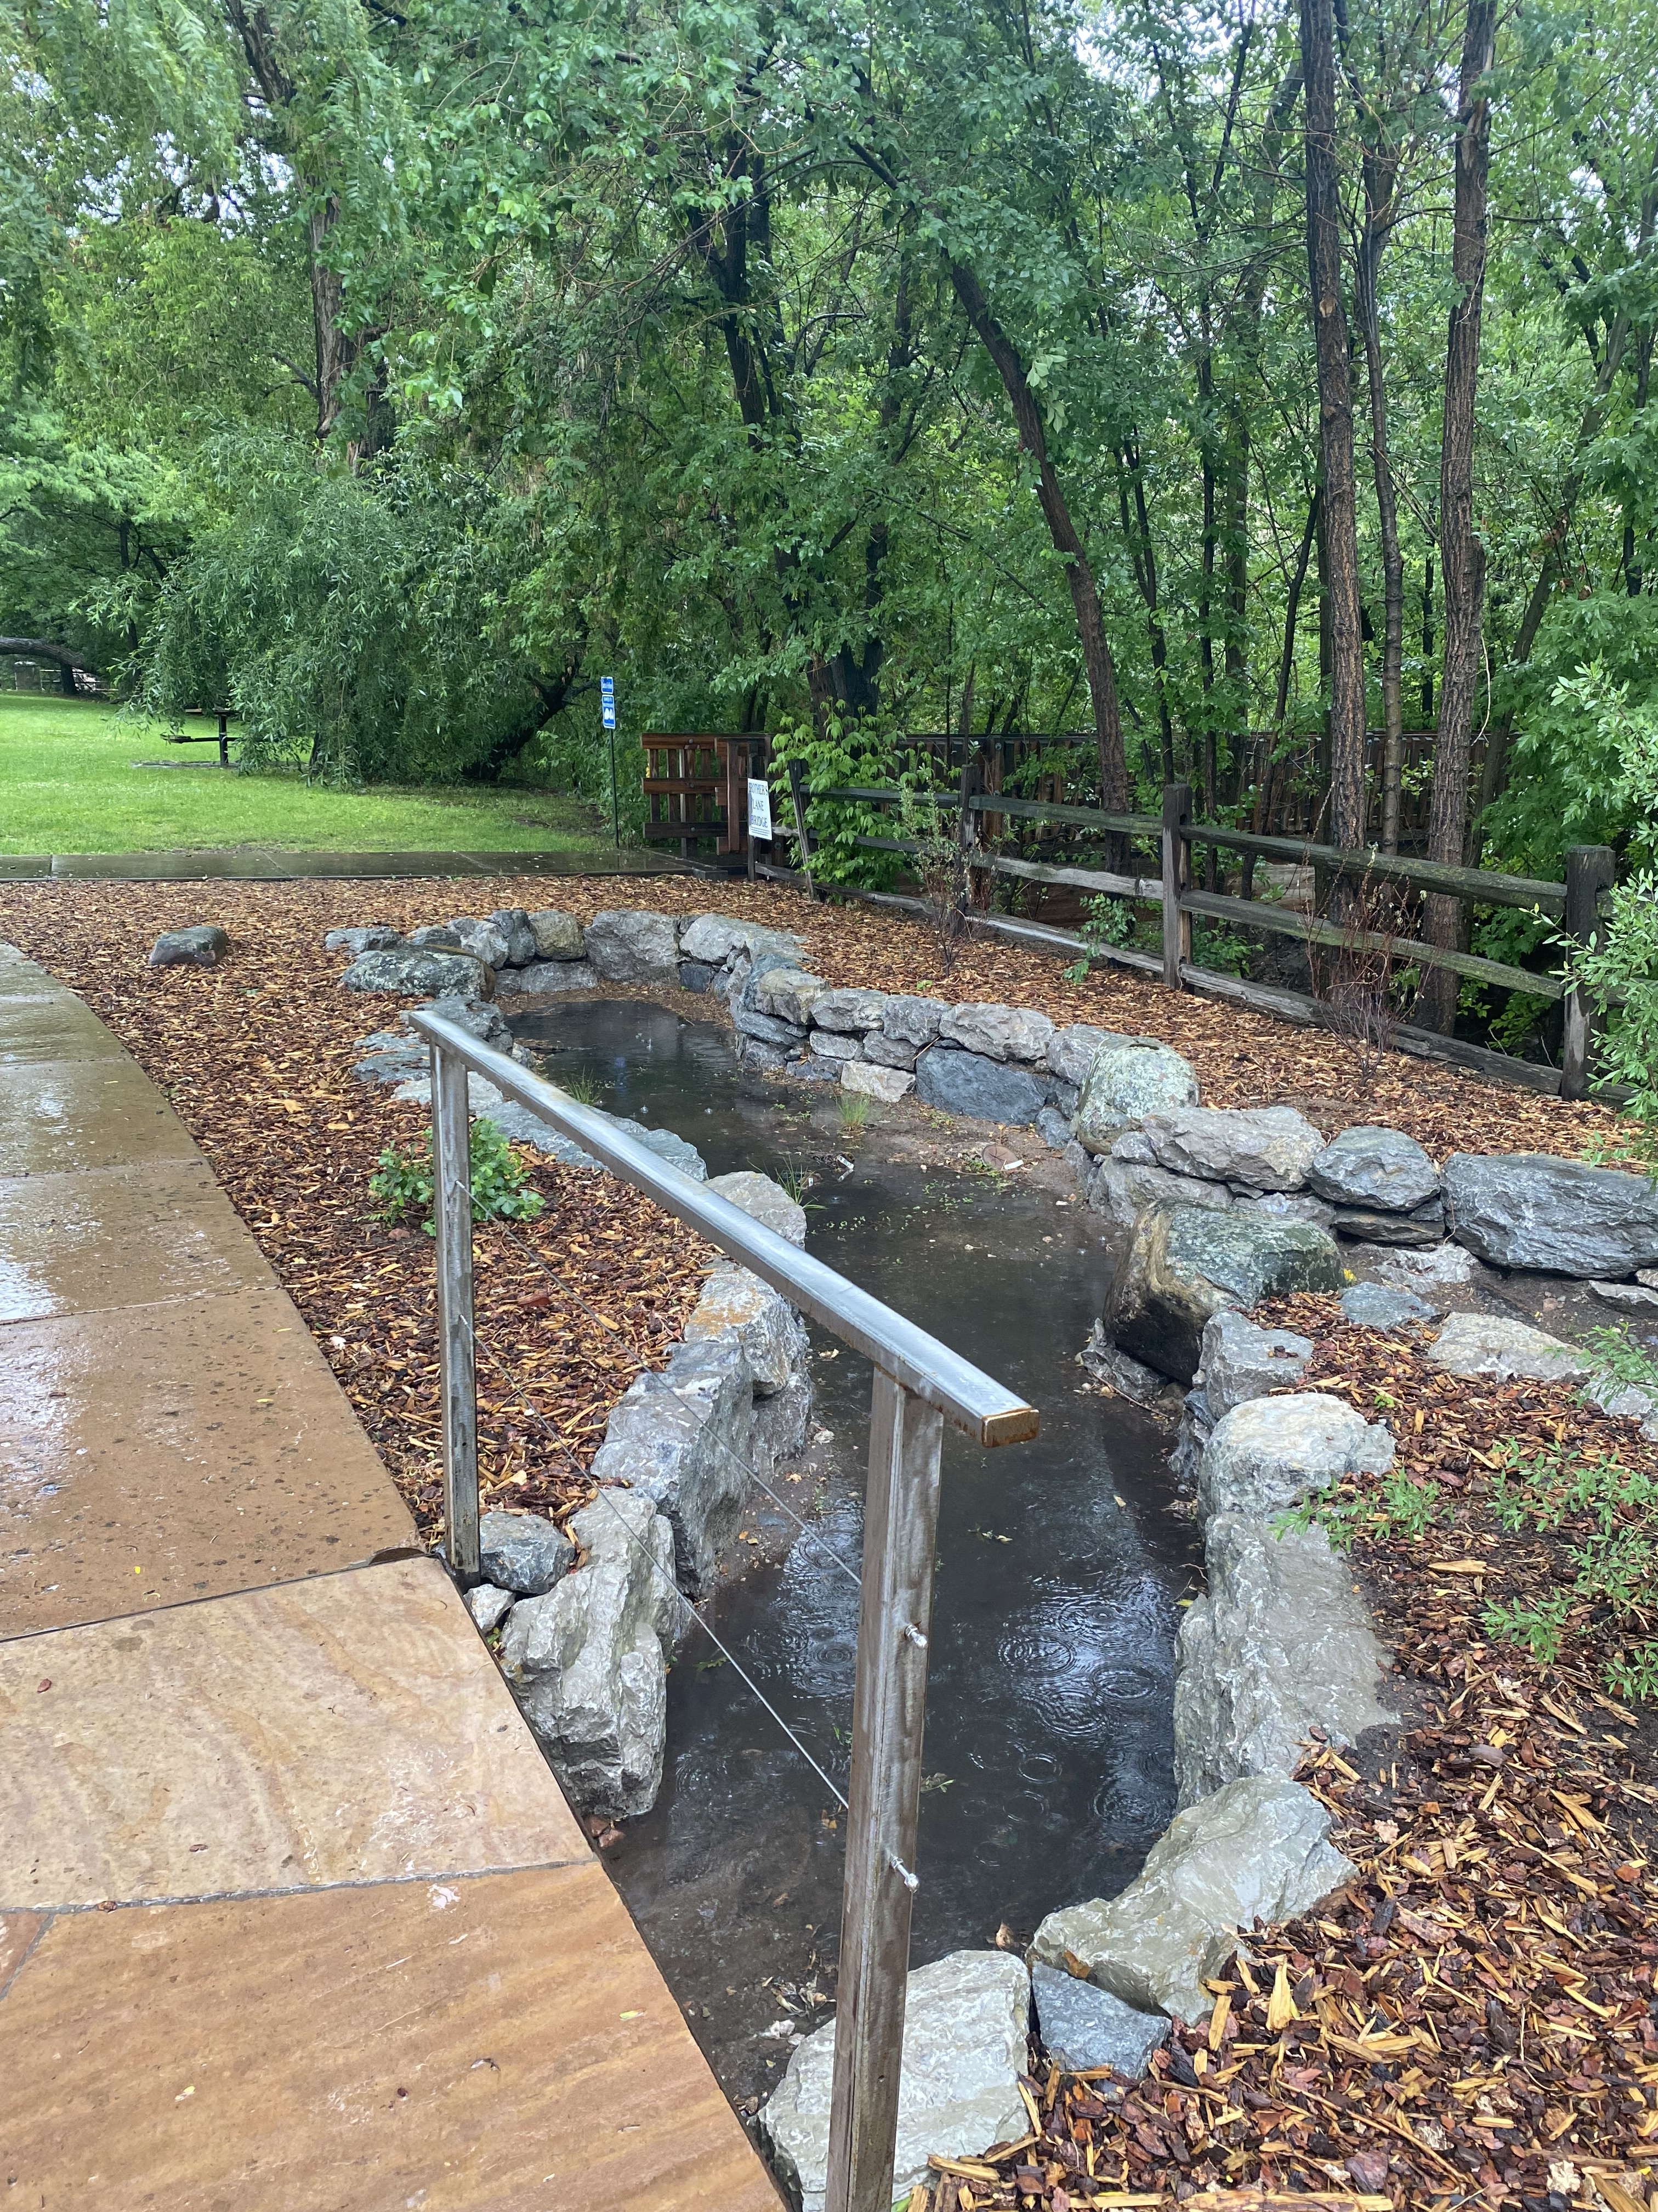
DISTINGUISH:
Define the problem
How will you design a passive rainwater harvesting system that will provide shade and sustain your plants year-round through the most efficient use of available water?
Unpack the problem:
What is sustain?
What is year-round?
What is the most efficient use of available water?
Notes:
DISTINGUISH
Define the problem?
Inform the students they will be going outside to look at the campus from the perspective of an engineer. Their goal is to design a rainwater harvesting system that meets the Criteria and Constraints discussed in Lesson 3 – Rainwater Harvesting and the Engineering Design Process. Remind them of the problem they are trying to solve.
Refer to the posted Criteria and Constraints lists in your classroom. Which Criteria & Constraints can be specified, clarified, or quantified by this exploration? Should any new Criteria & Constraints be added to the list?

Slide 4
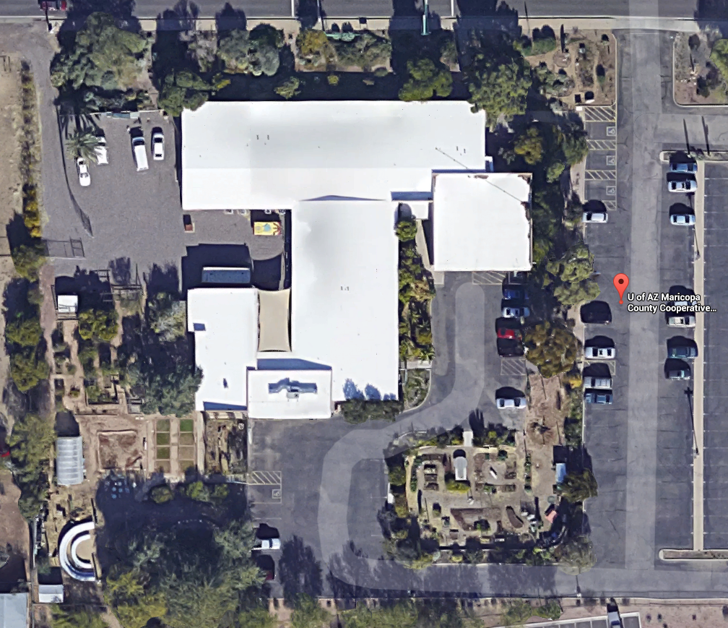

DISTINGUISH:
Identify areas on campus where water collects naturally or by design.
Notes:
DISTINGUISH
Identify areas on campus where water collects naturally or by design.
Show students an overhead or map view of your campus. Ask them to distinguish areas which have permeable and impermeable surfaces. From the aerial view, see if they can identify which areas need shade and could be watered using a rainwater harvesting system. From this quick overview, have them construct an explanation of factors that would make a good site for a rainwater system. Ask them: “What limiting factors could exist in terms of optimal project sites? (Limiting factors could include distance away from the landscape to be watered or the size of the collection area.)

Slide 5
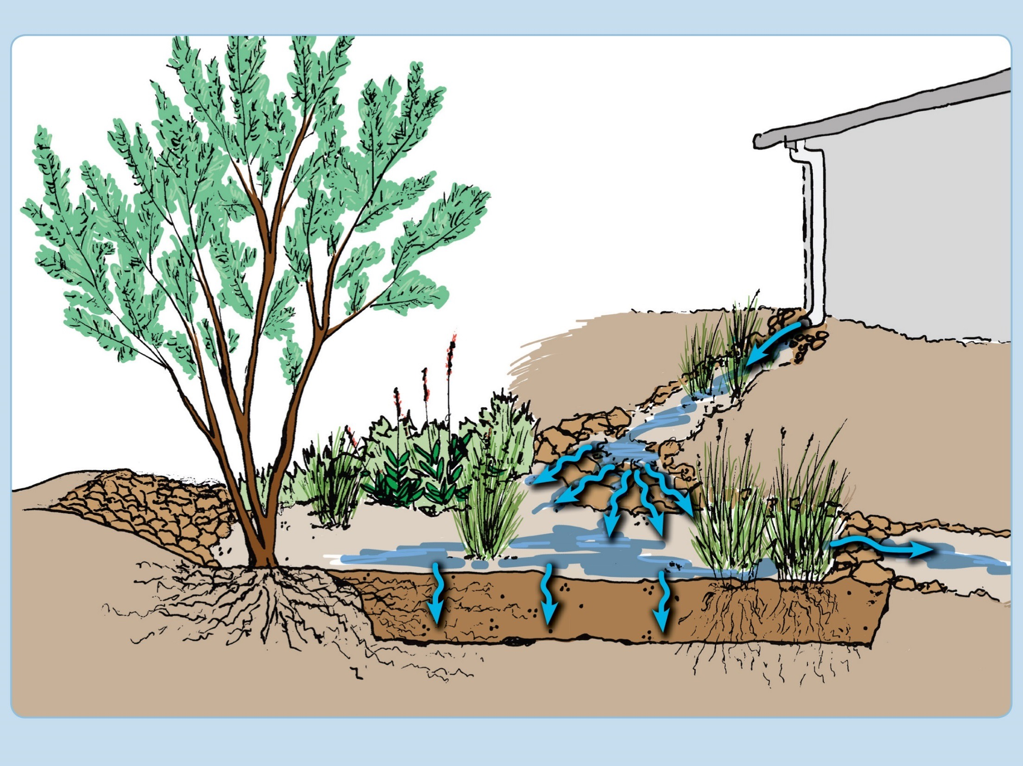
BUILD THE SYSTEM: What parts of a rainwater system are already in use at your school?
1. Collection
2. Conveyance
3. Infiltration
4. Storage
Notes:
BUILD THE SYSTEM:
What parts of a rainwater system are already in use at your school?
As a reminder, solicit input on the four processes involved in harvesting rainwater as introduced in Lesson 2 – What is Rainwater Harvesting? (collection, storage, conveyance, and infiltration). Have them keep these processes in mind during the schoolyard investigation.

Slide 6
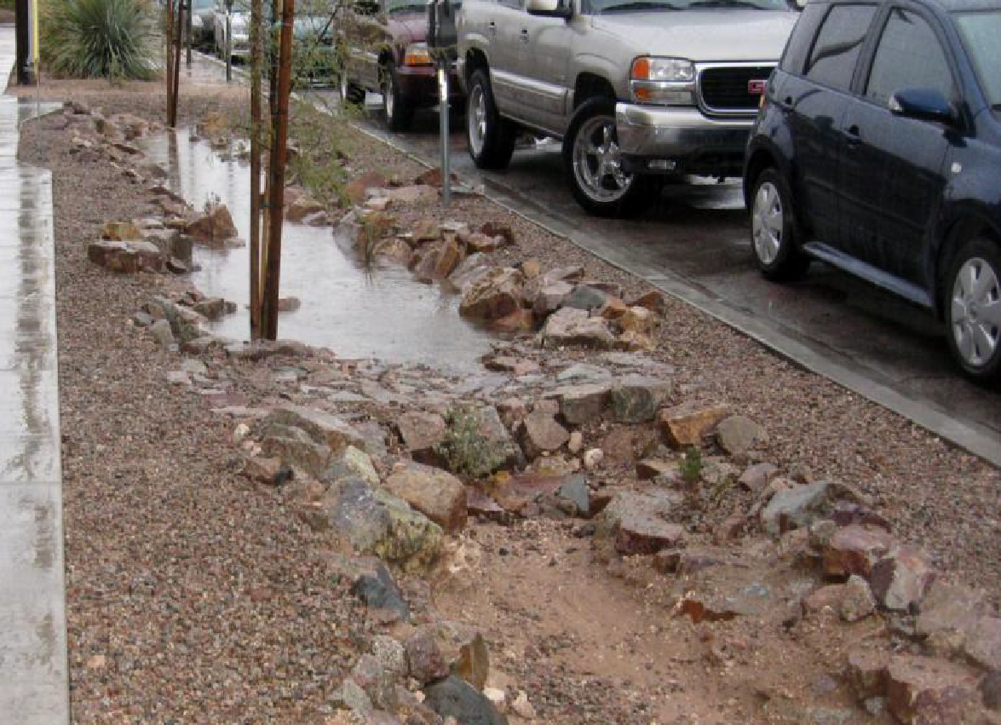
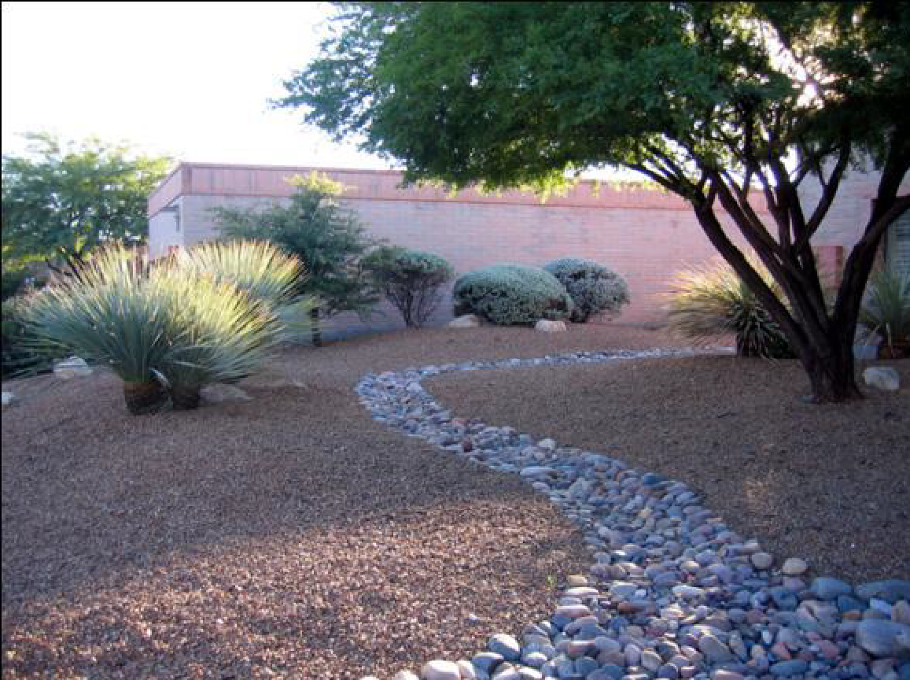
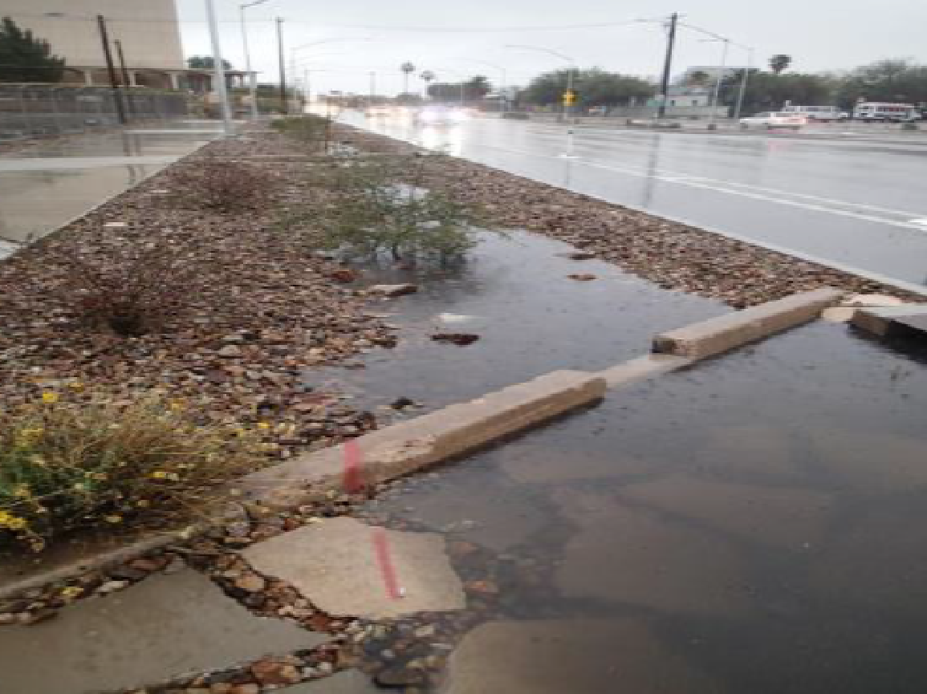
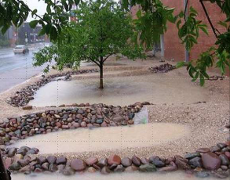
DISTINGUISH:
Where does water flow on your campus?
HIGH POINTS
FLOW DIRECTION
LOW POINTS
Berm
Basin
Notes:
DISTINGUISH
Where does the water flow on your campus?
It’s important for students to notice where the water is flowing on campus. Students will need a way to incorporate their school yard observations into their rainwater harvesting design. Show them this slide to introduce them to some of the landscape features they’ll be looking for. They’ll need a way to record their observations for use in their engineering design.

Slide 7
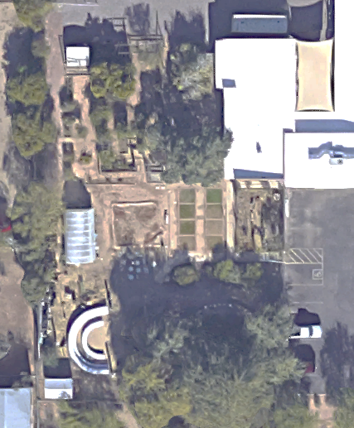
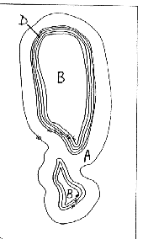
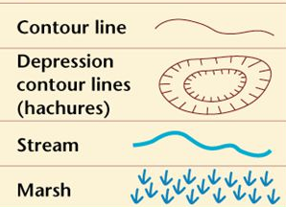
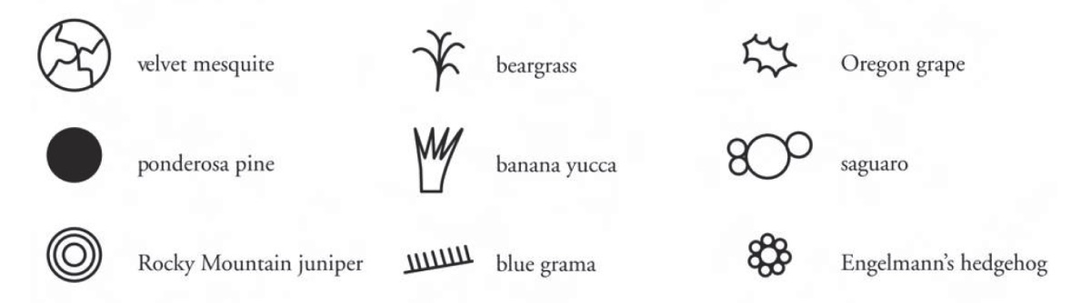

CREATING A KEY
Example symbols for physical features
Use arrows for flow direction
High Point
H
Low Point
L
Example symbols for plants
Notes:
Using Symbols and Creating a Map Key
Introduce students to the use of symbols as a way of recording data on their school yard map. They should create symbols for physical structures, like hardscape, as well as symbols to delineate where water flows.
Have them also designate symbols for the existing plants which need to be watered. The students may use the symbols already provided on the Schoolyard Inspection Datasheet or create their own key. They can refer to Map Symbols PDF as a guide.
NOTE: Students will learn about different types of plants and their watering requirements later in the unit. This knowledge will influence their ultimate rainwater harvesting system design.

Slide 8
SCHOOLYARD INSPECTION
Make a symbols and notes on the map key to show the following:
How does water flow on the school grounds?
Where does it end up?
Where does water come from?
Look for places where water drains off the roof, and follow the paths water takes, noticing where it leaves the school grounds. Where are the roof drains? Is any of the water from the roof kept onsite to water vegetation?
Where are hardscapes?
Where do you see erosion?
L
Flow
H
Erosion
Hardscape
Notes:
Schoolyard Inspection
While outside, students working in groups will be completing Questions 1 – 6 on the Schoolyard Inspection Datasheet:
How does water flow on the school grounds?
Where does it end up?
Where does water come from?
Look for places where water drains off the roof, and follow the paths water takes, noticing where it leaves the school grounds. Where are the roof drains? Is any of the water from the roof kept onsite to water vegetation?
Where are hardscapes?
Where do you see erosion?
Part 1:
Distribute the Schoolyard Inspection Datasheet and the aerial image of your campus (from Google Maps) to students and lead them outdoors for a campus tour. Remind them to complete Questions 1 – 6 while outdoors.
Encourage them to explore the schoolyard and observe any recognizable patterns on how rain/stormwater flows on their campus. Encourage them to work in their groups asking each other questions to further define the problem and support the four processes involved in rainwater harvesting.
Ask them to construct an explanation of how high and low spots may work with their designs, and whether erosion could be prevented by better water management.
Part 2:
As they continue their investigation, have them analyze and delineate the areas they believe would be best for collection, conveyance, infiltration, and storage. What evidence do they have for their claims? Each group will be focusing in on one site for the development of their rainwater harvesting system. Allow each group to choose a different site if possible.
Follow the steps 8 – 10 on the back page of the datasheet. Have them measure and draw the boundaries of the location they choose on their map.
If there is already vegetation in the area, have them count the types of plants and record them on the Schoolyard Inspection Datasheet.

Slide 9
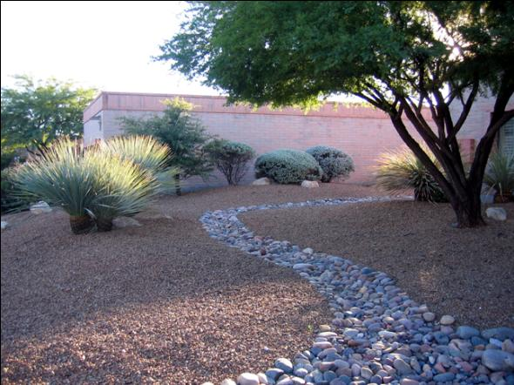
Swales
DISTINGUISH:
What distinctions can you make about Swales?
Notes:
Back in the classroom, provide the students with the information on berms, basins and swales (on this slide and the next). Collectively, they are all called earthworks. Students will be designing passive rainwater harvesting systems using earthworks. They should look for opportunities to direct the water flow to their earthwork design. Water flow can be directed by swales. Swales are dug out of the earth with a shallow slope to convey water in a controlled manner. Soil that is excavated to create a swale can be used to create a berm.

Slide 10
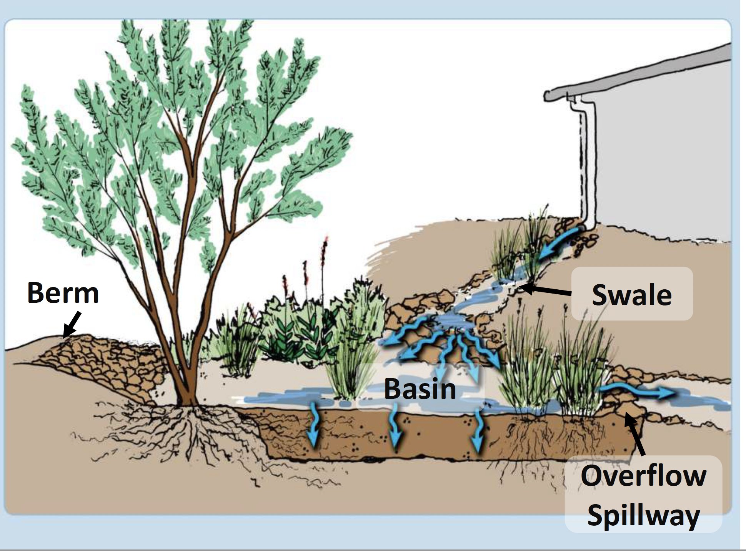
Earthworks
Diagram from: Watershed Management Group
Notes:
A berm is a raised and elongated mound perpendicular to the slope of the land. Berms are used to slow surface runoff to allow infiltration in an adjacent area. Basins are low areas that collect and infiltrate water.
Basins - bottom often sloped slightly due to large amount of excavation that would be otherwise needed.
Berms: On Contour, Boomerang/banana/smile Combo to create net

Slide 11
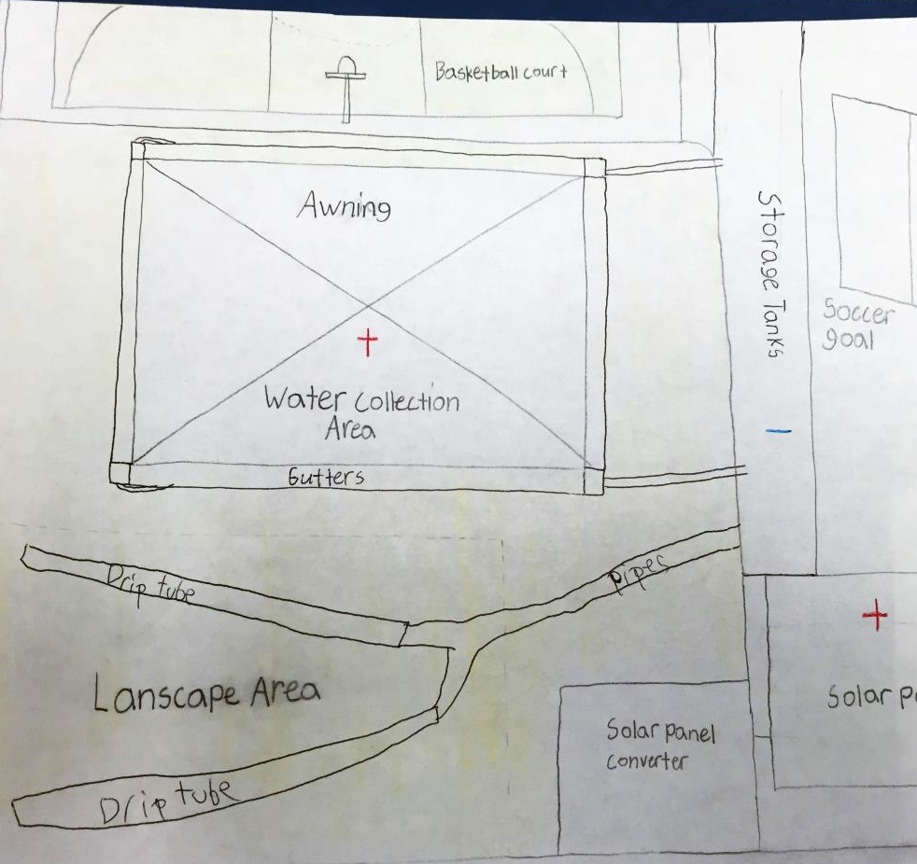
SCHOOLYARD INSPECTION
Select a site where you will design
your system.
Remember to consider the following:
Locate places where water could easily be harvested from the rooftop and used appropriately.
Remember that not all harvested rainwater has to be containerized or stored.
Water can be directed to swales (low areas). Berms or raised areas can be used to direct the flow of water.
Sketch your chosen site in your notes.
Remember to draw the boundaries of your location.
Make note of physical features you will need to include in your design.
Notes:
Back in the classroom, have students sketch their chosen site to scale on a larger piece of graph paper (at least 8-1/2 by 11) to use later in the engineering design project. Label all parts and processes. They will need to take measurements of the collection area as well as the location of the rain basin(s).
Note: Students are likely to forget to record some important items when they are in the field so more than one trip outdoors maybe required. Decide how you might need to manage students coming and going from the field to your classroom.

Slide 12
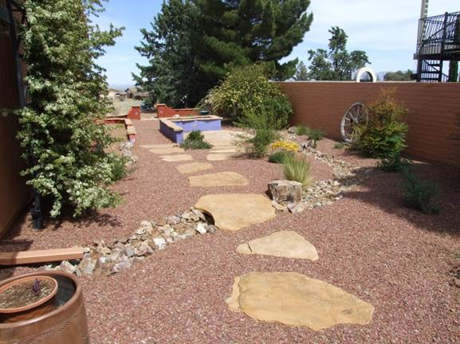
Problem: How will you design a passive rainwater harvesting system that will provide shade and sustain your plants year-round through the most efficient use of available water?
Criteria
Criteria are requirements or conditions that must be met to solve the problem.
Constraints
Constraints are limitations or restrictions.
Notes:
Have a group discussion on what the students observed and the problems they identified. Tell them to discuss in their table groups how the problems that they found could be solved. Then ask, “Could your rainwater harvesting design address any of the problems?”
Have students review the criteria and constraints lists and add any new ones from their site inspections

Slide 13
What did you learn?
DISTINGUISH:
What makes a good site for rainwater harvesting?
What makes a bad site for rainwater harvesting?
BUILD THE SYSTEM:
What are the parts of a site that are important to consider when beginning a rainwater harvesting project?
Notes:
Conclusion
DISTINGUISH:
What is a good site for rainwater harvesting?
As a wrap up, discuss what physical features they think might make for a good rainwater harvesting site. Ask them how many of these features they have in their chosen site. Discuss possible ways to change their site to collect more rainwater or include more basins.
What makes a bad site for rainwater harvesting?
In contrast, did they notice any areas on campus where they wouldn’t want to put a rainwater harvesting system? What might be some of the limitations of those areas? (confined spaces, too much pedestrian traffic, difficulty getting water where it is needed)
Ask students to discuss why they chose their particular site for harvesting rain. Based upon your discussions, are there things they can change to improve their ability to harvest rain?
BUILD THE SYSTEM:
What are the parts of a site that are important to consider when beginning a rainwater harvesting project?
Have students develop an answer to this question in small groups, and then share. This may inspire some groups to want to collect more information to add to their site map. (Students can do this during lunch or recess if needed.)
Could any of the existing parts of the rainwater management system be utilized for collecting rainwater?
How will rainwater be conveyed or transported to their chosen site?
How will it infiltrate into the soil? Is there a way for students to enhance infiltration on their site?
Are there constraints to this site that they may not be able to see? (Pipes and utility lines underground)
Is there room for trees to spread their root structure at their site?

Slide 14
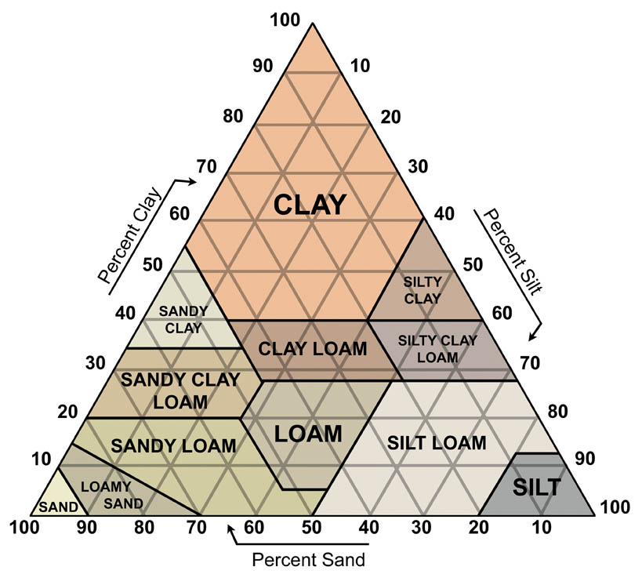
Soil Assessment at School
What will happen when rainwater falls on the soil at your school?
Conduct jar test: Dig a hole at least 1 foot deep. Fill a jar half full of soil. Shake sample in jar, allow soil to settle out
The next day have students estimate the percentages of different particle sizes and use the soil texture triangle to figure out the soil type.
Notes:
**OPTIONAL BUT ENCOURAGED**
Option 1: Soil Assessment at School to estimate percolation rate.
What will happen when rainwater falls on the soil at your school?
Conduct jar test (see Soil Texture Triangle.docx). Dig a hole at least 1 foot deep. Fill a jar half full of soil. Shake sample in jar, allow soil to settle out
The next day have students estimate the percentages of different particle sizes and use the soil texture triangle to figure out the soil type.
If there is time, students can also assess their soil type by feel. Have students use the chart on the back of the Soil Texture Triangle as a guide.

Slide 15
What will happen when rainwater falls on the soil at your school?
Texture | Estimated Permeability
Sand, loamy sand | Rapid and very rapid (>6.0 in/hr)
Sandy loam | Moderately rapid (2.0 - 6.0 in/hr)
Loam, silt loam | Moderate (0.6 - 2.0 in/hr)
Sandy clay loam | Moderately slow (0.2 - 0.6 in/hr)
Clay loam, silty clay loam | Moderately slow (0.2 - 0.6 in/hr)
Rules of Thumb above estimated from Soils Interpretation Help Sheet, Soils CDE – Interpretation Sheet (November 2010)
Notes:
Sandier or more gravelly soils will allow water to infiltrate faster. Silt and clay inhibit the flow of water into the ground.
Based upon the results of the jar test for your school, ask the students how fast or slow they think the water will enter the ground?

Slide 16
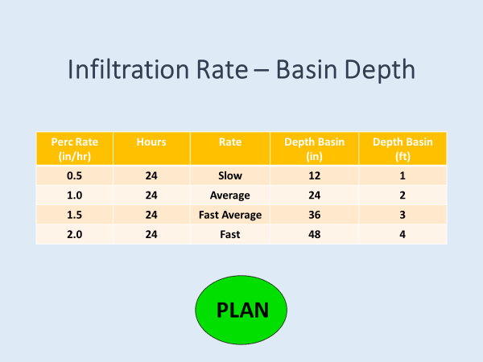
Notes:
Option 2: Infiltration Rate and Sizing Basins
When designing and sizing basins for rainwater harvesting, it is important to take into consideration the following factors:
Soil Texture: Permeability varies greatly based upon soil composition. Sand and sandy loam soils have a higher degree of permeability and allow for relatively rapid release of waters collected in a basin. The opposite occurs with sandy clay loam, clay loam and silty clay loam which will hold retained waters for a much longer period of time. For optimal rainwater harvesting as well as public health and safety, the following considerations must be made:
No standing water allowed. Due to local and State health codes, water must infiltrate through the basin within 24 hours. Standing water allows for disease carrying vector propagation such a mosquitos.
Infiltration Rate Determines Optimal Basin Depth. Knowing the infiltration rate or perc rate (inches/hour) of water in our soil tells us the maximum depth our rainwater harvesting basin could be. A Fast Average infiltration rate will allow for a basin depth of 3 feet deep.
Slope Safety. Steeply sloped basins can be hazardous to people and pets. A general rule of thumb is to maintain 3:1 slope ratio, or less, when creating berms and basins. This means for every 3 units of horizontal distance, you go down 1 unit vertically.

