Slide 1
Lesson Five How Much Rain Can We Collect?
How much rain can you collect from your project site?
Notes:
Connect to the Unit
In the previous presentation, APW staff came to your school to perform the Rainwater Harvesting Runoff Experiment which introduced students to the concept of Runoff Coefficients (R_{c}). Based upon the results of the run-off experiment, students learned that roofing materials which are smooth have a higher R_{c} than roofing materials that are textured or rough. They learned the R_{c} is an important factor in calculating the amount of rainwater that can be collected from a surface.
Launch this Lesson
This lesson will show students how to determine the amount of rainfall (supply) that can be collected over the course of a year for their chosen rainwater harvesting collection area.

Slide 2
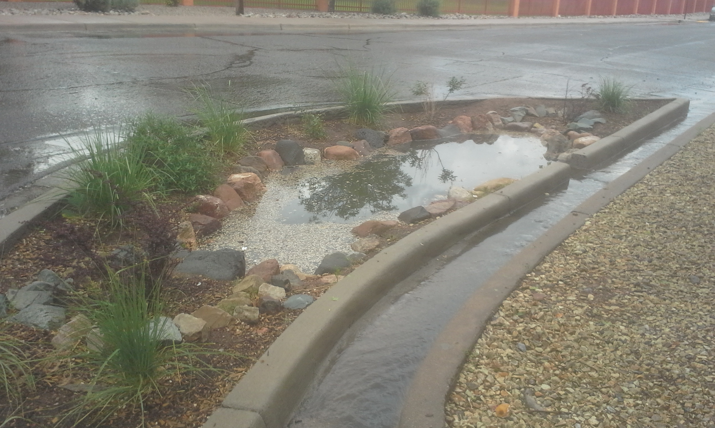
DISTINGUISH:
Define the problem
How will you design a passive rainwater harvesting system that will provide shade and sustain your plants year-round through the most efficient use of available water?
Unpack the problem:
What is sustain?
What is year-round?
What is the most efficient use of available water?
Notes:
DISTINGUISH
What is the problem?
Remind students of the problem they are trying to solve.
Design a rainwater harvesting system that will provide shade at your school and meet all of the plants’ watering requirements. Remember to create an integrated design using the Principles of Rainwater Harvesting.
What plants provide shade?
What are watering requirements?
Are watering requirements constant or do they change with seasons?
What is meant by integrated design?
How does it affect plants that are chosen?
What functions do the parts of my design serve?

Slide 3
Notes:
Where are we in the engineering design process?
We are still asking, exploring and imagining.

Slide 4
DISTINGUISH:
What do you need to know in order to size your system appropriately?
Notes:
DISTINGUISH:
What do you need to know in order to size your system appropriately?
Ask the students what information they need to design and build a rainwater harvesting that will meet the criteria and constraints.
One of the first things they need to know is how much water they can collect from their chosen collection area. They will also need to know how much water their plants need. In this lesson, students will focus on determining how much water can be collected and made available for their landscape.

Slide 5
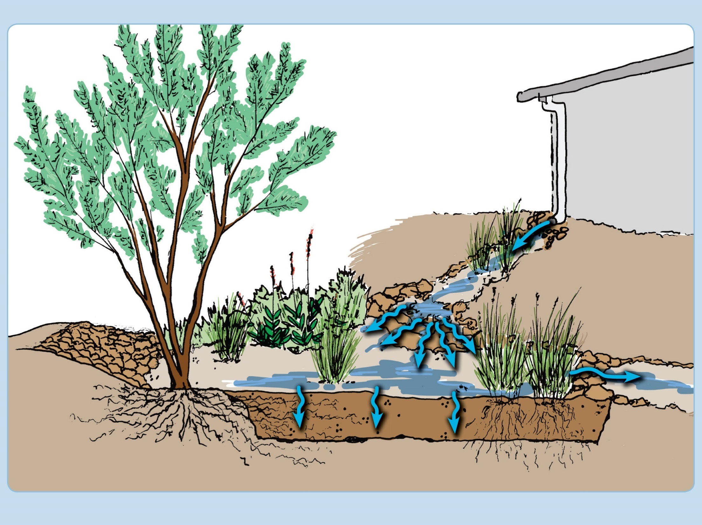
BUILD THE SYSTEM:
​What are the parts that you will use to determine how much water can be collected from your collection area?
Notes:
BUILD THE SYSTEM:
What are the parts that you will use to determine how much water can be collected from your collection area?
Give students time in small groups to discuss this.
Students should understand that they will need to know the how to calculate the surface area, in square feet, of their collection area. They will also need to know the amount of rain that falls on that surface in an average month. If they don’t come up with these at this point, don’t tell them. This is an opportunity to find out what they already know.
In this lesson, they will learn that the volume of rainwater they can collect will vary throughout the year. Some may remember the texture of the roof or collection area surface (the runoff coefficient) plays a role in how much rain they can collect.

Slide 6
DISTINGUISH:
What is average annual rainfall?
What is average annual rainfall not?
What is average monthly rainfall?
What is average monthly rainfall not?
What do these averages tell us?
Notes:
DISTINGUISH
What is average annual rainfall?
The amount of rain that we usually get each year.
What is average annual rainfall not?
It’s not monthly, weekly or daily data.
Ask the students whether they think it would better to use daily, monthly or annual rainfall values to determine the size of their system.
What is average monthly rainfall?
The amount of rain that we usually get in each month of the year.
What is average monthly rainfall not?
It’s still not daily. Would daily data be better to use than monthly? Why or why not?
Discuss the frequency of precipitation in our area. Students will likely know about times of year when we get more rain, like the monsoon season. They may know that there are long periods with no rain too. Ask them: “Will annual or monthly data tell you about one big storm?” No, neither one will. “Would it be helpful to have more data on rainfall or less?” More, yet when is it too much and too time consuming?
For most rainwater professionals using daily data is overkill. A constraint that we all have in designing and building a rainwater harvesting system is time. So, we are going to analyze monthly rainfall.

Slide 7
DISTINGUISH:
What else do you need to know to determine how much water could be harvested from your collection surface?
Notes:
DISTINGUISH
What else do you need to know to determine how much water could be harvested from your collection surface?
We need to know the surface area of the collection surface that we will be harvesting from.

Slide 8
DISTINGUISH:
What is a good collection area for your chosen area?
What is not a good collection area for your chosen area?
Notes:
DISTINGUISH
What is a good collection area for your chosen area?
The collection area for their system should have been determined in Question 8 on their Schoolyard Inspection Datasheet. Ask students, “What constraints or criteria does a collection area need to meet?” (It has to be close to the location to be watered. It has to be an impermeable surface to collect water off, e.g. a roof or paved playground area.) Remember, where do we need shade?
What is not a good collection area for your chosen area?
It is not any area off the school grounds. It’s not a low point.

Slide 9
RELATE:
What is the difference between a roof area and a paved area?
Which do you think would be easier to harvest water from?
Notes:
RELATE:
What is the difference between a roof area and a paved area?
Engage students in a discussion of whether a roof area or paved area would be easier to collect water from and why?
Which do you think would be easier to harvest water from?
Higher areas might be easier to collect water from because you have the help of gravity, roof areas may already have structures you can use to help harvest rain (downspouts, gutters). Paved areas are lower and may require more work to direct water to useful locations.

Slide 10
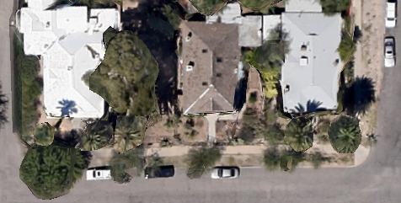
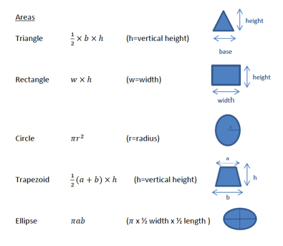
Calculate the surface area of your collection area.
What is the surface area of your collection area that drains into your landscape?
https://www.google.com/earth/
Notes:
How to calculate the area of the roof:
Use the Google Earth link (https://www.google.com/earth) to help your students find the roof area that they are planning on working with. Students may be working only with a portion of the roof for their projects. Circulate the room to ensure students are performing this task correctly. Note: they may need to use different shapes and add the areas together.

Slide 11
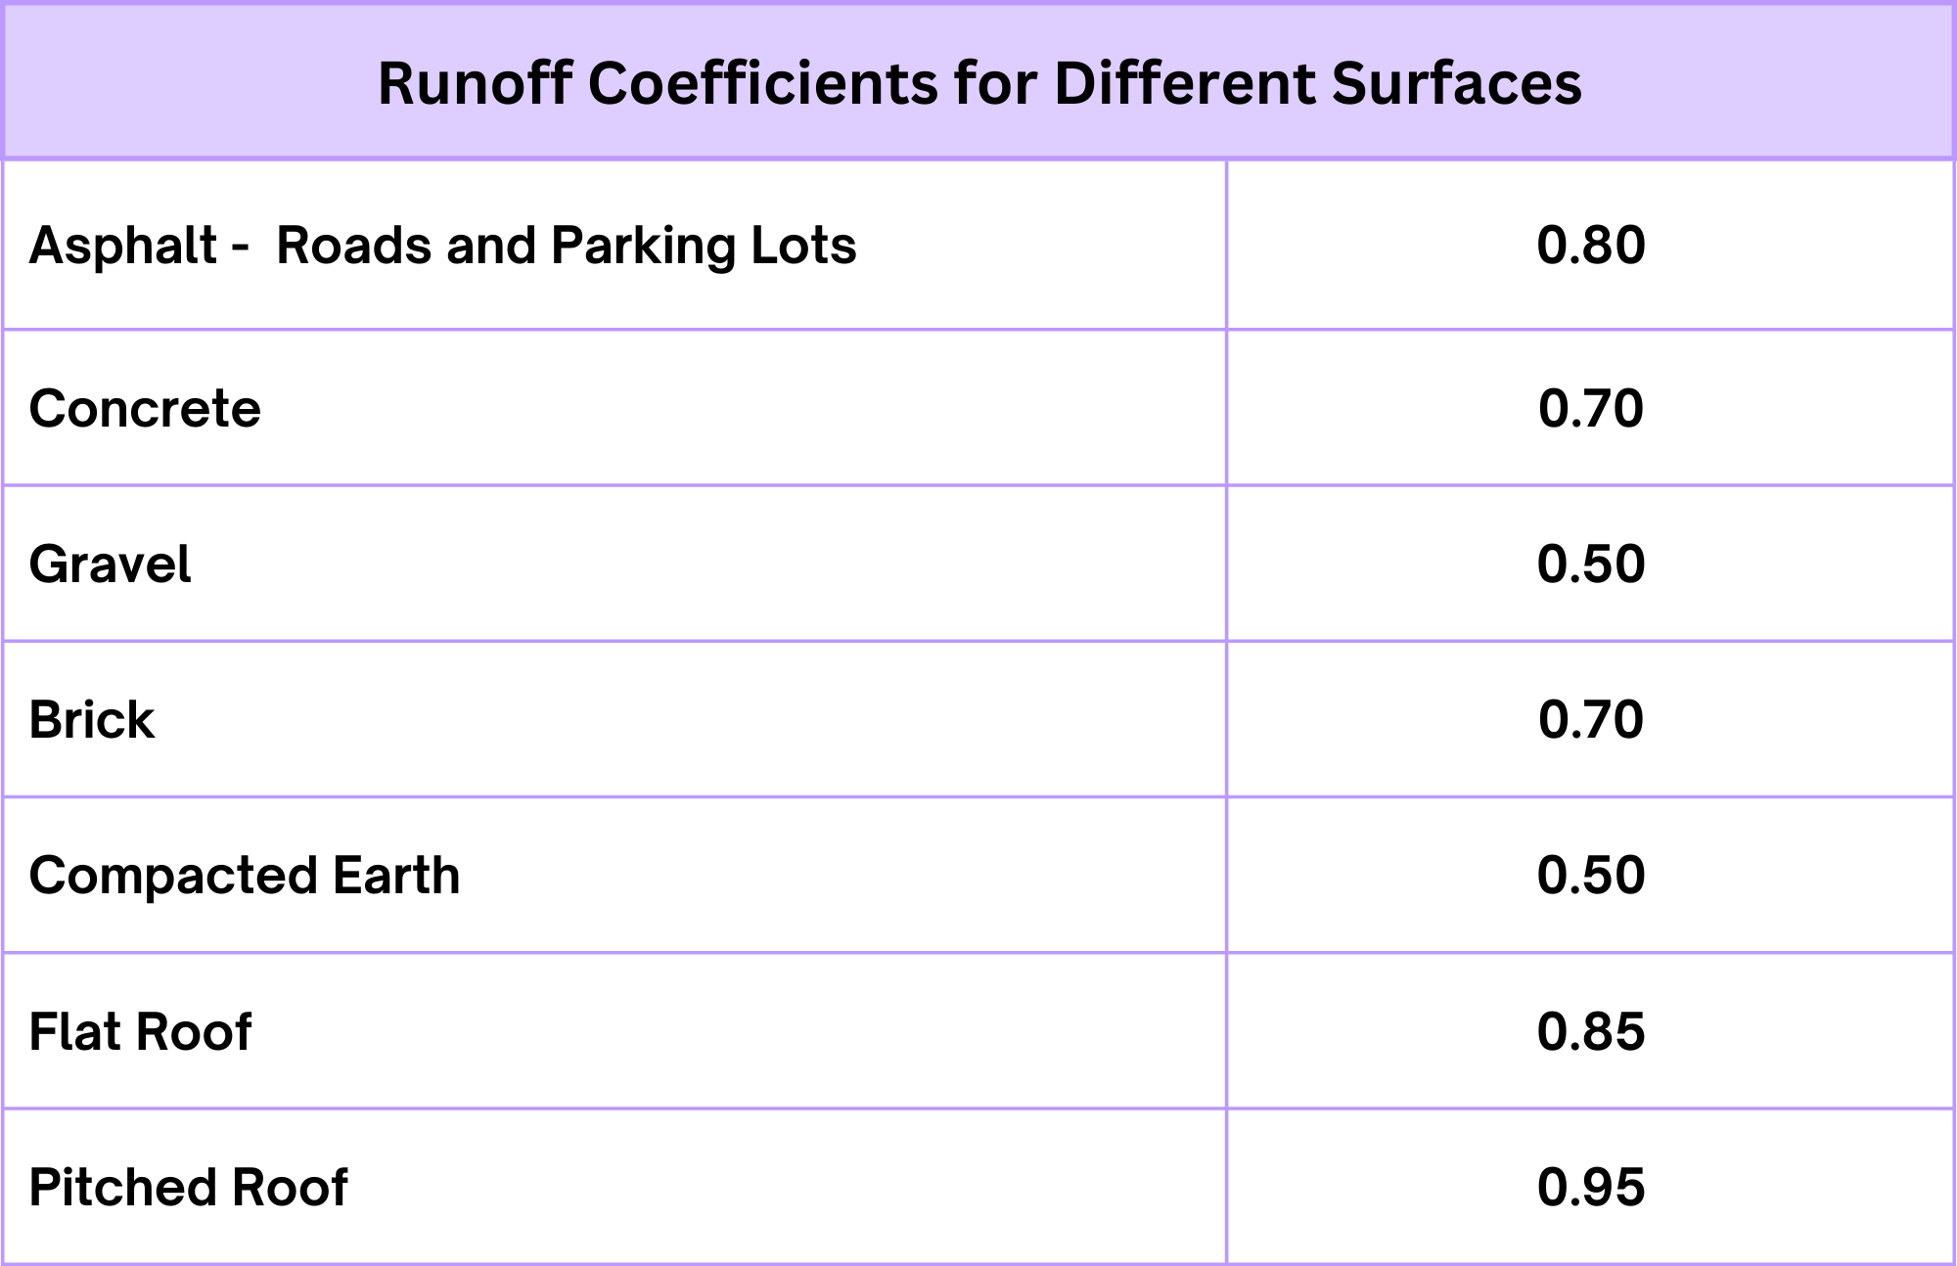
RELATE: What are the relationships between the amount of water that falls on a surface and the amount of water that runs off a surface?
Notes:
RELATE:
What are the relationships between the amount of water that falls on a surface and the amount of water that runs off a surface?
Do you remember what we learned about the different roof textures in the rainwater harvesting challenge? Give student groups time to discuss and articulate the answers. Ideally, they’ll remember that the smoother the surface, the more water can be collected.
Why did the different roof surfaces have different amounts of runoff?
Permeable surfaces allow rainwater to sink in. Impermeable surfaces shed rainwater. Some impermeable surfaces shed more water than others.
What value did we calculate during the Runoff experiment to help us account for this? What was this called and what does it mean?
The runoff coefficient is the proportion of water that runs off a particular surface. It accounts for the loss of some water that is captured and stays on the surface rather than running off.

Slide 12
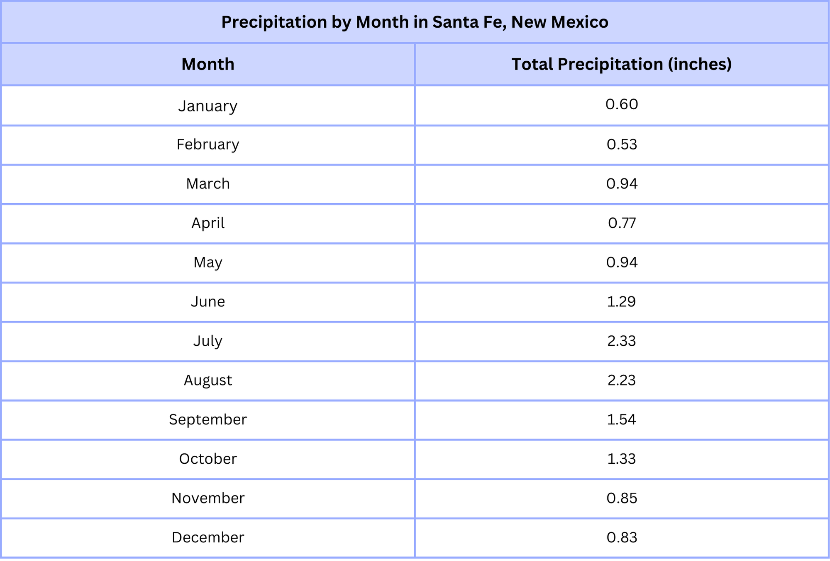
Analyze rainfall data for your city
How much water falls on your project area?
Notes:
BUILD THE SYSTEM:
Identify the types of data needed to mathematically determine how much water can be collected in a year.
Introduce the Supply Worksheet to the students. Tell them the Supply Worksheet will help them think through all the factors that go into figuring out how much rain can be collected at their chosen location.
Some teachers prefer to pre-fill the worksheet with the appropriate rainfall data (see links to rainfall data below) rather than have students access and copy the data themselves.
The SUPPLY Worksheet is also available as an Excel spreadsheet with formulas already inserted if you prefer to have students do this work on computers.
Supply Spreadsheet
To facilitate understanding, walk students through an explanation of each column on the spreadsheet. It may be helpful to use a document viewer to review the worksheet
.
Column A – Collection Area in ft². This is calculated as below:
Collection Surface: Length (ft) x Width (ft) = Area (ft2)
Column B – Average Monthly Rainfall– you may opt to have them find the information themselves using the website links provided above or prefill the data on the worksheet before handing it out.
Column C – Rainfall on Collection Area. This is the amount of rain that falls onto the collection area. Students calculate this by multiplying Columns A x B. Notice the units. ft²•in. Is this a volume? Yes, but it is not a standard unit for measuring volume. What do units do we use to measure volume? (ft³, gallons, liters…) How do we get there? (We need to convert our units).
Column D is a conversion factor to get us to ft³. How many inches in a foot? (12 inches)
So if we multiply our value by ((1 𝑓𝑡)/(12 𝑖𝑛)) we can cancel out inches and Column D is the Rainfall on Collection Area in ft³.
Column E is a conversion factor to get us to gal. How many gallons in a ft³? ((7.48 𝑔𝑎𝑙)/〖𝑓𝑡〗^3 ) So if multiply by this conversion factor, it gives us Rainfall on Collection Area in gallons.
Column F of the Supply Worksheet is where students add the appropriate runoff coefficient for their collection surface. The runoff coefficient will not change for one type of collection area, so the same value is entered into every row. These are listed on the Supply Worksheet.docx.
Column G is how much water can be harvested from the collection area in gallons. In other words, it’s the amount of water they can collect by month and over the course of the year.
Give them time to fill in the spreadsheet with the information they have. Circulate the room to make sure they are on task.

Slide 13
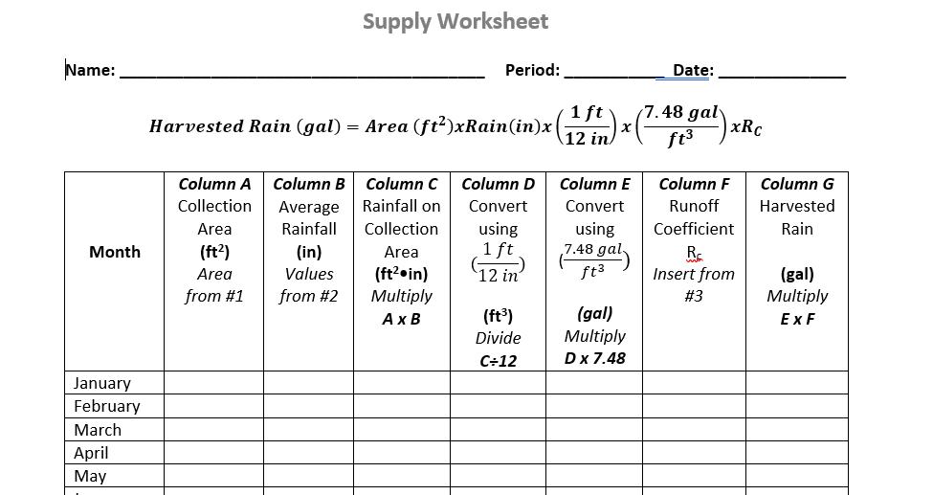
​Build the System:
​Identify the types of data needed to mathematically determine how much water can be collected in a year.
Notes:
BUILD THE SYSTEM:
Identify the types of data needed to mathematically determine how much water can be collected in a year.
Introduce the Supply Worksheet to the students. Tell them the Supply Worksheet will help them think through all the factors that go into figuring out how much rain can be collected at their chosen location.
Some teachers prefer to pre-fill the worksheet with the appropriate rainfall data (see links to rainfall data below) rather than have students access and copy the data themselves.
The SUPPLY Worksheet is also available as an Excel spreadsheet with formulas already inserted if you prefer to have students do this work on computers.
Supply Spreadsheet
To facilitate understanding, walk students through an explanation of each column on the spreadsheet. It may be helpful to use a document viewer to review the worksheet
.
Column A – Collection Area in ft². This is calculated as below:
Collection Surface: Length (ft) x Width (ft) = Area (ft2)
Column B – Average Monthly Rainfall– you may opt to have them find the information themselves using the website links provided above or prefill the data on the worksheet before handing it out.
Column C – Rainfall on Collection Area. This is the amount of rain that falls onto the collection area. Students calculate this by multiplying Columns A x B. Notice the units. ft²•in. Is this a volume? Yes, but it is not a standard unit for measuring volume. What do units do we use to measure volume? (ft³, gallons, liters…) How do we get there? (We need to convert our units).
Column D is a conversion factor to get us to ft³. How many inches in a foot? (12 inches)
So if we multiply our value by ((1 𝑓𝑡)/(12 𝑖𝑛)) we can cancel out inches and Column D is the Rainfall on Collection Area in ft³.
Column E is a conversion factor to get us to gal. How many gallons in a ft³? ((7.48 𝑔𝑎𝑙)/〖𝑓𝑡〗^3 ) So if multiply by this conversion factor, it gives us Rainfall on Collection Area in gallons.
Column F of the Supply Worksheet is where students add the appropriate runoff coefficient for their collection surface. The runoff coefficient will not change for one type of collection area, so the same value is entered into every row. These are listed on the Supply Worksheet.docx.
Column G is how much water can be harvested from the collection area in gallons. In other words, it’s the amount of water they can collect by month and over the course of the year.
Give them time to fill in the spreadsheet with the information they have. Circulate the room to make sure they are on task.

Slide 14
How will we use these calculations to design our rainwater harvesting system?
DISTINGUISH
What does this data tell us?
What does it not tell us?
Notes:
DISTINGUISH
What does this data tell us?
After they finish their spreadsheets, have them look at the amount of water which can be harvested per month versus the amount harvested per year. Compare the amount that can be harvested in each month. What does the data tell us?
What does it not tell us?
It doesn’t tell us about individual storm sizes.
The data only tells them the water they have available for use. It does not tell them if they have enough to meet their plants’ watering requirements.

Slide 15
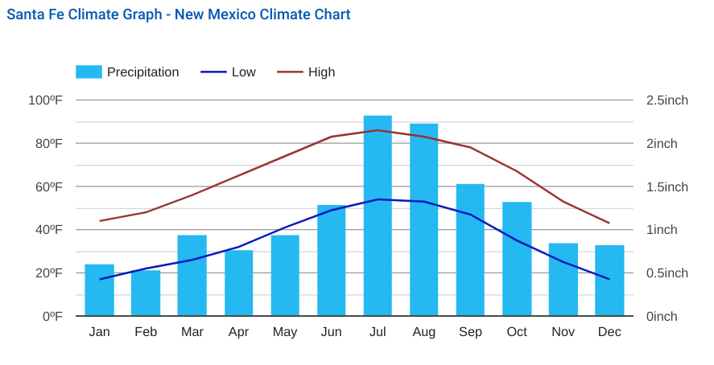
RELATE:
What are the relationships between rainfall for the various months of the year?
Analyze the data and try to anticipate if and when rainwater storage might be needed.
Notes:
RELATE
What are the relationships between rainfall for the various months of the year?
Which month will supply the most water? Which month will supply the least water?
Have them refer to their supply worksheet to answer these questions. Have them think about how rainfall patterns may be a factor in designing a rainwater harvesting system that supports plants all year. They should notice that from April through June there is little to no precipitation and then the rainy season starts.
How might we need to accommodate months with low rainfall?
They should understand that months with little to no rainfall will impact the types of shrubs and trees they can plant.
They should also consider what will happen to their rainwater harvesting system if an extreme weather event occurs and results in extensive flooding. Consider this:
A Sept. 8, 2014, storm, fed by the monsoon and the remnants of a Pacific Ocean hurricane, started in the middle of the night and shattered rainfall records. The heaviest downpour was recorded in Chandler, where 5.5 inches fell in 8 hours. More extreme storms are predicted for the southwestern U.S.
In designing our rainwater harvesting system then, we will also want to consider the impacts of a 100-year storm which drops several inches of rain in a matter of hours. Here in the Phoenix area that means a storm dropping 2.2 inches or more of rain in 60 minutes. (See: https://hdsc.nws.noaa.gov/hdsc/pfds/pfds_map_cont.html?bkmrk=az)
The 100-year storm phenomenon then is an essential planning tool when sizing the storage part of their system. It should be added to the list of criteria. Note: We’ll look at how to incorporate this factor in student designs in Lesson 9.

Slide 16
TAKE A PERSPECTIVE:
From the perspective of a plant, how would rainfall patterns affect the choice of your plants?
What kind of plants do well during the dry months?
Notes:
TAKE A PERSPECTIVE:
From the perspective of a plant, how would rainfall patterns affect the choice of your plants?
Remember that the watering requirements for your plants need to be met by your system.
What kind of plants do well during the dry months?
They should start to realize that native and or desert adapted plants should do through the dry months. Note: This is just a quick preliminary discussion.

Slide 17
What did you learn?
BUILD THE SYSTEM:
Identify the types of data needed to mathematically determine how much water can be collected in a year or in a month.
Rainfall Harvested = Volume
Area
X
Rainfall
X
Rc
Notes:
CONCLUSION
BUILD THE SYSTEM:
Identify the types of data needed to mathematically determine how much water can be collected in a year or in a month.
Rainfall Harvested Volume = Area x Rainfall x Rc
(Rc is the Runoff Coefficient)

Slide 18
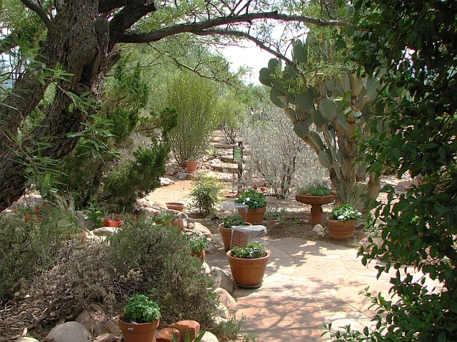
What did you learn?
RELATE
The amount of water collected each month to the design of plants that will supply shade.
Notes:
RELATE
The amount of water collected each month to the design of plants that will supply shade.
Once students have completed the Supply Worksheet and applied DSRP thinking to analyze the data, return to your criteria and constraints lists. Which of the criteria and constraints questions does this exploration answer? Which criteria and constraints have been specified, clarified or quantified by this exploration? What new criteria and constraints should be added to each list based on this exploration?

