Slide 1
Lesson Six How Much Water Do My Plants Need?
How much water do we need for the plants we have during each month of the year?
Notes:
Launch this Lesson
In this lesson, students begin exploring the demand side of their design challenge; meeting the watering requirements of their plants. They will begin to determine the monthly watering needs of their landscape project area by accounting for watering needs by type of plant, the number of plants, and the coverage area of the plants as a percentage of land use.
Students will:
Learn about differences in watering needs for Very Low, Low, Moderate, High, and Very High water use plants.
Select appropriate plants for their project which meet the criteria of:
Provide shade
Watering requirements met
Integrated design/stacking functions

Slide 2
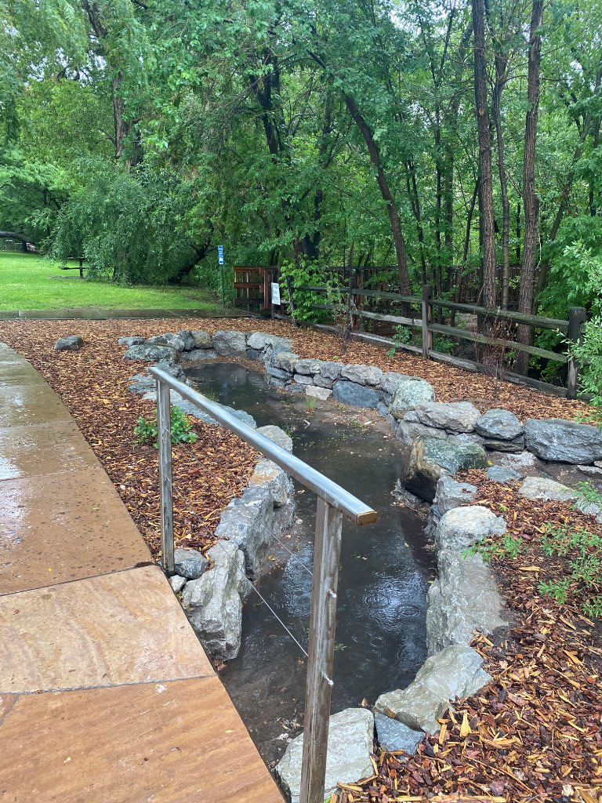
DISTINGUISH:
Define the problem
How will you design a passive rainwater harvesting system that will provide shade and sustain your plants year-round through the most efficient use of available water?
Unpack the problem:
What is sustain?
What is year-round?
What is the most efficient use of available water?
Notes:
DISTINGUISH
Remind the students of the driving question and orient them to where they are in the process of answering that question:
What do we know?
Ask students what they learned during Lesson 4, the school yard exploration. They should know the number and types of existing plants in their selected area and how water moves through their chosen area.
From Lesson 5, they should know the amount of rainfall that can be collected and stored.
What don’t we know?
If they are designing their system to support new plants, they need time to research the types of trees, shrubs and plants that will support the driving question.
Engage students in supply vs demand thinking. They know how much water they potentially have to work with. Now they need to know what the specific water needs of their project area is throughout the year.

Slide 3
Notes:
Thirsty Plants lesson from Project WET Activity and Curriculum Guide (white book), p. 116.
Students will be going outside and placing a small, sandwich size Ziploc plastic bag over a set of leaves on a plant that are in the sun to demonstrate transpiration.

Slide 4
Activity Prep
Set up for Thirsty Plants lesson.
On your desk is a plastic bag.
Examine your bag and record observations about how it looks on a piece of scratch paper.
Go outside and choose a plant in a sunny place. Put your bag over a few leaves of the plant. Make sure to seal the bag tightly.
Record the number of leaves inside the bag.
Estimate the total number of leaves on the tree and record.
Record the time that you placed the bag on the plant.
Predict what you think will happen and write your prediction down on the scratch paper.
Notes:
Set up for Thirsty Plants lesson.
On your desk is a plastic bag.
Examine your bag and record observations about how it looks on a piece of scratch paper.
Go outside and choose a plant in a sunny place. Put your bag over a few leaves of the plant. Make sure to seal the bag tightly.
Record the number of leaves inside the bag.
Estimate the total number of leaves on the tree and record.
Record the time that you placed the bag on the plant.
Predict what you think will happen and write your prediction down on the scratch paper.

Slide 5
Notes:
Where are we in the engineering design process?
We are still asking questions, but we’re also exploring and imagining as we proceed in our effort to find the best solution as defined by our criteria and constraints.

Slide 6
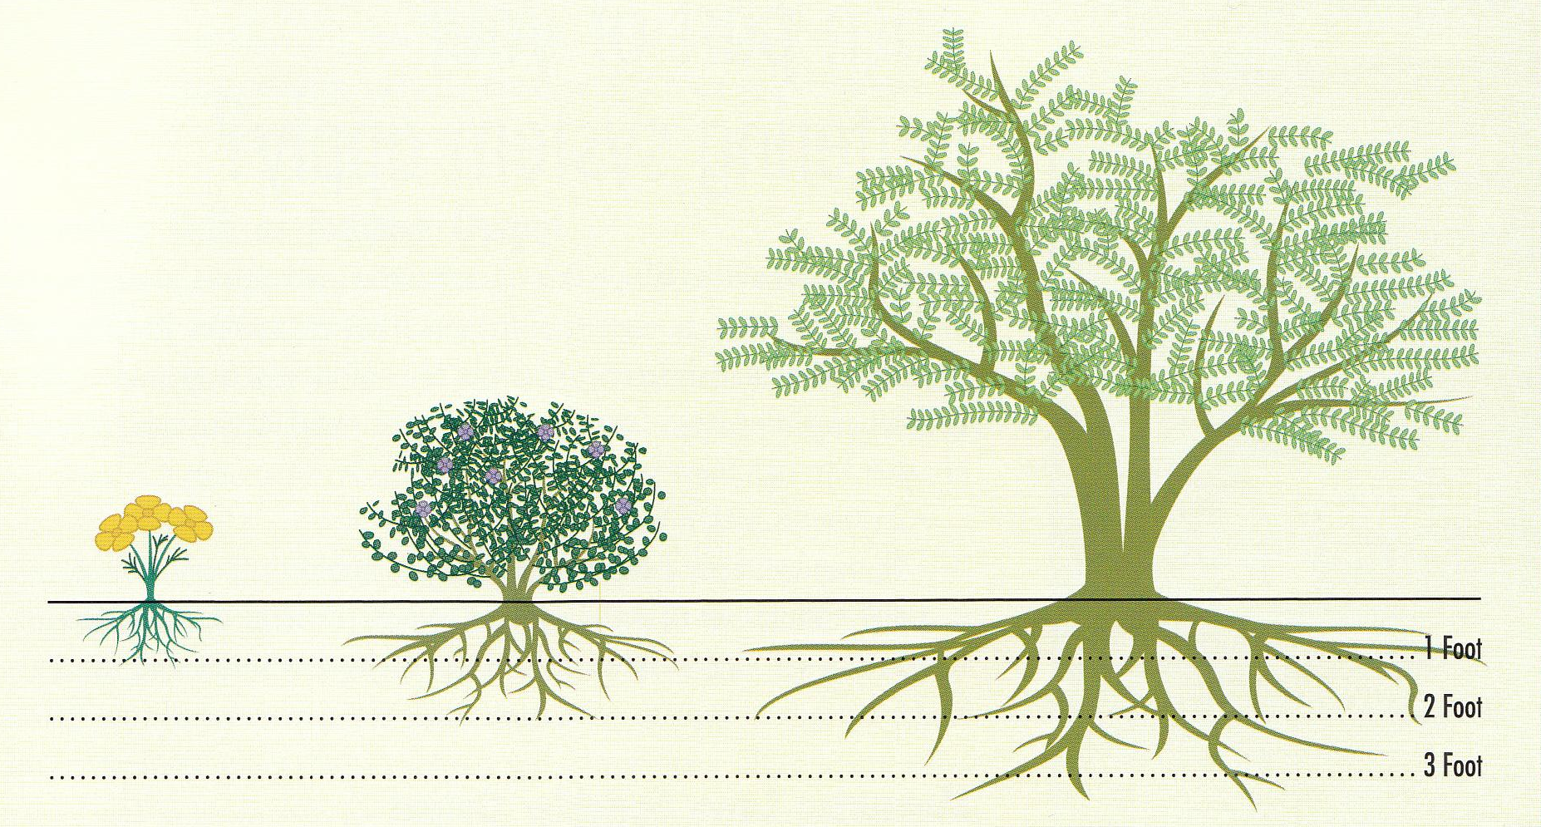
BUILD THE SYSTEM
What are the parts of plant water demand?
Notes:
DISTINGUISH
What are the parts of plant water demand?
Kind of plant, Size of plant, Monthly or seasonal climate (Rainfall), Evapotranspiration. (They might not know about evapotranspiration now but will by the end of the lesson).

Slide 7
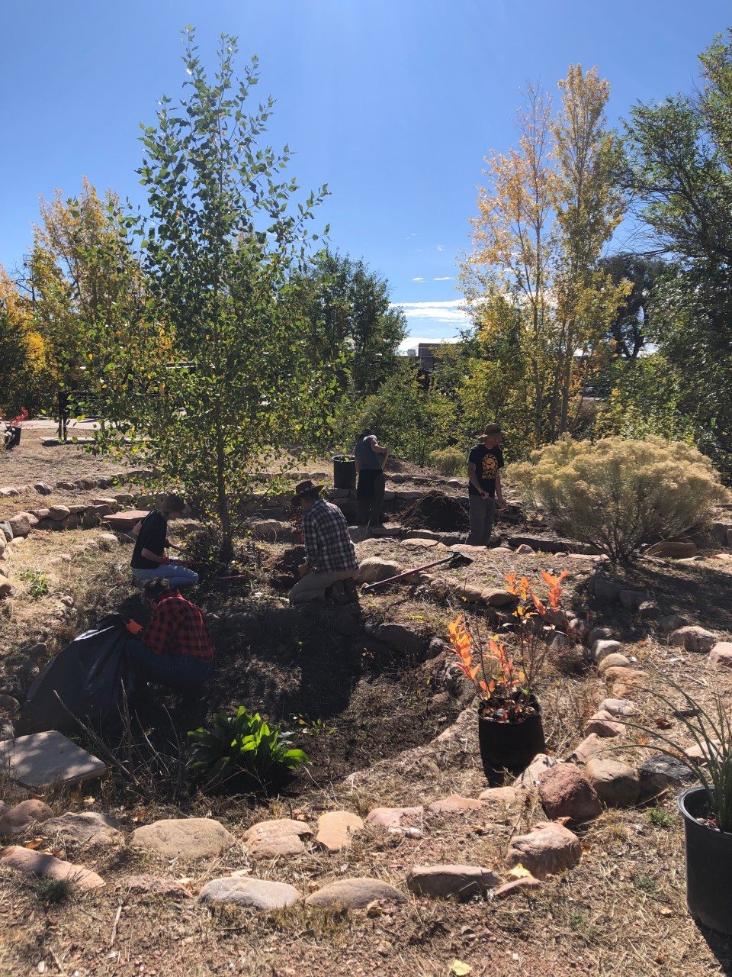
DISTINGUISH
What kinds of plants are there?
What kinds of plants provide shade?
What is meant by “integrated design” in our design statement?
What other kinds of plants might you consider in your design?
Notes:
DISTINGUISH
What kinds of plants are there?
Trees, Shrubs, Grasses, Turf, Vegetables, Fruit trees, Native, Non-native
What kinds of plants best provide shade?
Trees, large shrubs
What is meant by “integrated design” in our design statement?
Each element in the design should serve more than one function. Every function is supported by many elements.
What other kinds of plants might you consider in your design?
Grasses to clean water and increase infiltration.
Flowering shrubs can provide habitat, beauty, attract pollinators.

Slide 8
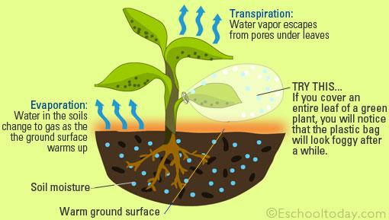
DISTINGUISH:
What is evaporation?
What is evaporation not?
What is transpiration?
What is transpiration not?
What do you think happens to the air around plants when evapotranspiration happens? Why?
Notes:
DISTINGUISH
What is evaporation?
Ask a student to define evaporation. (water changing from a liquid to gas due to the absorption of heat energy.)
What is it part of? (part of the water cycle.)
What is it not?
It’s not condensation, precipitation, respiration, or perspiration. It’s not gas changing to liquid.
DISTINGUISH
What is transpiration?
Ask students what transpiration is? (Water leaving the leaf surfaces, changing from a liquid to gas due to the absorption of heat energy.)
What is transpiration not?
It’s not evaporation, condensation, precipitation, respiration, or perspiration. It is water moving through a plant in liquid form and leaving the plant in vapor form.
Inform the students that to calculate water needs for their landscape areas, they’re going to combine these two ideas into a single measure called evapotranspiration. The reason one value is used in place of two is because it’s too difficult for scientists to measure evaporation and transpiration separately.
Ask students what they think happens to the air around plants as evapotranspiration occurs? If they have trouble imaging that, ask, them how it feels when they are in a wooded area. (The air is cooled.)
Why does the air become cooler? (because, when changing from liquid to vapor, the water molecules absorb heat energy from the air, and that leaves less heat energy in the air.)
So, trees and plants not only cool us by creating shade they also cool the air around them due to transpiration.
Evapotranspiration is the combined loss of water due to evaporation from the soil and transpiration from the plants.
To put it another way, Evapotranspiration is the process of transferring moisture from the earth to the atmosphere by evaporation of water and transpiration from plants.

Slide 9
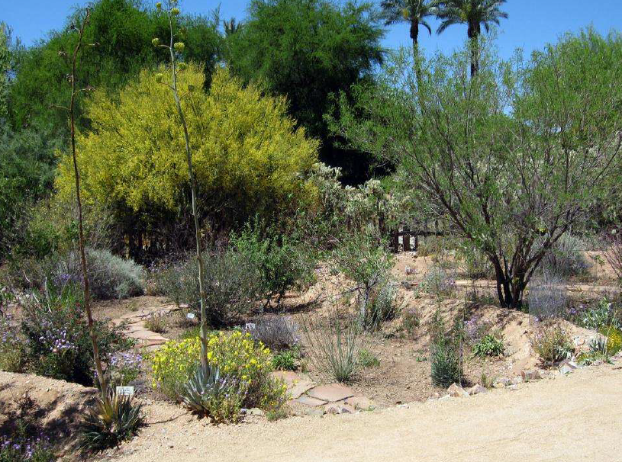
RELATE:
How does climate influence plant water use?
BUILD THE SYSTEM:
What conditions or situations might impact their plants’ watering needs?
Notes:
RELATE:
How does climate influence plant water use?
Hotter, drier climates have a higher evapotranspiration rate.
BUILD THE SYSTEM:
What conditions or situations might impact their plants’ watering needs?
Remind students that a system is a collection of parts working together as a whole. To create their rainwater harvesting systems they need to understand how much water their plants need to help determine the size of their system.
Ask students, “What conditions or situations might impact their watering needs?” type of plants, size of plants, climate (rainfall, evapotranspiration)

Slide 10
RELATE:
Looking at A Guide to Native Plants for the Santa Fe Landscape, what claims can you make based on the data about types of plants and the water requirements associated with them?
Notes:
RELATE
• Looking at A Guide to Native Plants for the Santa Fe Landscape, what claims can you make based on the data about types of plants and the water requirements associated with them?
Plants and grasses that are native to the area generally have Very Low and Low water usage. Trees that are native and don’t live near bodies of water or higher elevations that receive more snow generally have Medium and Low water usage.
(If they can’t get there, have them think about what kinds of plants they see in the natural landscape around them. Do we get a lot of precipitation locally? Do those plants use a lot of water?)

Slide 11
Notes:
Ten minutes before the end of class, have the students go and retrieve their plastic bag. Look at the plant bags together.
Have them analyze the phenomenon and interpret what they observe. They should also know how many leaves were in the bag and have an estimate of how many leaves are on the tree.

Slide 12
Notes:
Transpiration as a phenomenon:
Ask them how the water cycle works with plants.
How does water get into plants? What form is it in?
How does water get out of plants? What form is it in?
How does water get from the bottom of a plant to the top?
What enables water to move up the plant against the force of gravity?

Slide 13
What did you learn?
DISTINGUISH
What are the differences between native and non-native plants for our region?
BUILD THE SYSTEM:
What are the parts of plant water demand?
RELATIONSHIP
What are the relationships between the amount of water needed and the type, species and size of plants?
Notes:
Conclusion
DISTINGUISH:
What are the differences between native and non-native plants for our region?
BUILD THE SYSTEM:
What are the parts of plant water demand.
RELATE
What are the relationships between the amount of water needed and the type, species and size of plants?

Slide 14
What did you learn?
RELATIONSHIP
What are the relationships between the amount of water needed and the type, species and size of plants?
RELATIONSHIP
How do your plant’s watering requirements relate to your monthly rainfall amounts?
TAKE A PERSPECTIVE
From the perspective of your rainwater harvesting system, how will climate affect the plants that you choose?
Notes:
RELATE
What are the relationships between the amount of water needed and the type, species and size of plants?
RELATE
How do your plant’s watering requirements relate to your monthly rainfall amounts?
TAKE A PERSPECTIVE
From the perspective of your rainwater harvesting system, how will climate affect the plants that choose?

