Slide 1
Lesson Seven Calculating Plant Water Needs
How much water do the plants we have picked need for the year?
Notes:
Connect to the Unit
In Lesson 6, students explored the watering needs of different types of plants. They learned that plants can be categorized by water needs: Very Low, Low, Moderate, High, and Very High. Very Low and Low water plants for our area are typically native species. Students evaluated the use of native versus non-native plants in their gardens. They engaged in an experiment to observe evapotranspiration. Finally, students were given time to research the watering needs of plants for the landscape they intend to create.
Launch the lesson
In this lesson, students will calculate the water demand for the plants on their project landscape. They will determine how to grow shade while meeting the watering requirements of their plants through passive rainwater harvesting.

Slide 2
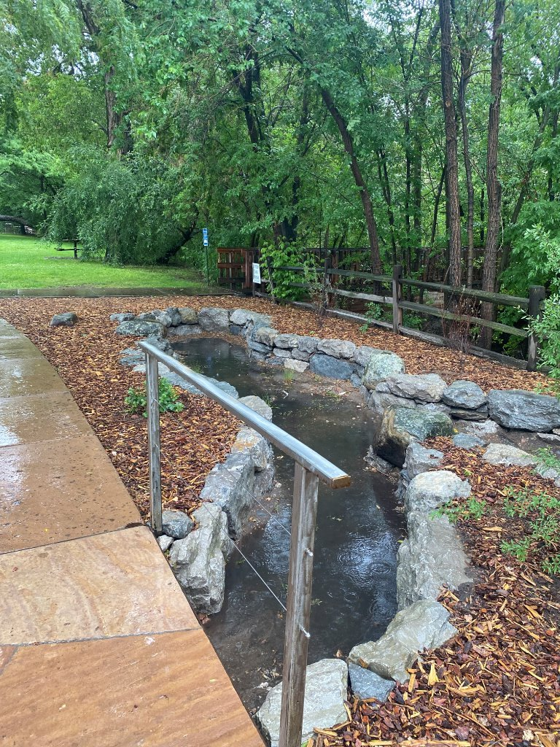
DISTINGUISH:
What’s the problem?
What do we know?
What don’t we know?
How will you design a passive rainwater harvesting system that will provide shade and sustain your plants year-round through the most efficient use of available water?
Notes:
Remind the students of the driving question and orient them to where they are in the process of answering that question:
What do we know?
Students should now know: the amount of rainfall they can collect for their site, how water moves through their site, the types of plants, and the number of each type of plants.
What don’t we know?
Students need to determine the specific water needs for their landscape in order to sustain it throughout the year.

Slide 3
Notes:
Where are we in the engineering design process?
We are Imagining, Improving and Planning in our effort to find the best solution as defined by our criteria and constraints.

Slide 4
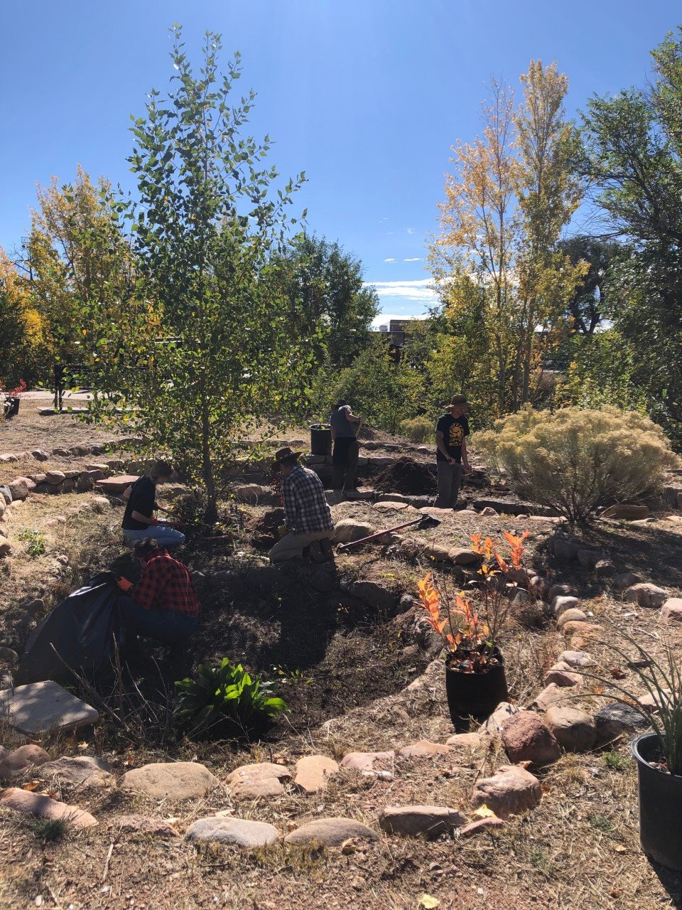
DISTINGUISH
What functions does my rainwater harvesting system provide?
Notes:
DISTINGUISH
What functions does my rainwater harvesting system provide?
Students should be able to list functions beyond just providing shade. Others may include infiltrating water, cooling through evapotranspiration, habitat, attracting pollinators, reduce flooding.

Slide 5
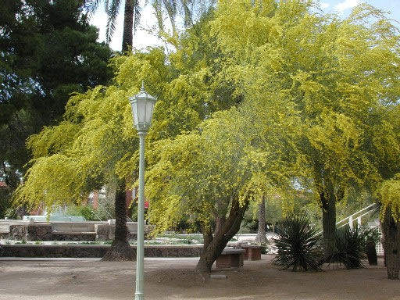
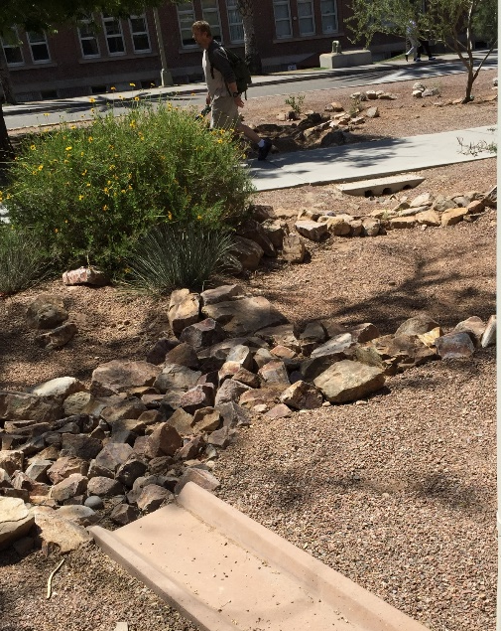
RELATE
• What are the relationships between the chosen plants and the function(s) that each plant serves?
Notes:
RELATIONSHIP
What are the relationships between the chosen plants and the function(s) that each plant serves?
Each element in an integrated design should serve more than one function, and every function is supported by many elements. Relate the elements or structures to functions in your system.

Slide 6
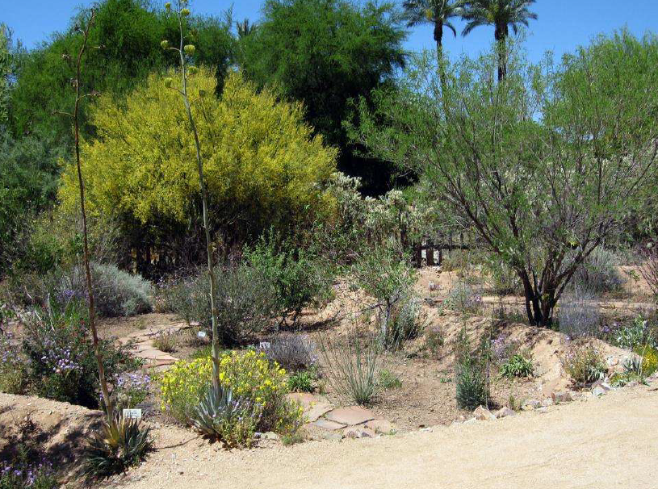
BUILD THE SYSTEM:
How much water do your plants need?
Notes:
BUILD THE SYSTEM:
How much water do your plants need?
Students will learn and apply the factors involved in calculating the water needed to sustain the plants on their project site.
At this point, students should have identified the existing types of vegetation and their plant water use needs. Students should also have identified in their designs the number of each type of plant and their corresponding water use requirements. Do not move forward with the lesson until this information is acquired.

Slide 7
Notes:
Engineering Design Steps
Direct students through the Imagine and Improve & Plan steps:
Complete Water Budget Calculation Worksheet_Santa Fe
Did your water budget balance?
Yes – Continue to Create phase
No – Adjust plants and harvest surface area as necessary
Repeat steps

Slide 8
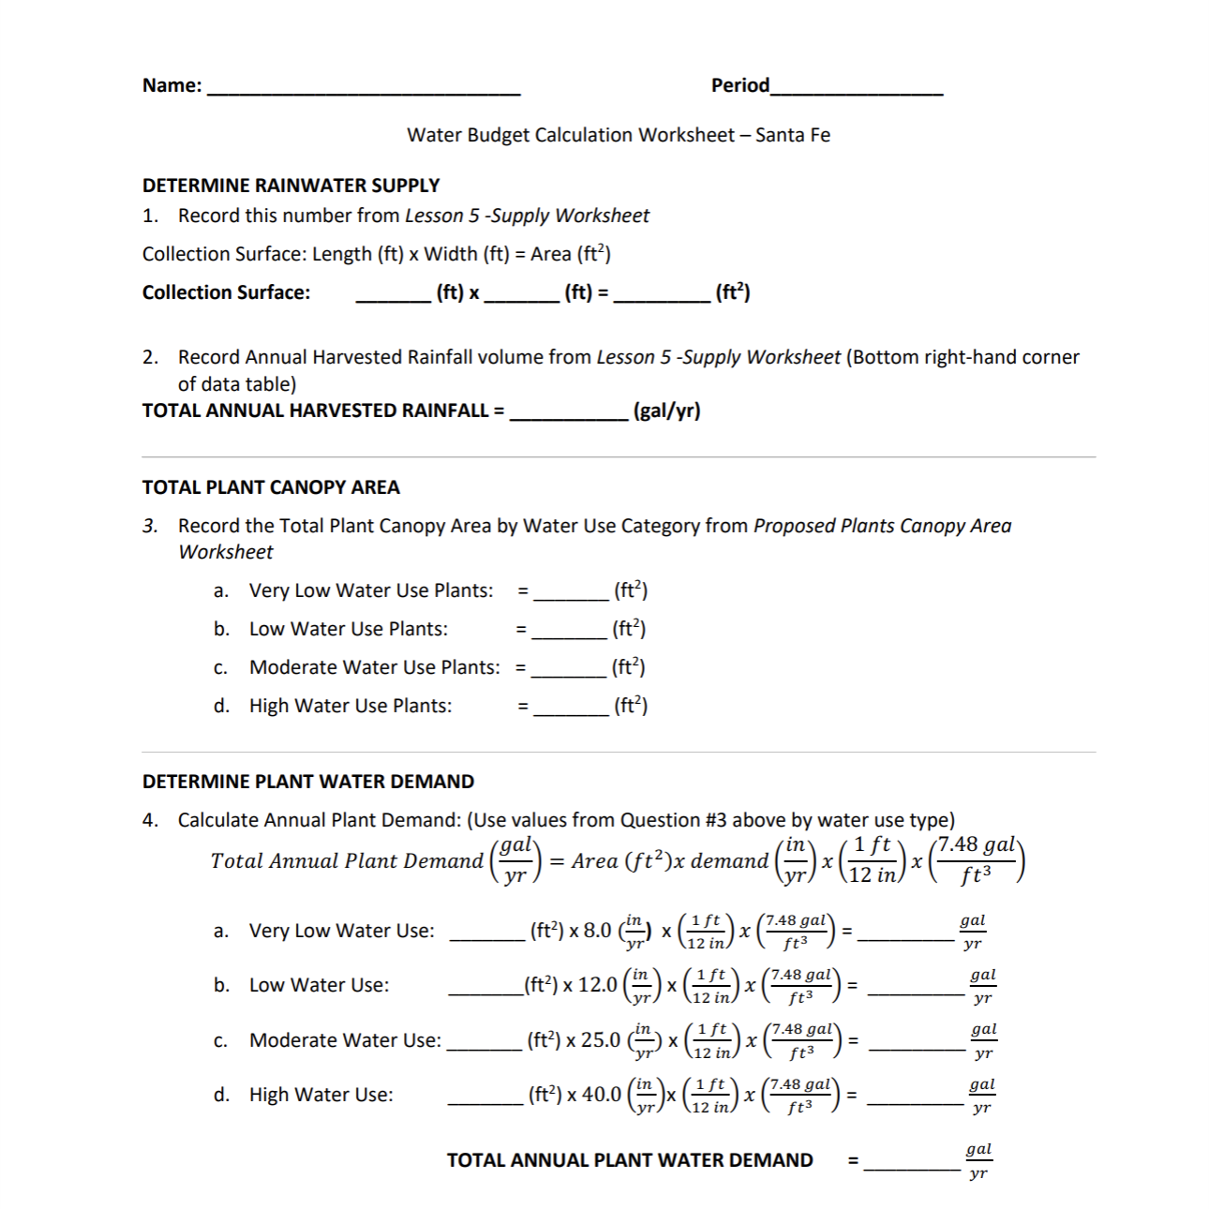
Water Budget Calculation Worksheet

Slide 9
Problem: How will you design a passive rainwater harvesting system that will provide shade and sustain your plants year-round through the most efficient use of available water?
Step 2: Criteria
Criteria are requirements or conditions that must be met to solve the problem.
They may come from the customer: the plants must be taken care of year-round.
They may come from what you know: plants need more water when it’s hot, less when it’s cool.
They may need to be clarified by research: different plants need different amounts of water; how much do the plants in this design need?
What design criteria should we consider for our systems?
Notes:
What is your total water demand?
Once students have completed the demand worksheets and applied DSRP thinking to analyze and interpret the data, return to your criteria and constraints lists. Ask:
Which of the criteria and constraints questions does this exploration answer?
Which criteria and constraints have been specified, clarified or quantified by this exploration?
What new criteria and constraints should be added to each list based on this exploration?

Slide 10
Problem: How will you design a passive rainwater harvesting system that will provide shade and sustain your plants year-round through the most efficient use of available water?
Step 3: Identify Constraints
Constraints are limitations or restrictions.
They may also come from the customer: the project may not cost more than $1000.00.
They may come from what you know: we cannot run a hose across the sidewalk because it would be a trip hazard.
They may have to be clarified through research: we live in an arid place, we get more rain during some months than other months, how much rainfall should we design our system for?
What kinds of constraints will limit our design?
Notes:
What is your total water demand?
Once students have completed the demand worksheets and applied DSRP thinking to analyze and interpret the data, return to your criteria and constraints lists. Ask:
Which of the criteria and constraints questions does this exploration answer?
Which criteria and constraints have been specified, clarified or quantified by this exploration?
What new criteria and constraints should be added to each list based on this exploration?

Slide 11
What did you learn?
DISTINGUISH
How will the plants that you’ve selected meet the engineering design criteria of providing shade and serving other functions in the integrated design of the rain basin?
BUILD THE SYSTEM
What are the variables that you used to calculate the watering needs for the project site?
Notes:
Conclusion
DISTINGUISH:
How will the plants that you’ve selected meet the engineering design criteria of providing shade and serving other functions in the integrated design of the rain basin?
BUILD THE SYSTEM
What are the variables that you used to calculate the watering needs for the project site?

Slide 12
What did you learn?
RELATE
What are the relationships between the amount of water required for native, desert-adapted and non-native plants?
TAKE A PERSPECTIVE
From the perspective of the data collected to this point, what will your rainwater harvesting system design need to accomplish?
Notes:
RELATE:
What are the relationships between the amount of water required for native, desert-adapted and non-native plants?
TAKE A PERSPECTIVE:
From the perspective of the data collected to this point, what will your rainwater harvesting system design need to accomplish?

