Slide 1
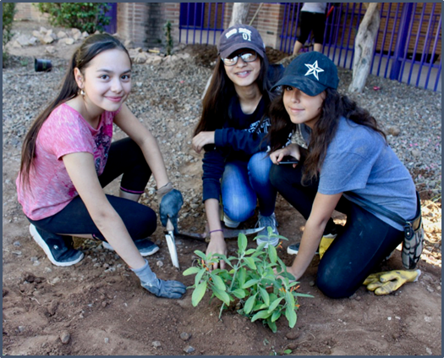

Lesson Eight
Basin Sizing
How do we size and design our basins?
Notes:
Launch the Lesson
Students will be reminded of the four major parts of a passive rainwater harvesting system: collection, conveyance, infiltration and storage. They know how much water they can collect from their collection area and they know what plants they can grow with that water in order to meet the engineering design problem. Now they will have to figure out another part of the puzzle. They will need a way for their plants to access the water. They will need to plan and size their infiltration basins.
Students will be sizing their basins based on the 100-year storm or flood event for their region. They will use data on the percolation or infiltration rate to figure out the depths of their basins. They will have to iterate back and forth between depths and surface areas in order to store the amount of water needed for their plants.

Slide 2

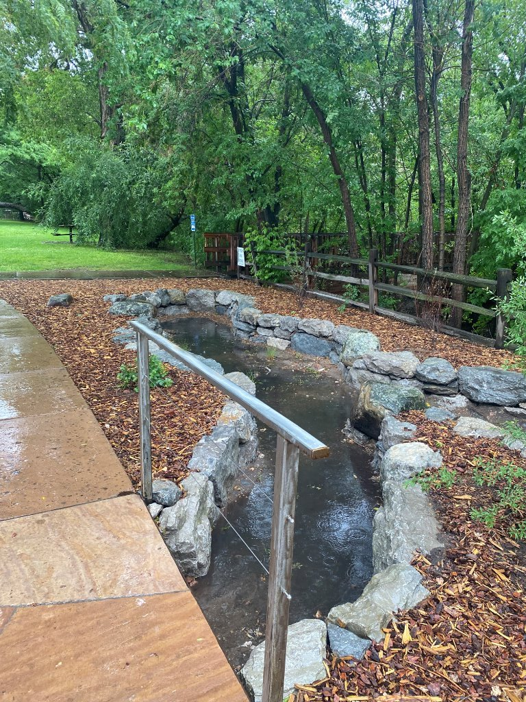
DISTINGUISH:
What’s the problem?
What do we know?
What don’t we know?
How will you design a passive rainwater harvesting system that will provide shade and sustain your plants year-round through the most efficient use of available water?
Notes:
Remind the students of the driving question and orient them to where they are in the process of answering that question:
What do we know?
Students should now know: the amount of rainfall they can collect for their site, how water moves through their site, the types of plants, and the number of each type of plants.
What don’t we know?
Students need to determine the specific water needs for their landscape in order to sustain it throughout the year.

Slide 3



BUILD THE SYSTEM:
What are the parts of a rainwater harvesting system?
RELATE:
How are the parts related to our criteria and constraints?
Notes:
BUILD THE SYSTEM:
What are the parts of a rainwater harvesting system? Ask students if they remember the 4 major parts or roles of a rainwater harvesting system that were discussed earlier in the unit. They should recall collection, conveyance, infiltration and storage.
RELATE:
How are the parts related? Have a discussion about how each of components could be connected to each other. Though covered previously, students should now have a deeper understanding of the relationships.

Slide 4
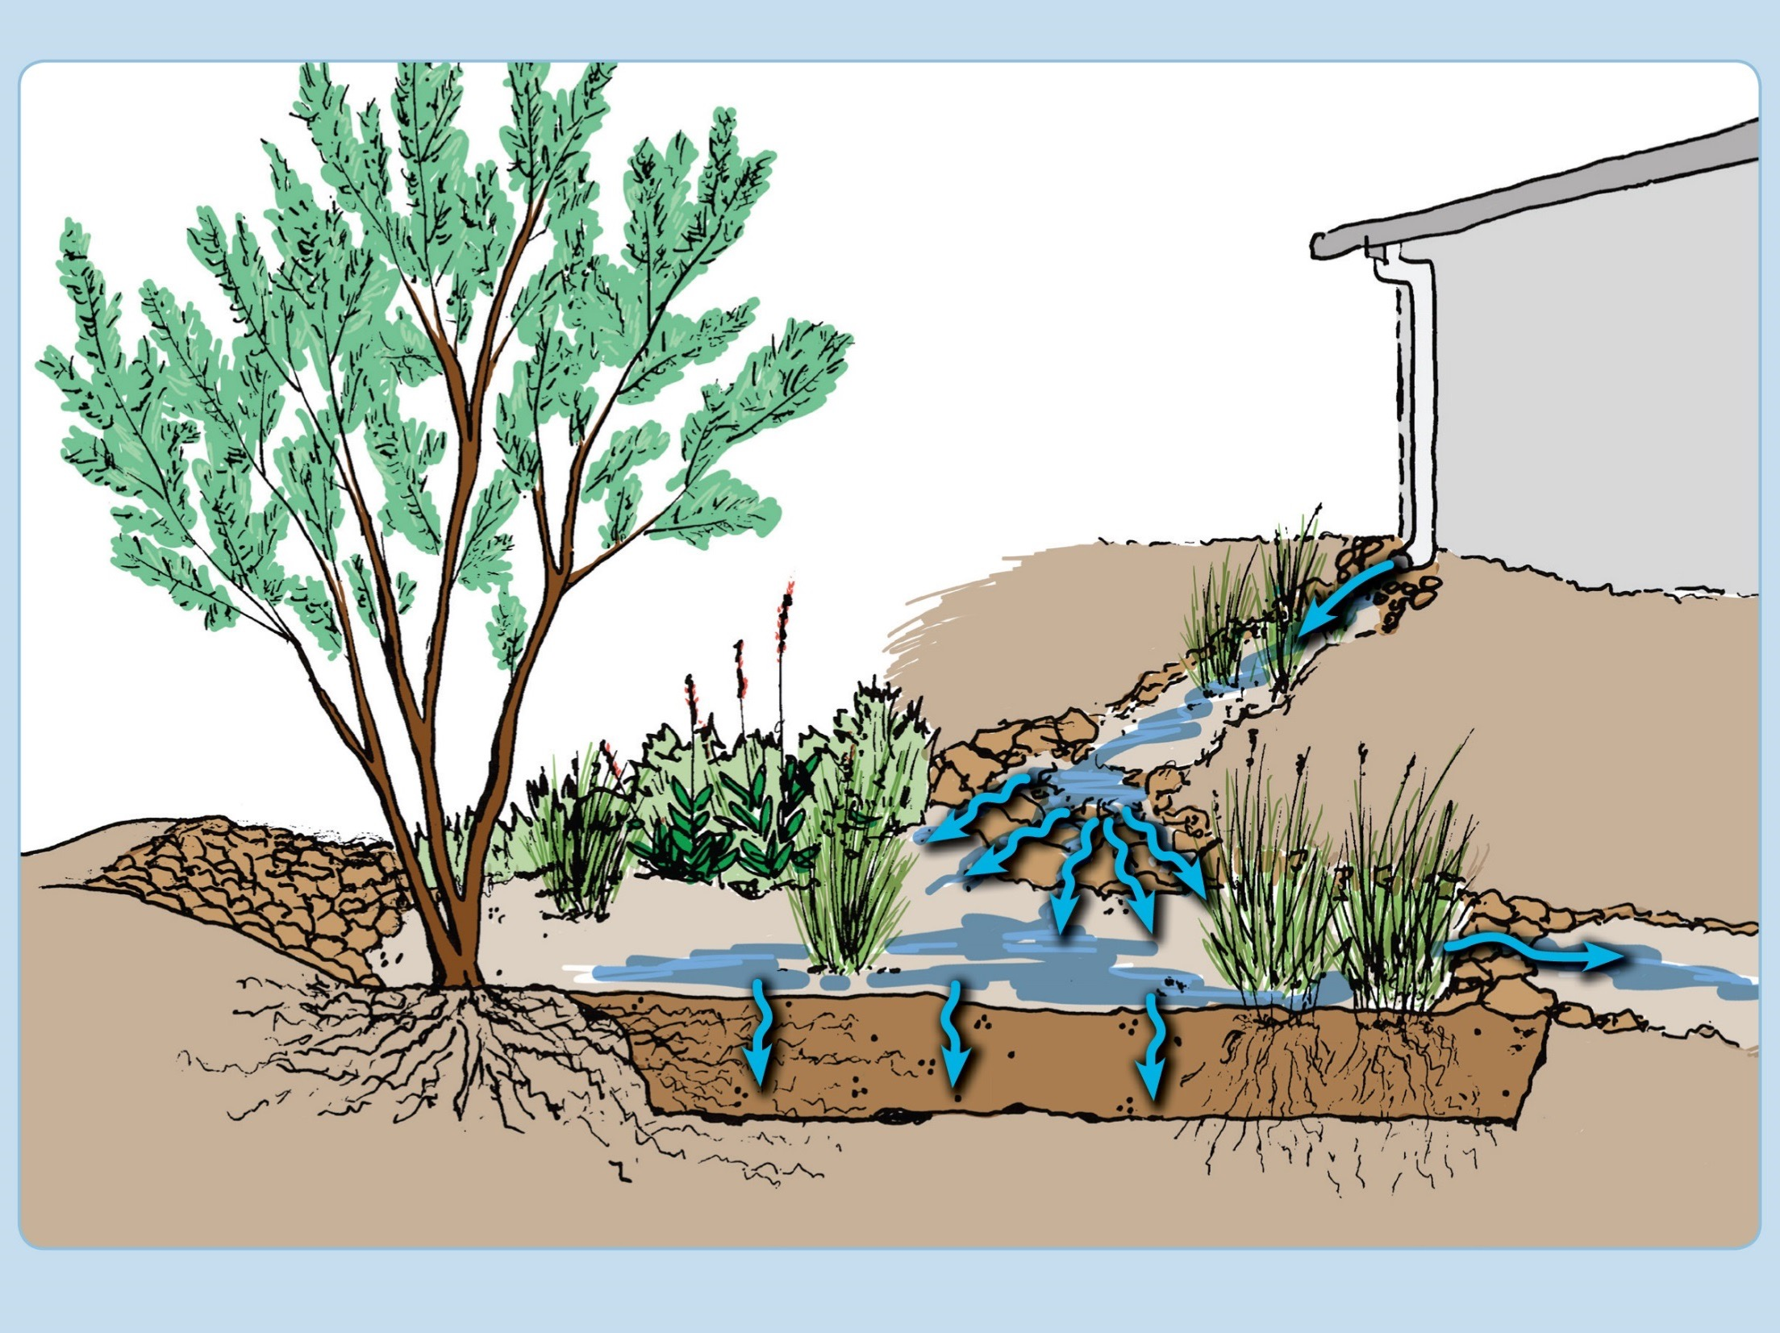
1. Collection
2. Conveyance
3. Infiltration
4. Storage
Notes:
The slides below will assist in facilitating a discussion about how each of components are connected to each other. Though covered previously, students should now have a deeper understanding of the relationships.

Slide 5
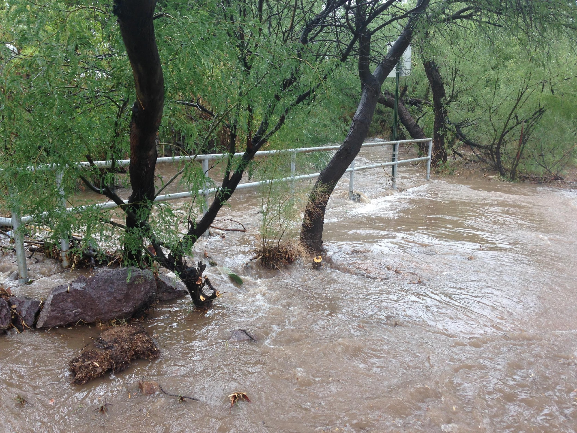
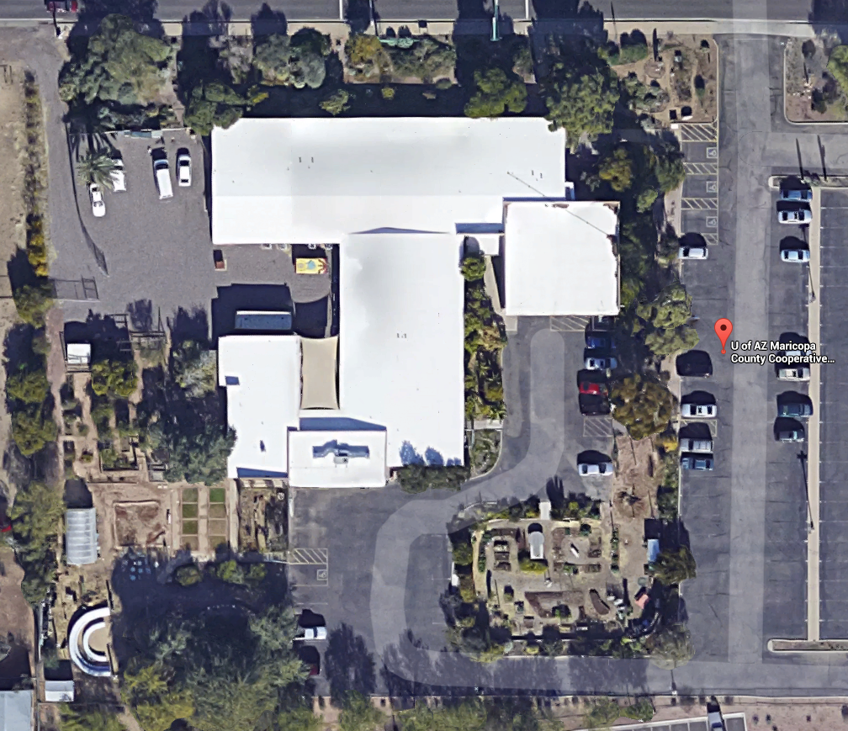
DISTINGUISH: What are the parts of Collection?
Notes:
Collection includes type of surface, size of surface and amount of rain.

Slide 6
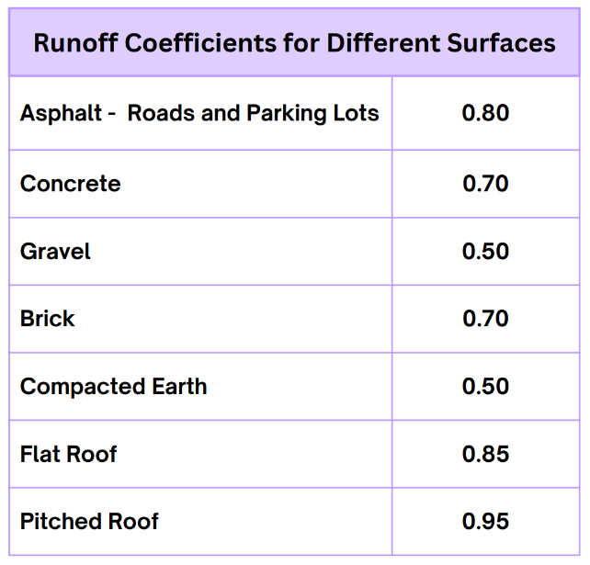


RELATE: What are the relationships between the amount of water that falls on a surface and the amount of water that runs off a surface?
Notes:
RELATE: What are the relationships between the amount of water that falls on a surface and the amount of water that runs off a surface?
Do you remember our rainwater harvesting challenge that started this engineering unit? Give student groups time to discuss and articulate the answers.
What else do we need to take into consideration?
It’s the question of how much of the water actually runs off of your roof. The amount of water that will run off a particular surface differs depending on the surface. Permeable surfaces allow rainwater to sink in. Impermeable surfaces shed rainwater. To take this effect into consideration when calculating runoff volumes, a runoff coefficient (Cw) is used.
The runoff coefficient is the proportion of water that runs off a particular surface. It accounts for the loss of some water that is captured and stays on the surface rather than running off.
Do the math: Use rainfall data, your roof area and your runoff coefficient to calculate water to be collected on a monthly and annual basis.
Have students complete the SUPPLY Worksheet to calculate the amount of water that can be collected from their rooftop collection area. The SUPPLY Worksheet is also available as an excel spreadsheet with formulas already inserted if you prefer to have students do this work on computers.

Slide 7
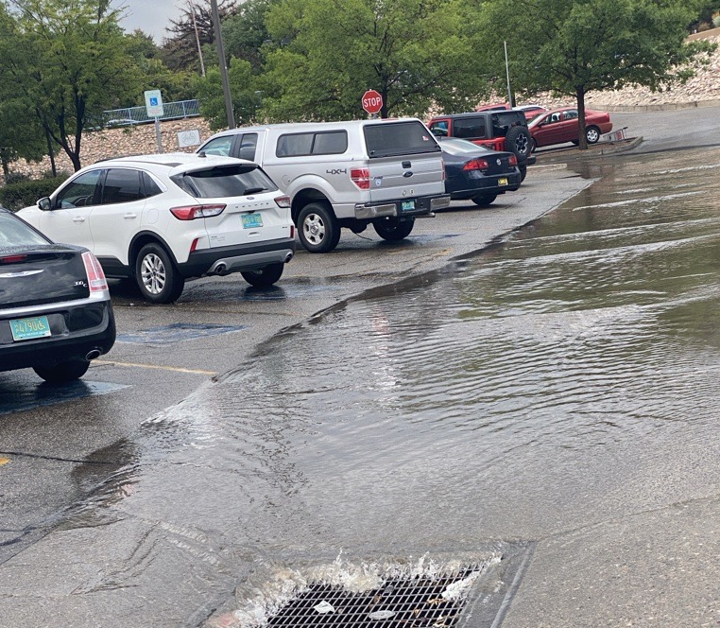
RELATE:
What is the difference between a roof area and a paved area?
Which do you think would be easier to harvest water from?
What can you add to Criteria/Constraints for Collection?
Notes:
RELATE:
What is the difference between a roof area and a paved area?
Ones higher and ones lower.
Which do you think would be easier to harvest water from? In most cases the higher one .. because you can use gravity to help you move it in to your system.
This ties into our Rainwater Harvesting Principles: Start at the top of the watershed and leads us into Conveyance

Slide 8
DISTINGUISH: What are the parts of Conveyance?
1. Collection
2. Conveyance
3. Infiltration
4. Storage
Notes:
Elevation differences, gravity, infrastructure like rain gutters and downspouts,

Slide 9
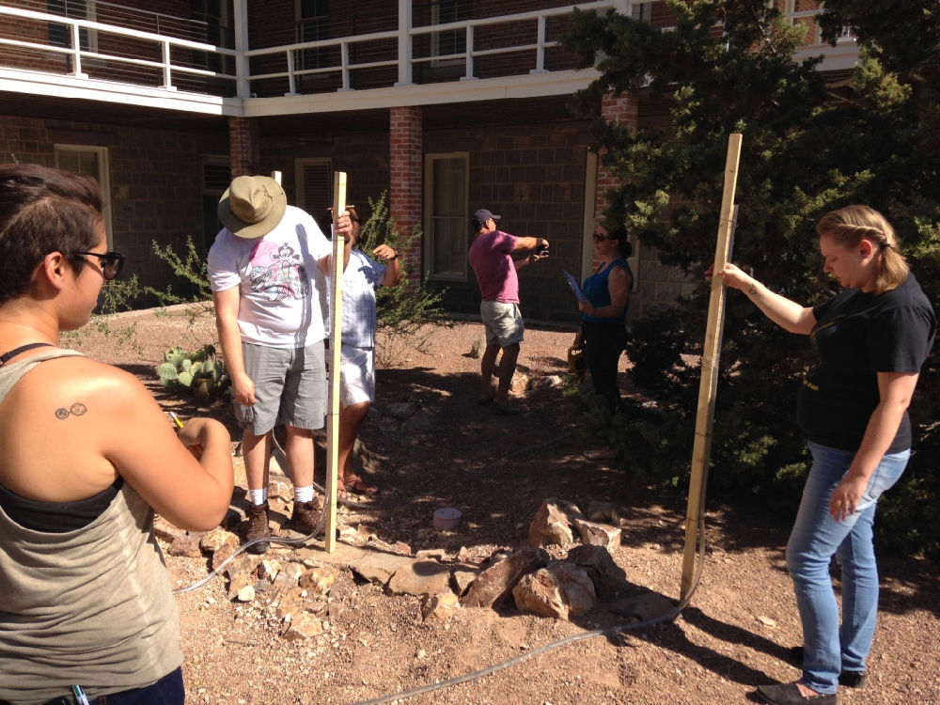
RELATE:
How do the parts of Conveyance relate to your design?
How are you using gravity?
What does that look like in your system?
What Constraints do you have?
Notes:
How do the parts of Conveyance relate to your design?
How are you using Gravity?
What does that look like in your system?
What Constraints do you have?

Slide 10
DISTINGUISH: What are the parts/constraints of Infiltration?
1. Collection
2. Conveyance
3. Infiltration
4. Storage

Slide 11
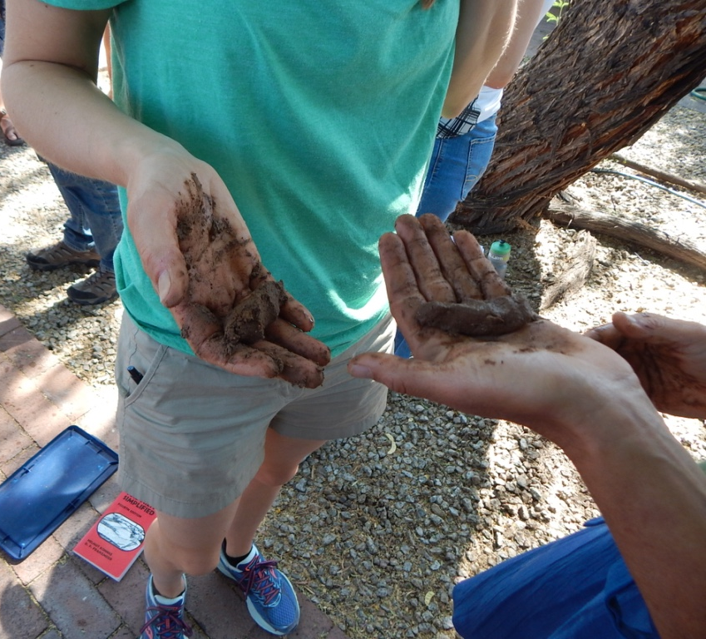
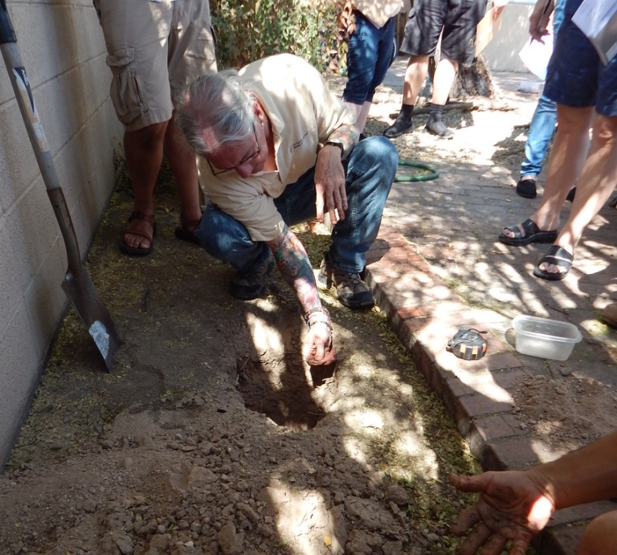

Infiltration Parts/Constraints
Notes:
Types of soil, percolation rate, mulch, and time: we need to sink the water in a basin within 96 hours. These are all Constraints for our design. We cannot change them.

Slide 12
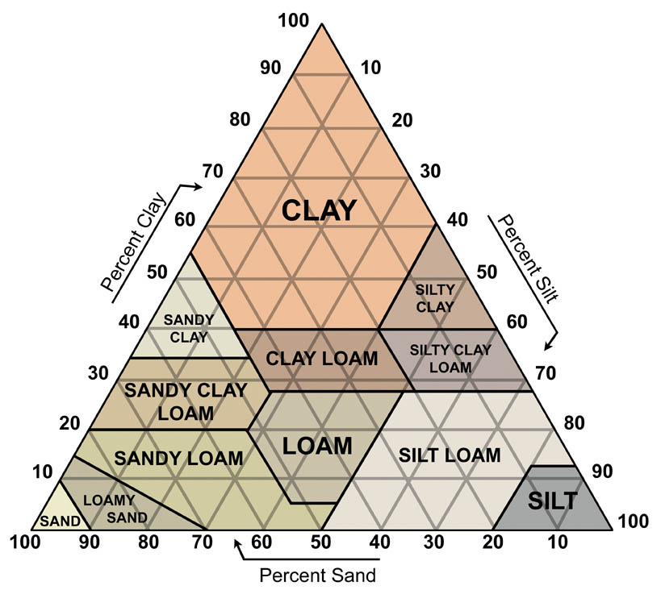
Soil Assessment at School
What will happen when rainwater falls on the soil at your school?
Conduct jar test: Dig a hole at least 1 foot deep. Fill a jar half full of soil. Shake sample in jar, allow soil to settle out
The next day have students estimate the percentages of different particle sizes and use the soil texture triangle to figure out the soil type.
Notes:
Soil – Infiltration
Ask, “Do you remember doing the Jar Test in Lesson 4?”
BUILD THE SYSTEM:
What are the parts of the ground below the basin bottom?
Soil types, compaction levels and spaces between soil particles that allow water to pass through.
Percolation rate - How quickly does water sink or infiltrate into the ground at the site.

Slide 13
What will happen when rainwater falls on the soil at your school?
Texture | Estimated Permeability
Sand, loamy sand | Rapid and very rapid (>6.0 in/hr)
Sandy loam | Moderately rapid (2.0 - 6.0 in/hr)
Loam, silt loam | Moderate (0.6 - 2.0 in/hr)
Sandy clay loam | Moderately slow (0.2 - 0.6 in/hr)
Clay loam, silty clay loam | Moderately slow (0.2 - 0.6 in/hr)
Rules of Thumb above estimated from Soils Interpretation Help Sheet, Soils CDE – Interpretation Sheet (November 2010)
Notes:
Soil Types and Permeability
As they discovered by performing the Lesson 4 jar test, sandier or more gravelly soils will allow water to infiltrate faster. Silt and clay inhibit the flow of water into the ground. Soil composition directly relates to how deep a basin should be constructed.

Slide 14
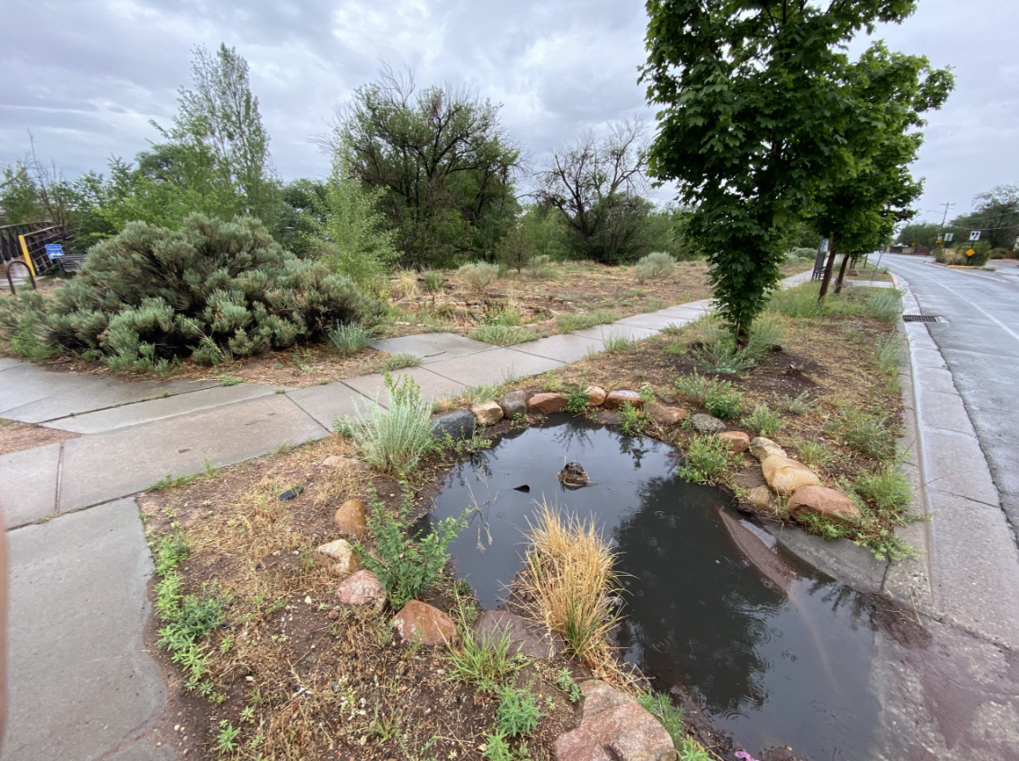
What about standing water?
Notes:
Basins – Potential Issue
What happens when water is left standing in a basin over time? Mosquitos breed. Mosquitos are vectors for several diseases which are currently on the rise due to climate change.
How does a city manage standing water? Ordinances tell us that all stormwater in a man-made basin must infiltrate into the ground in 96 hours – this is a criteria if it hasn’t already been listed.

Slide 15
Summarize Criteria/Constraints of Infiltration
Relate Soil Type to Infiltration
Relate 96-hour requirement to Infiltration
Same Volume of Water different basin surface areas, which will infiltrate quicker?
Volume of H₂O
Volume of H₂O
Basin Surface Area
Basin Surface Area
Notes:
Soil type will determine the infiltration rate of the water.
State regulations require that water infiltrates within 24 hours in a basin.
The time for a set volume of water to infiltrate will decrease if spread over a wider basin area.

Slide 16
DISTINGUISH: What are the parts/criteria of Storage?
1. Collection
2. Conveyance
3. Infiltration
4. Storage

Slide 17
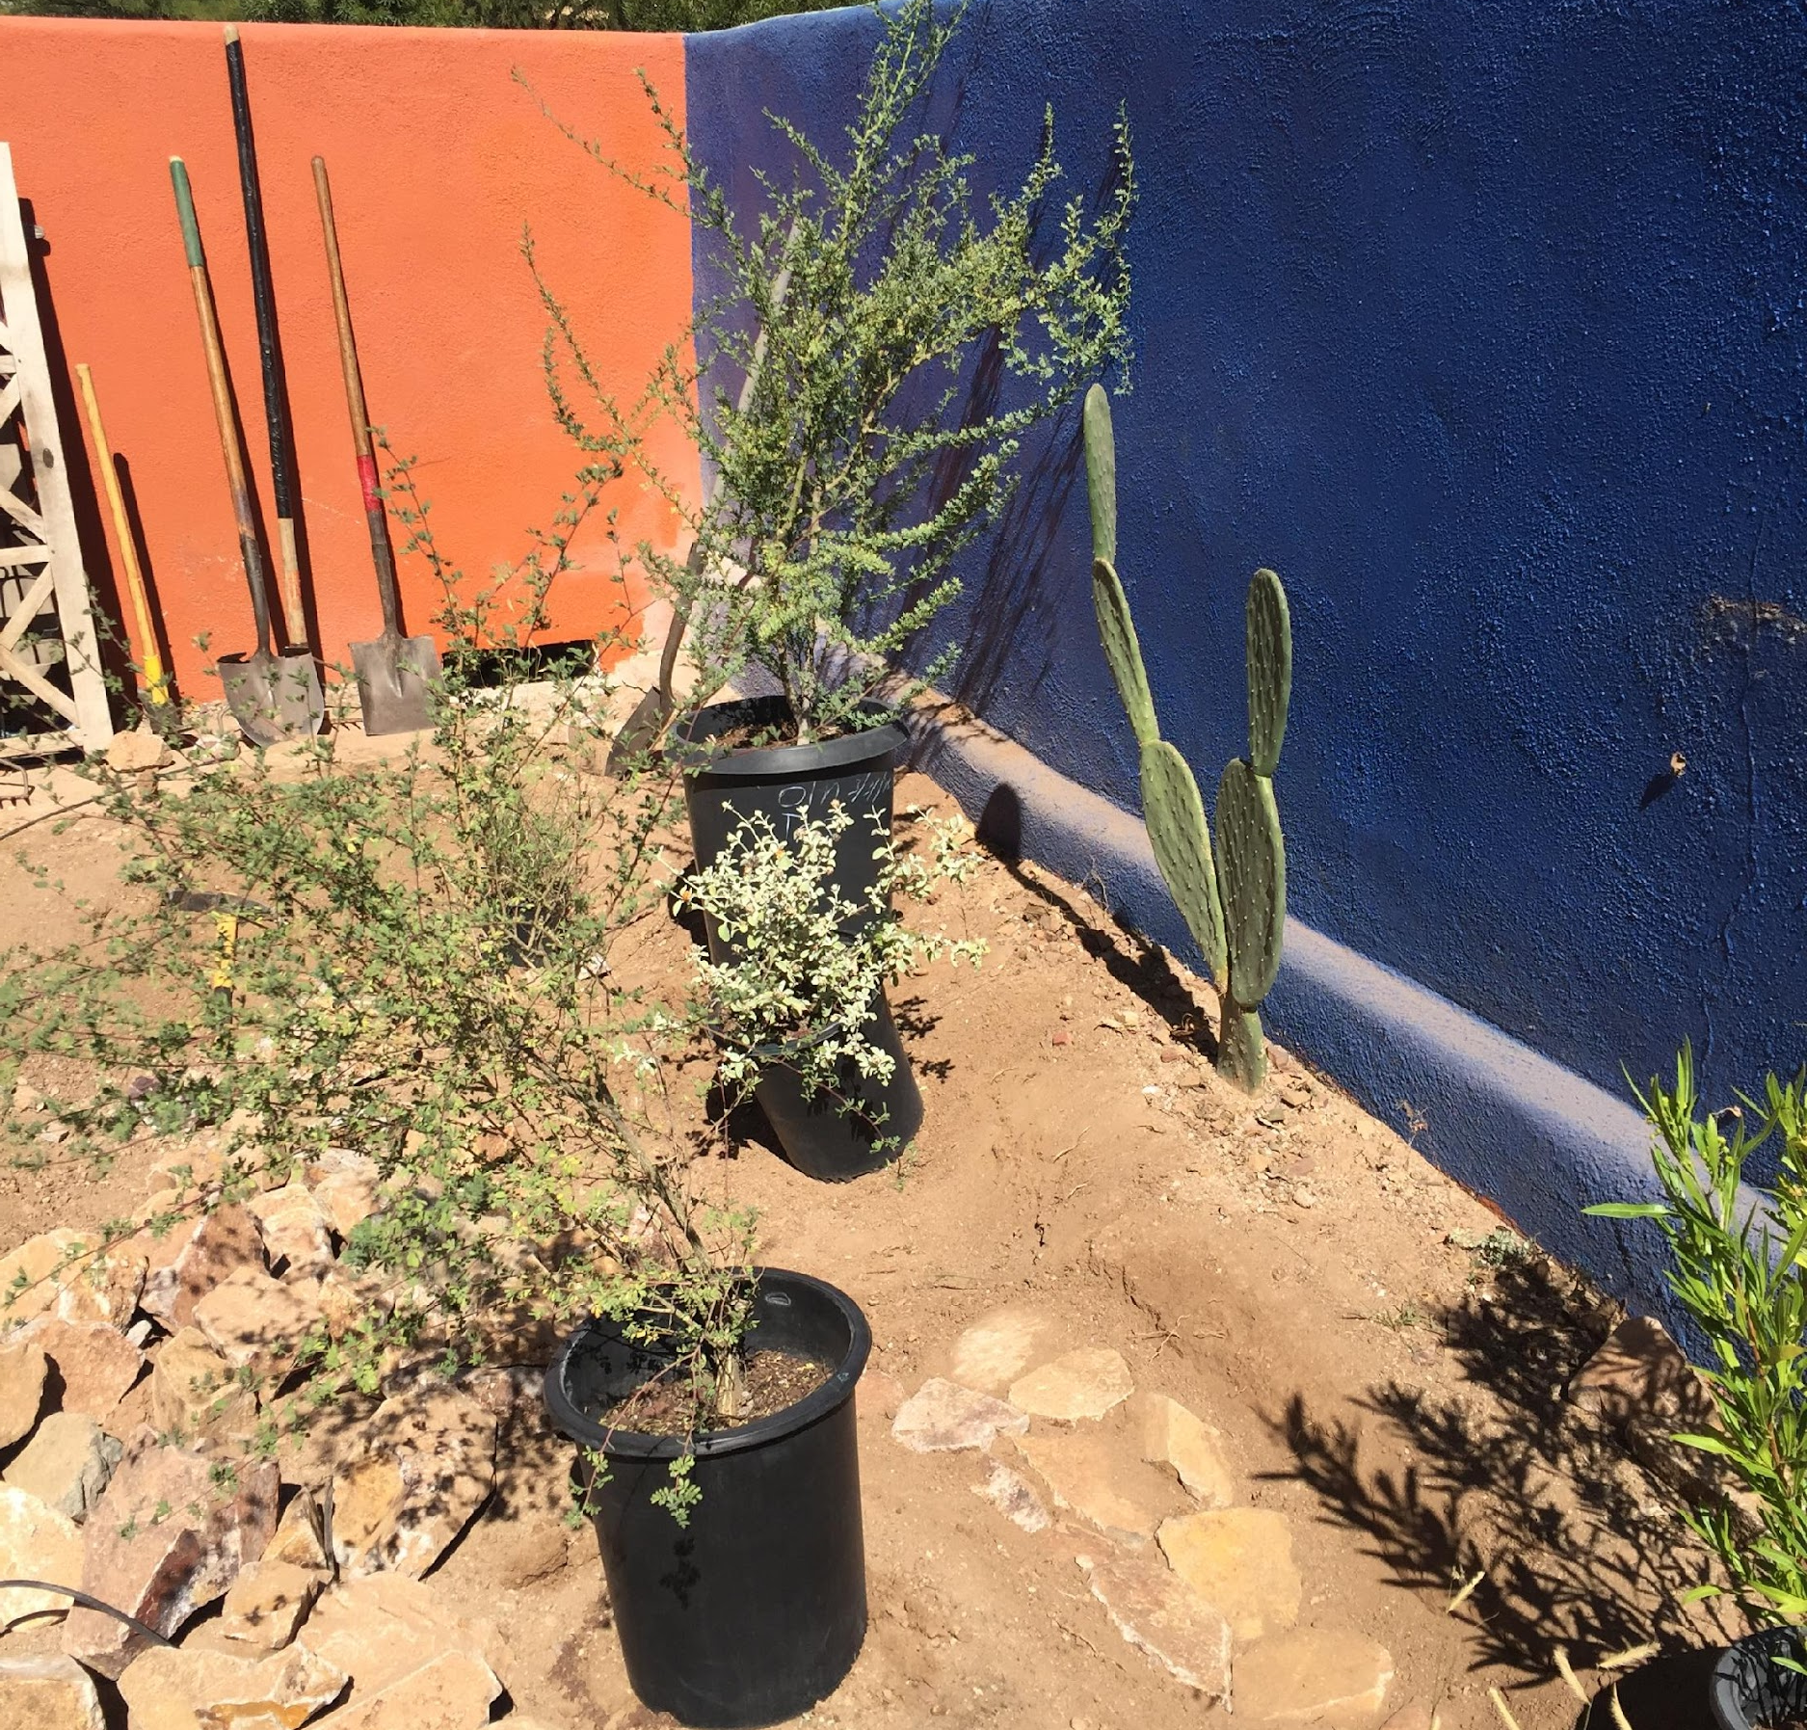
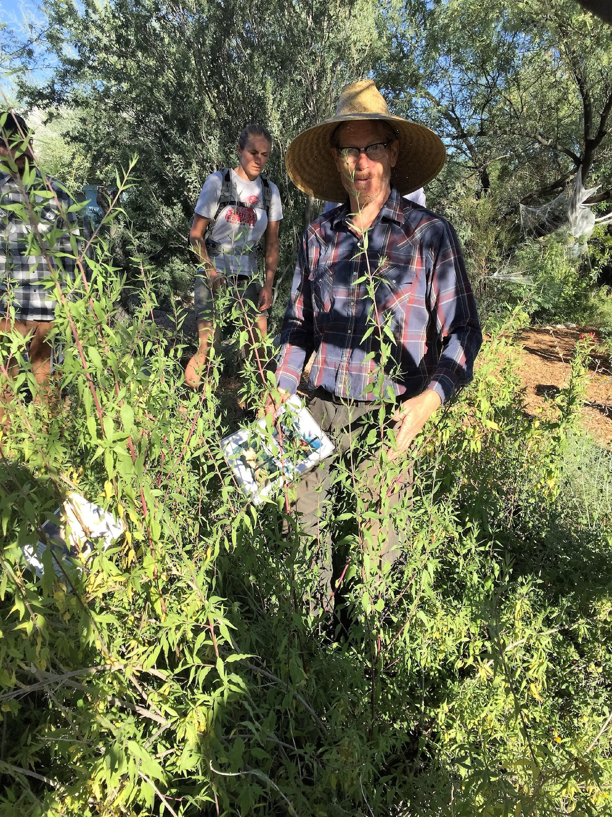
Plants!!!!
Store water
Grasses assist with infiltration
Notes:
Plants

Slide 18
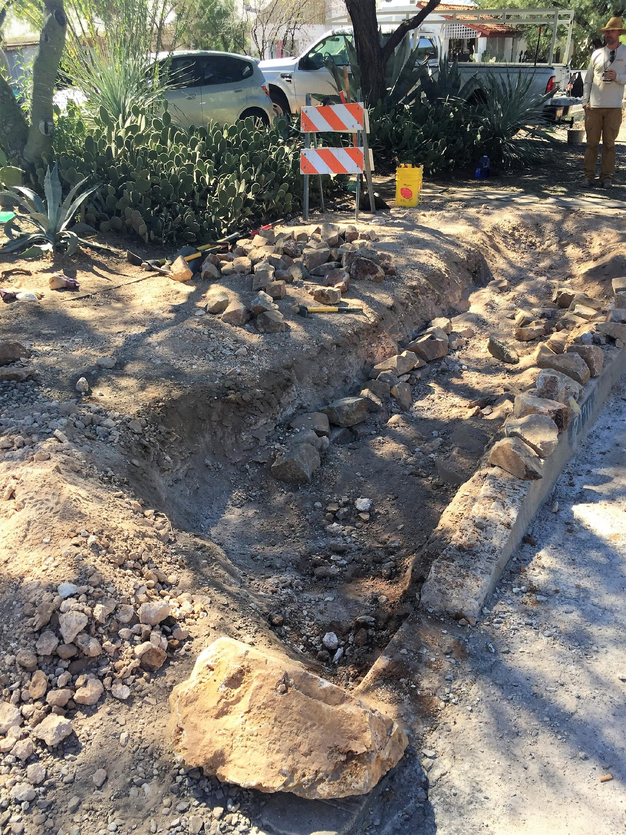
Area/Volume of Basin(s)
Notes:
We will determine how to calculate this.

Slide 19
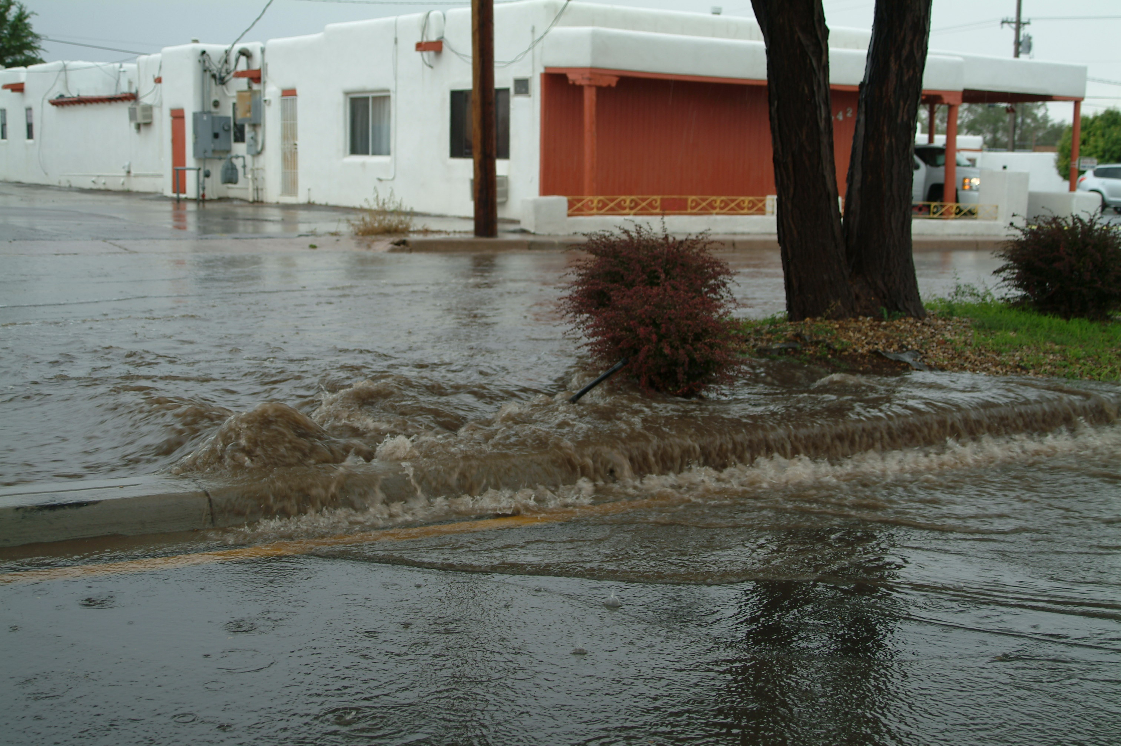
Constraint
Infiltrate Water in 96 - hours
Do we only want to do that some of the time or all of the time?
Any ideas what our worst-case scenario would be?
Notes:
We are required to infiltrate water within 96 hours by state water laws. This does not mean that we can selectively agree to obey the law. We also want to plan for our worst case scenario of a 100 year flood event,

Slide 20
Figuring out the 100-year Storm Event for your Region
NOAA Site:
https://hdsc.nws.noaa.gov/pfds/
Find your location on map by moving red cross-hair icon to your city
Scroll down to table
Select the value on top bar of 100 years
Scroll down to 60-min and record the rainfall amount (inches)
Santa Fe: _____ inches
Notes:
NOAA publishes data for the amount of rainfall that occurs in large storm events:
https://hdsc.nws.noaa.gov/pfds/
These are designated by the probability that they will occur. A 100-year storm event based upon climate records is statistically calculated to occur every 100 years. Ask students, “Does that mean that they will only occur every 100 years?” No, they can occur more often and even on consecutive days depending on weather patterns. Tell them that as the climate changes, we are experiencing more extreme storm events across the globe.
Ask again, “What volume of rain should we engineer our basins to handle if space is not an issue?” The volume of rain from a 100-year storm event. Have students follow the directions on the slide or do so through projection for the whole class.
In Santa Fe, we need to size our basin to handle a 2.0” rain event.
Review:
Again, how do we calculate that amount of water that comes off our collection area in a 100-year storm event? We use the same formulas we used in Lesson 5 except we plug in the rainfall for our hundred-year event to help us determine how big our basins need to be.

Slide 21
What is the equation to determine the amount of water our basin should be able to collect during a 100-year storm event?
Insert the rainfall value for a 100-year flood in inches.

Slide 22
So, how can we determine basin size?
Basin size is based upon volume of water in 100-year storm event.
Volume = Length x Width x Height (depth)
What is our Surface Area?
Length x Width of the basin
What are the units for Surface Area?
Feet²
What dimension are we missing from our equation?
Depth
What are the units for depth?
Feet
What else do we need to know to figure out Depth?
Notes:
So, again, how do we calculate basin size?
Basin size is based upon Volume.
Volume = Length X Width X Depth
Surface area: Length x Width of the basin.
What are the units? Feet squared
What dimension are we missing? Depth.
What are the units? Feet.
Ask students “What else should we consider to figure out what depth our basins should be?” How hard is the ground, what depth would cause sides to be too steep?
Are their safety considerations?
There is also a constraint set by our state government that we must not have any standing water after 96 hours.

Slide 23
Percolation Rate – Basin Depth
Texture | Estimated Permeability
Sand, loamy sand | Rapid and very rapid (>6.0 in/hr)
Sandy loam | Moderately rapid (2.0 - 6.0 in/hr)
Loam, silt loam | Moderate (0.6 - 2.0 in/hr)
Sandy clay loam | Moderately slow (0.2 - 0.6 in/hr)
Clay loam, silty clay loam | Moderately slow (0.2 - 0.6 in/hr)
Perc Rate (in/hr) | Hours | Rate | Depth Basin (in) | Depth Basin (ft)
0.5 | 24 | Slow | 12 | 1
1.0 | 24 | Average | 24 | 2
1.5 | 24 | High Average | 36 | 3
2.0 | 24 | Fast | 48 | 4
Notes:
Examples of percolation rates with Basin Depth.
This takes us back to our infiltration or Perc test based upon soil type. What is an infiltration rate? It is how many inches of water go into the ground over time. This slide is an example of infiltration rates.
What this tells us is the maximum depth of our basin based on how fast water moves through the soil. Let’s physically think about these numbers. (pull out a yard stick or measuring tape) Do we want a basin 4 feet deep, on a school ground where kids run around? No, it is safety risk. Is this a constraint? Yes, we need to look at our perc rate and think of safety issues when designing our basin depths.
Remember from Lesson 4, we discussed Slope Safety:
Slope Safety. Steeply sloped basins can be hazardous to people and pets. A general rule of thumb is to maintain 3:1 slope ratio, or less, when creating berms and basins. This means for every 3 units of horizontal distance, you go down 1 unit vertically on slopes. If you have Average or Slow infiltration rates, your basin should be shallower, requiring even less slope in your basin design.

Slide 24
Basin Volume
Volume of basin = length x width x depth
  Choose the depth of the basin based on perc rate.
  Pick the limiting dimension length or width and determine the remaining dimension.
  Determine length of basin:
    Length = (volume of water for 100-year storm event) / (width x depth)
Work with Constraints of land area- spread volume into multiple basins if needed.

Slide 25
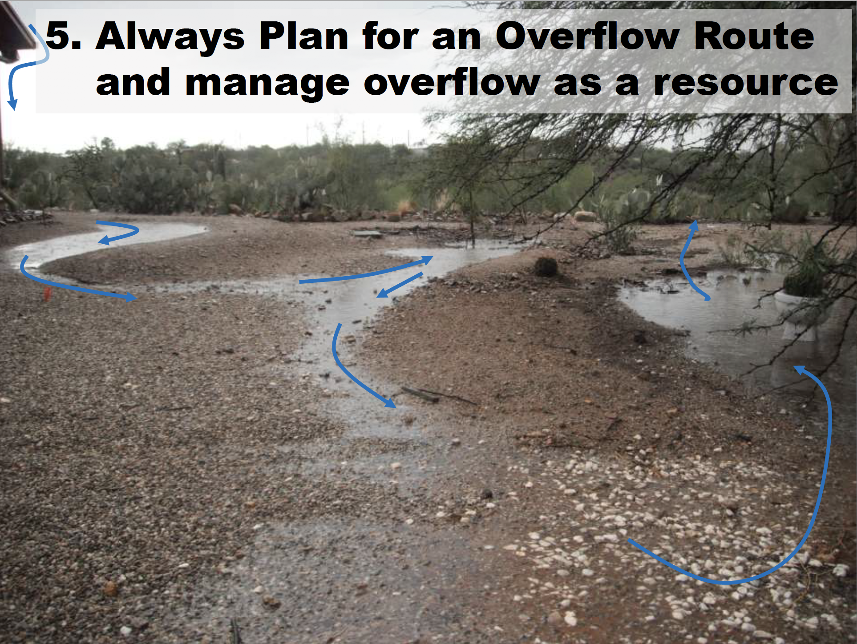
Diagram from: Watershed Management Group
Notes:
Plan for Overflow to Accommodate Excess Water
Take into account the actual area of land space and spread its volume into multiple basins as needed.
Give students time to figure out their basin configuration and dimensions. Make sure that they plan for overflow.

Slide 26
Basin Design
RELATE:
How are the parts related?
Volume _{Basin(s)} = Volume _{rain} (100-year storm event)
Perc Rate determines Basin Depth
Safety Constraints affect Basin Depth
Area available for basins affect Basin Size
Elevation Differences affect Basin Design
Constrained by distance from building or runoff surface, slope, utility lines
State laws about pooled water

Slide 27
What Did We Learn?
BUILD THE SYSTEM:
Identify all of data needed to size basins that meet the criteria for a 100-year storm and city ordinances pertaining to standing water.
BUILD THE SYSTEM:
Use mathematics and computational thinking to size infiltration basins to most optimally meet the engineering design challenge.
RELATE
Plan and carry out investigations that relate water storage needs to water supply and demand.

