Slide 1
Lesson Nine System Design & Improvement
Students develop campus rainwater harvesting designs using their collected data, imagining, planning, and offer peer review feedback.
Notes:
Launch the Unit
In this Lesson, students will complete the following tasks:
Compile their data and think through all parts of their system
Design their system based on the criteria and constraints.
Test their design on their classmates
Improve their system utilizing peer feedback to create the best design based on the criteria and constraints.
Present their system designs to classmates.

Slide 2
DISTINGUISH:
What’s the problem?
What do we know?
What don’t we know?
How will you design a passive rainwater harvesting system that will provide shade and sustain your plants year-round through the most efficient use of available water?
Notes:
Remember the driving question…

Slide 3
Notes:
Where are we in the engineering design process?
We have been Asking questions, Exploring, Imagining and Planning regarding this engineering project. In this lesson, we move forward in the Planning stage and then begin the Create and Test phases of the Engineering Design Process.

Slide 4
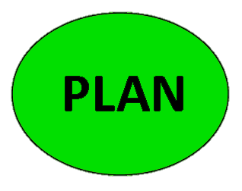
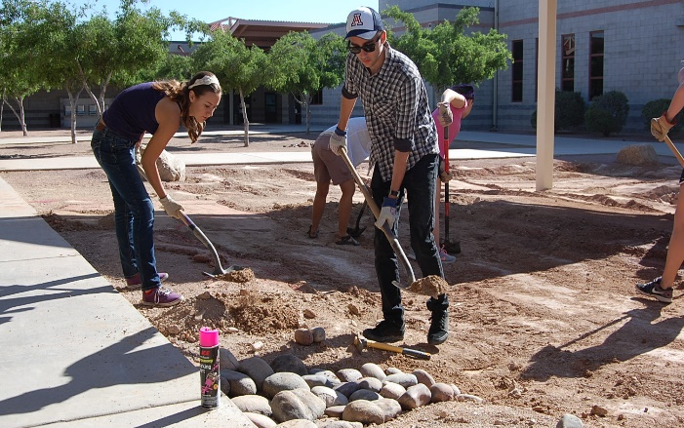
BUILD THE SYSTEM:
Design Your System
How will you design a passive rainwater harvesting system that will provide shade and sustain your plants year-round through the most efficient use of available water?
Using your site inspection sketches and your supply & demand calculations, you will now design your own rainwater harvesting system for your campus.
Notes:
The students will have two class periods to design their system:
Students will compile their data using the Your Rainwater Harvesting System Worksheet instructions. They will also need their Site Maps (to scale), Basin Drawings, their supply and demand calculations and all their notes.
They will then begin to design their rainwater harvesting systems.
Go over the parts of the worksheet with the students. The next ten slides cover 4 key parts of the worksheet.

Slide 5
BUILD THE SYSTEM:
Refine Criteria and Constraints
Quantify where possible
Customer Criteria | Revised to be specific | What you will do to meet the criteria?
Passive rainwater harvesting system.
Provide Shade.
Sustain Plants through efficient use of available water.
Customer Constraints | Revised to be specific | What you will do to fit within the constraints
Use available water.
Infiltrate water in 96 hours.
Notes:
As you circulate the room, ask them questions about how their design accommodates the data they developed throughout the explorations.
Require data-driven decisions. Not guesses.
Students should return to their criteria and constraints. They’ve been building their lists and refining these throughout the unit. If they’ve adequately recorded the criteria and constraints in their notebooks or on paper in the classroom, they should just review them at this point. There are table within the worksheet to think through them, add to them and refine them if that’s useful.

Slide 6
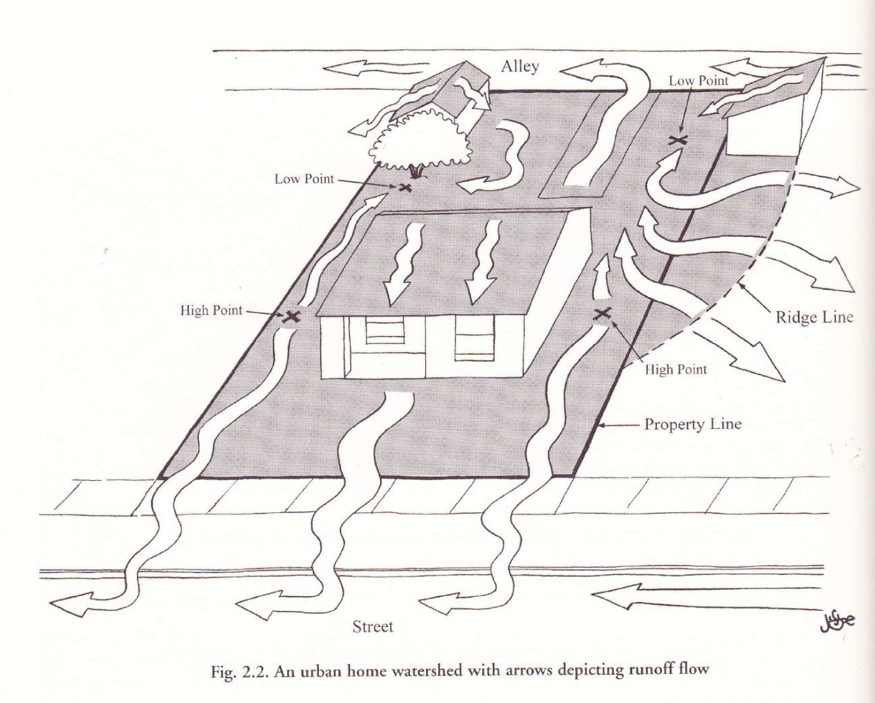
BUILD THE SYSTEM:
Site Map
Schoolyard Inspection Data Sheet
From Lesson 4
L
L
H
H
Notes:
One version of a site map.
Diagram from: Rainwater Harvesting for Drylands Volume 1 (2nd Edition) Guiding Principles. Rainsource Press. Brad Lancaster, 2013.

Slide 7
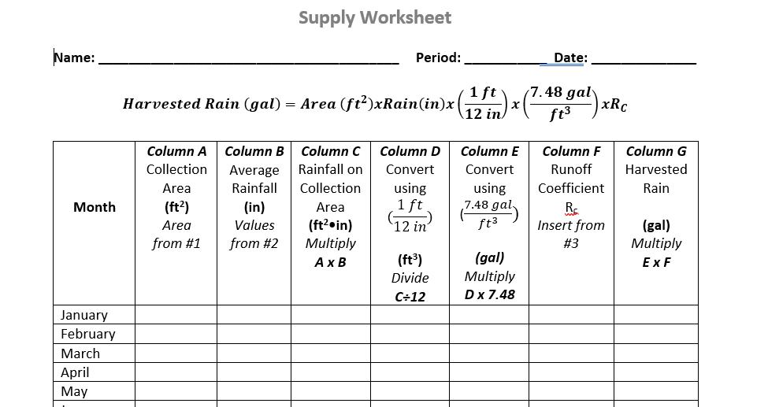
BUILD THE SYSTEM: How Much Water Can We Collect?

Slide 8
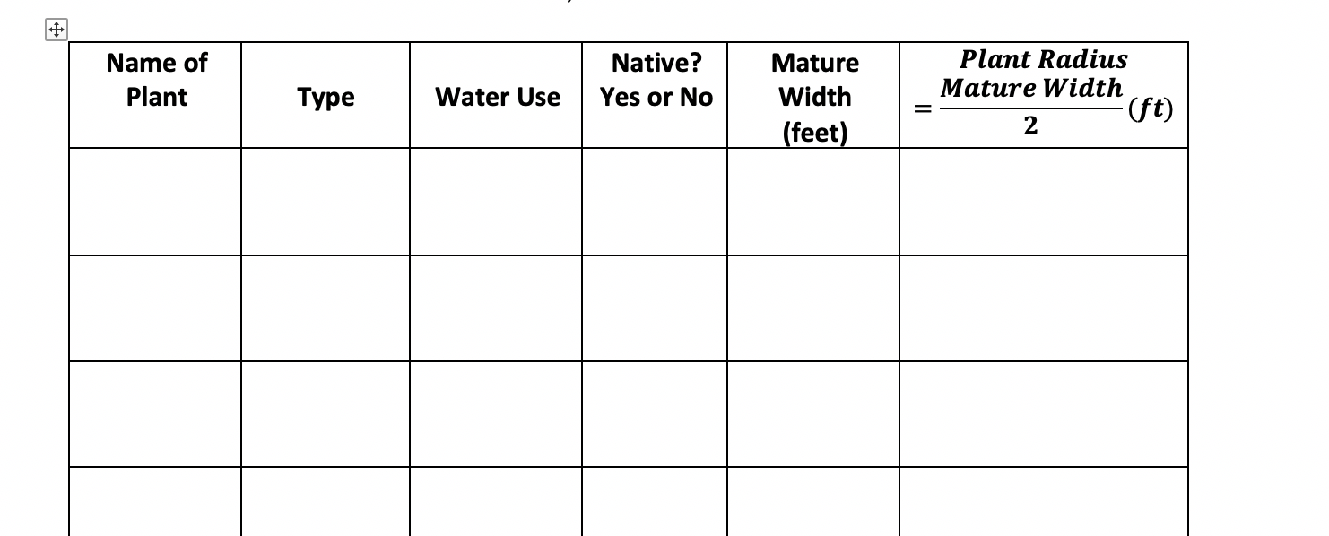
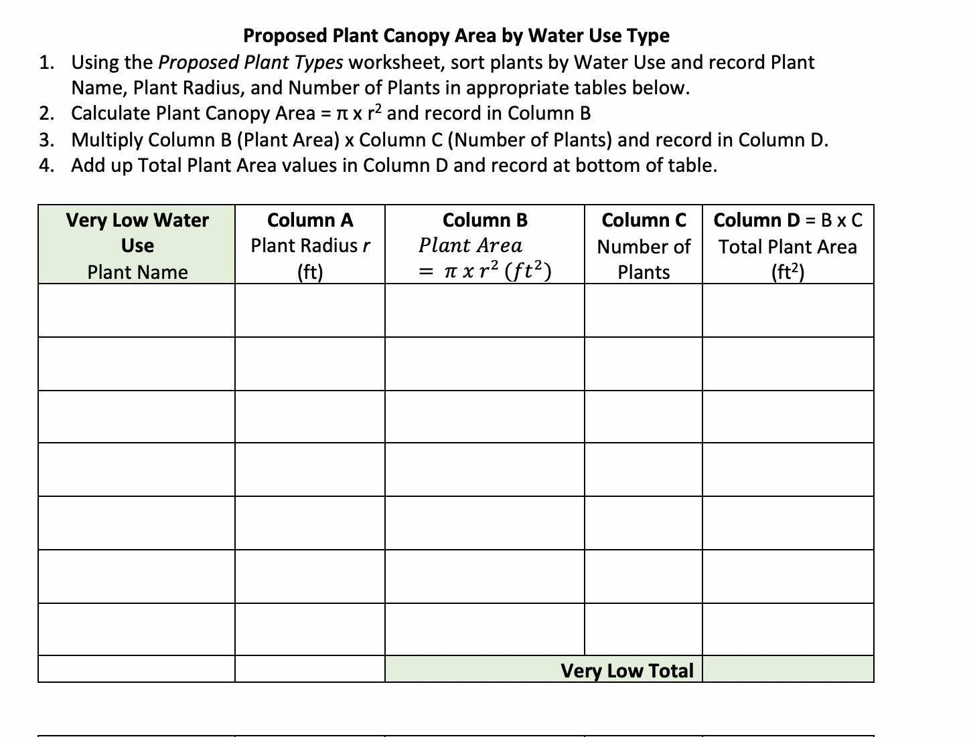
BUILD THE SYSTEM: Plants

Slide 9
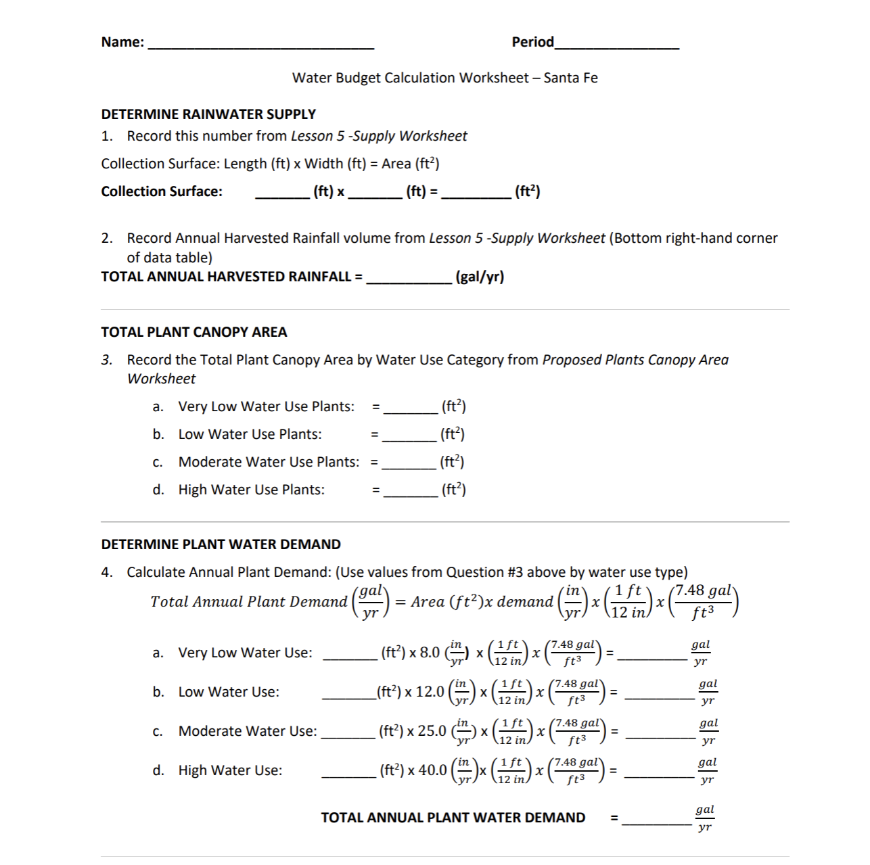
BUILD THE SYSTEM: Water Budget

Slide 10
BUILD THE SYSTEM: Basin Sizes
$$Harvested Rain \left(gal\right)=Area \left({ft}^{2}\right)xRain\left(in\right)x\left(\frac{1 ft}{12 in}\right)xR_{C}$$
Perc Rate
Length x Width x Depth
Notes:
Show the Math

Slide 11
BUILD THE SYSTEM:
Basin Drawings
Simple to Detailed
Length
Width
Depth
Notes:
Basin Drawing
Check the to-scale drawings of your basins from Lesson 9 and add to it or start another one. It would be good to have a map or overhead view and a cross-sectional view of the site. Label all parts.
Will water flow through your site by gravity? Is the highest elevation nearest your collection area?
Have you used your chosen area well? Do you have basins that infiltrate the water in a pleasing pattern over the area?
What depth are your basins?
Are there places where you want to construct berms (small mounds) to slow the flow of runoff?
Are there places where you want swales to move water from one place to the other?
Are there places where you want check dams to slow the flow of water?
List the parts of your system that need to be installed. Include sizes, quantities or special features in their descriptions, if applicable.

Slide 12
BUILD THE SYSTEM:
Basin Design
Will water flow through your site by gravity? Is the highest elevation nearest your collection area? ​
Have you used your chosen area well? Do you have basins that infiltrate the water in a pleasing pattern over the area?
What depth are your basins?​
Are there places where you want to construct berms (small mounds) to slow the flow of runoff?
Are there plaves where you want swales to move water from one place to the other?
Are there places where you want to slow the flow of water?
List the parts of your system that need to be installed. Include sizes, quantities, or special features in their descriptions, if applicable.

Slide 13
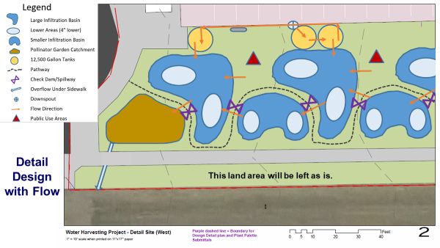
BUILD THE SYSTEM:
Basin Drawings

Slide 14
BUILD THE SYSTEM:
Onsite Plant Arrangement
Where should the water for trees go? Trees should get water out beyond their tree canopies, so they shouldn’t be planted in the bottom of basins.
What kinds of plants help water infiltrate into the soil? Grasses have a lot of active roots and can help infiltration so they should be planted in the basin bottoms.
Deserts plants like cactus can be planted outside of the basins. They’ve adapted to our desert climate and periods with no rain.
Native flowering plants and shrubs can go in to the sides of the basins and should be arranged in ways that makes the landscape pretty. Think of color, height, width and structure.

Slide 15
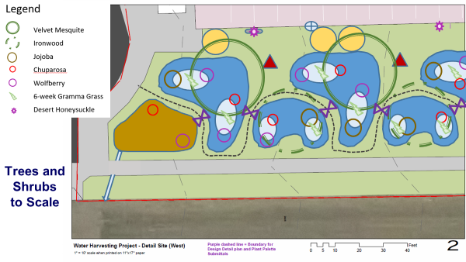
BUILD THE SYSTEM:
Onsite Plant Arrangement

Slide 16
BUILD THE SYSTEM:
Rainwater Collection Area and Conveyance System
Draw your collection area to scale and label it.
Identify where the water will come off the collection area.
How will the water get to your basins? What conveyance structures are needed?
If the water runs directly off of the roof, how will you capture it and direct it to your basins? If the water runs off a lower surface area like a parking lot, how will you direct it?
List the parts of your system that need to be installed. Include sizes, quantities or special features in their descriptions, if applicable.

Slide 17
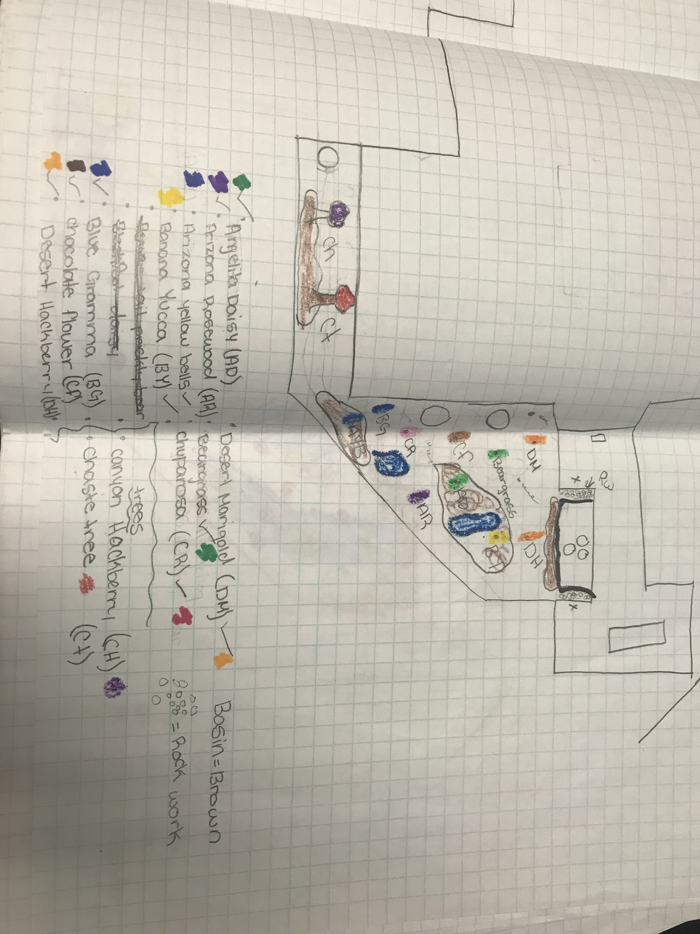
BUILD THE SYSTEM: Schematic Diagram
Notes:
What makes a good design?
By preparing a schematic drawing, students have a better understanding of the physical components involved in their system. The have already created maps of their systems using a map view or aerial perspective.
Ask students why they think it’s important to use schematic drawings and overhead view design layouts. Ask students, “What are the benefits of the two types of diagrams?”
A schematic drawing shows the parts of the system without too much worry about scale, placement. This is the place where showing all system components is important. These components should be listed and described in the chart on question 3.g. on the worksheet.

Slide 18
BUILD THE SYSTEM:
Complete Designs
How did you solve the problem?
How did you use data to make decisions?
How did you meet the criteria?
How did you accommodate the constraints?
Notes:
Lesson 10 – TEST through peer feedback
Where are we in the engineering design process? We have been Planning and Creating a rainwater harvesting system. In this lesson, we move in to the Testing phase of the Engineering Design Process. The reason for doing a test is to be able to improve the design before the final product is completed.

Slide 19
Notes:
Lesson 10 – TEST through peer feedback
Where are we in the engineering design process?
We have been Planning and Creating a rainwater harvesting system. In this lesson, we move in to the Testing phase of the Engineering Design Process. The reason for doing a test is to be able to improve the design before the final product is completed.

Slide 20
TAKE A PERSPECTIVE:
Peer Review
Be Kind.
Be Specific.
Be Helpful.
When reviewing your peers’ designs:
Does the design solve the problem?
How are design decisions based on data?
How does the design meet the criteria and fit within the constraints?
That’s Dumb
It’s Cool
I like…..
I wonder…..
What if…..
Notes:
TAKE A PERSPECTIVE:
Review peer’s work and provide helpful feedback.
The design review is a mental test of the system. Peer experts will examine the design plan and will think through how it works. They will give helpful feedback regarding how to improve the system. Helpful feedback is specific and kind. Starting sentences with the phrases on this slide will help students to give useful feedback.
Conduct a “Gallery Walk” for students to explore each other’s designs and make CONSTRUCTIVE CRITICISM on post it notes. One student from each group should remain with their design to answer questions and clarification on feedback from others.

Slide 21
TAKE A PERSPECTIVE:
Improve & Complete Designs
Use the suggestions from your peers to make changes to your design:
Improve the system design
Adapt the design to meet the criteria
Create the best potential design or product
Notes:
TAKE A PERSPECTIVE:
Improve & Complete Designs
Continuous improvement is a model or process which promotes the idea that making regular, smaller changes can lead to large improvements in function.
Encourage students to look for opportunities to continue to improve their system designs based on the feedback they received. How can they adapt them to create the best product?
Once they have completed their revised designs, students should prepare for their final presentations.

Slide 22
How does the engineering design process help us solve problems?
What did you learn?
Notes:
Conclusion
How does the engineering design process help us solve problems?

