Slide 1
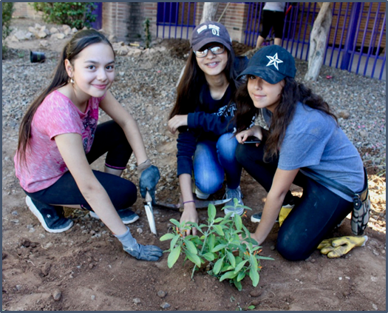

Lesson Ten
Communicating Your Achievements
Students will create design proposals, reflect on the value of rainwater harvesting in their world, and present their thoughts to their peers.
Notes:
Launch Lesson 10
In this lesson, students will obtain, evaluate and communicate information about how the designed rainwater harvesting system meets specified criteria and constraints of the engineering design process. They will make an argument based on evidence. Finally, students will consider how rainwater harvesting is related to the larger water distribution system and heat in the Southwest.

Slide 2

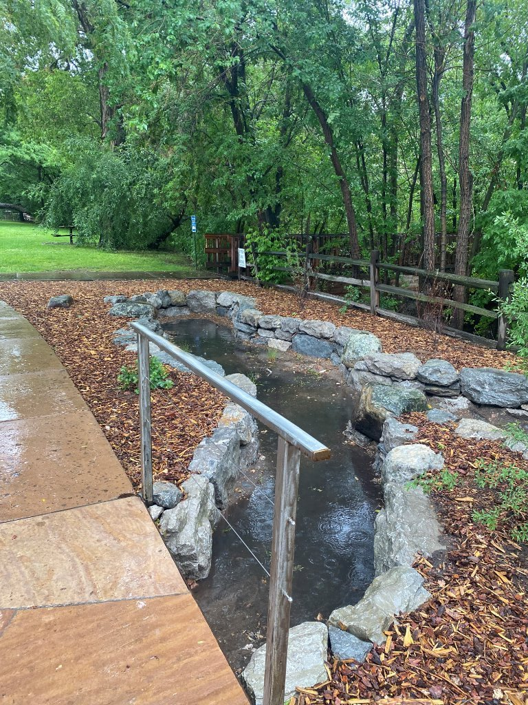
DISTINGUISH:
What’s the problem?
What do we know?
What don’t we know?
How will you design a passive rainwater harvesting system that will provide shade and sustain your plants year-round through the most efficient use of available water?
Notes:
Students have now examined the driving question and answered it through exploration, imagining, planning, creating, testing and improving.
Ask the students, “When we put all of those activities together what were they doing? What is the benefit of using this process?”

Slide 3
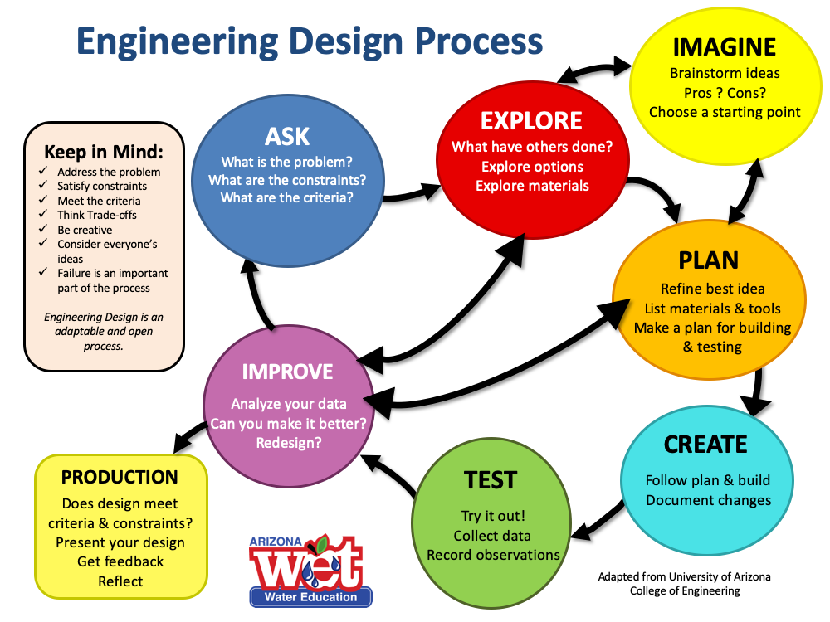
Notes:
They are utilizing the engineering design process to solve a problem in the most effective way.

Slide 4
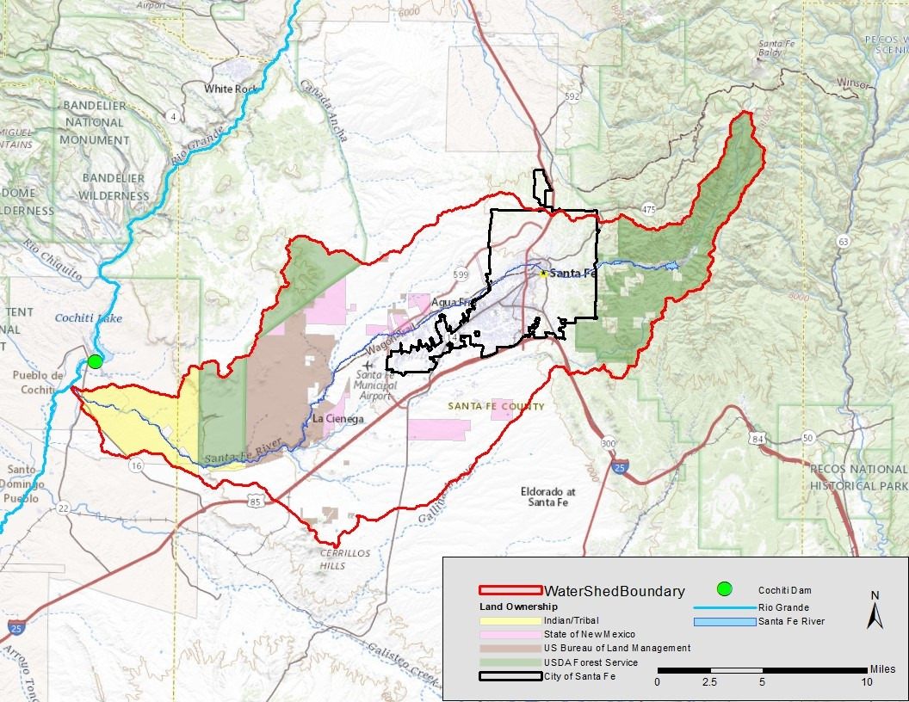
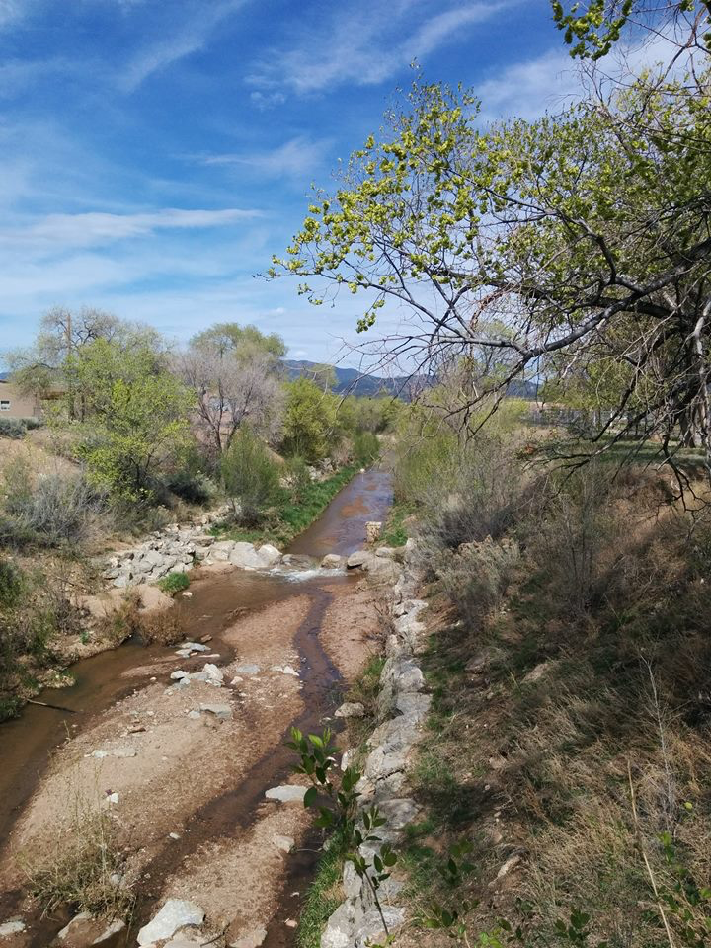
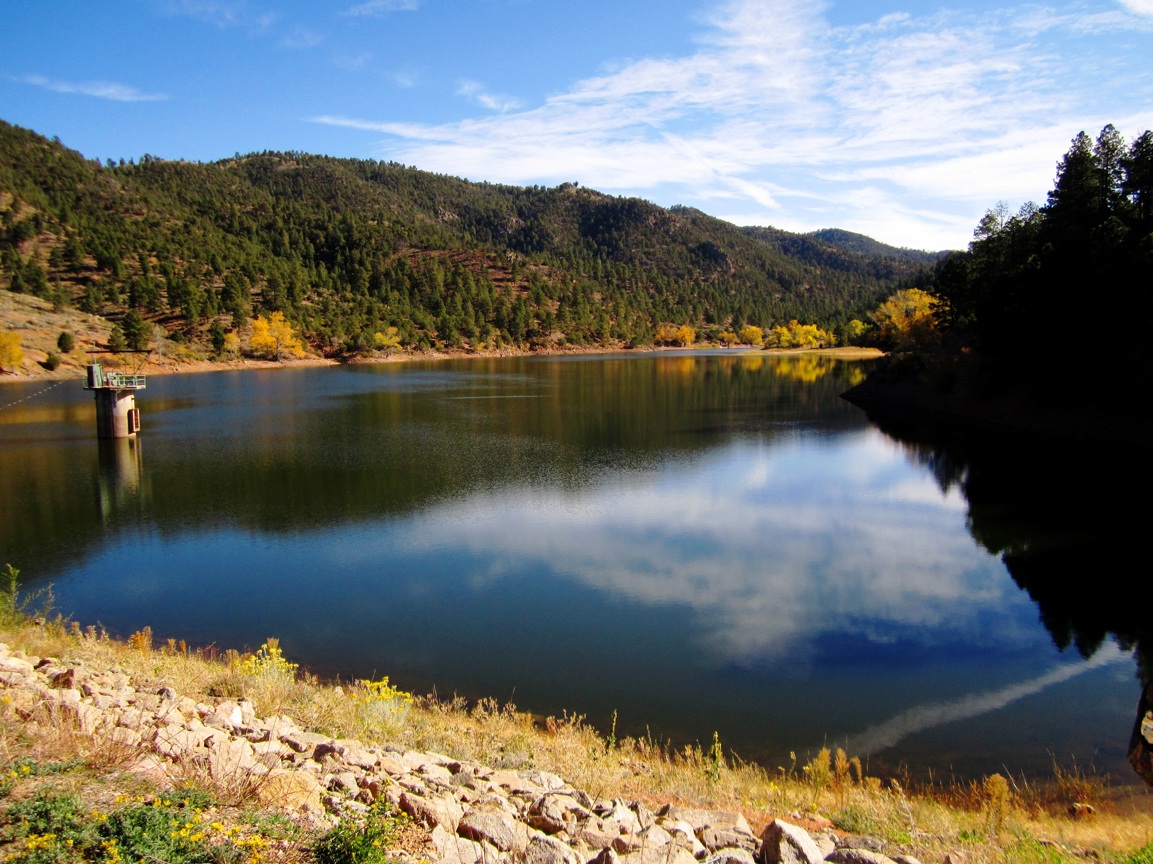
BUILD THE SYSTEM:
What is a rainwater harvesting system a part of?
Notes:
BUILD THE SYSTEM:
What is a rainwater harvesting system a part of?
It’s part of our water supply, the local water cycle, the natural system, water resources.
It’s a small-scale system that has very similar parts to the large-scale water supply systems!
It’s a way to conserve our potable water while mitigating heat by creating shade and evapotranspiration.

Slide 5
TAKE A PERSPECTIVE:
What is the value of rainwater harvesting in the environment that you live in?
In your table groups, discuss the above question. Things that might be considered:
What is the cost of rainwater?
What problems are solved by the rainwater harvesting system that you designed?
Are there benefits outside of your school?
Are there benefits that extend to your community?
What problems may result from the rainwater harvesting system that you designed?
Notes:
TAKE A PERSPECTIVE:
What is the value of rainwater harvesting in the environment that you live in?
Encourage students to think of rainwater harvesting from the broader perspective of the environment that we live in. Most understand that we live in a desert and have limited water, but what does that really mean? Is it only about conserving potable water or are there other things to consider?
In your table groups, discuss this question. Things that might be considered:
What is the cost of rainwater?
What problems are solved by the rainwater harvesting system that they designed?
Are there benefits outside of their school?
Are there benefits that extend to their community? Have they thought of flood mitigation? Reducing erosion? Saving water that would otherwise be wasted?
What problems may result from the rainwater harvesting system that they designed?

Slide 6
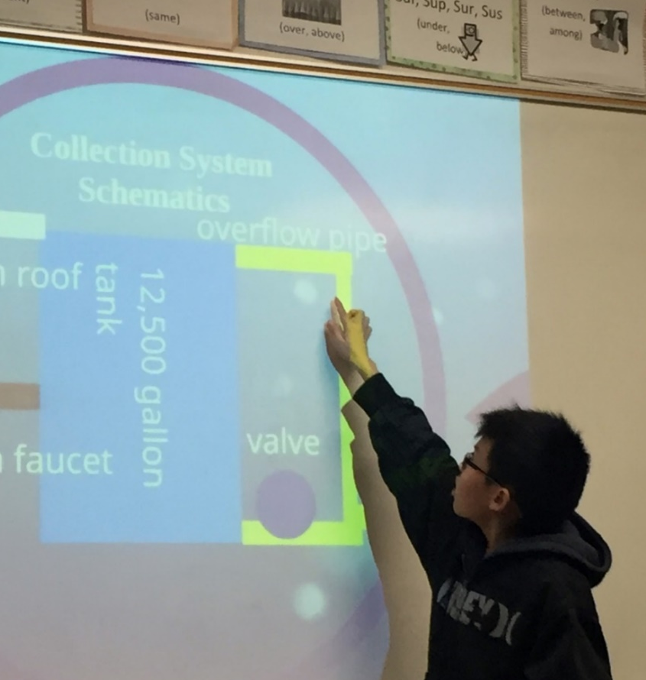
Design
Presentations
Imagine that your group is presenting your design to the school as a potential rainwater harvesting system.
1. Show your design from many perspectives.
2. Explain how your design solves the problem.
3. Explain how you met the criteria.
4. Explain how you accommodated the constraints?
5. Describe at least one decision you made in order to improve your design or better meet the criteria and accommodate constraints.
6. Summarize the value of rainwater harvesting in your environment.
Notes:
Design Presentations
Students present their system designs:
Imagine that your group is presenting your design to the school as a potential rainwater harvesting system.
Show your design
Explain how your design solves the problem.
Explain how you met the criteria.
Explain how you accommodated the constraints?
Describe at least one decision you made in order to improve your design or better meet the criteria and accommodate constraints.
Summarize the value of rainwater harvesting in your environment.
It is very important that students use data, particularly the supply and demand data, to justify their design decisions. They will also tell a “story” about a decision that they made in order to improve the design.
Use the rubric to communicate to students the expectations and grade presentations.

Slide 7
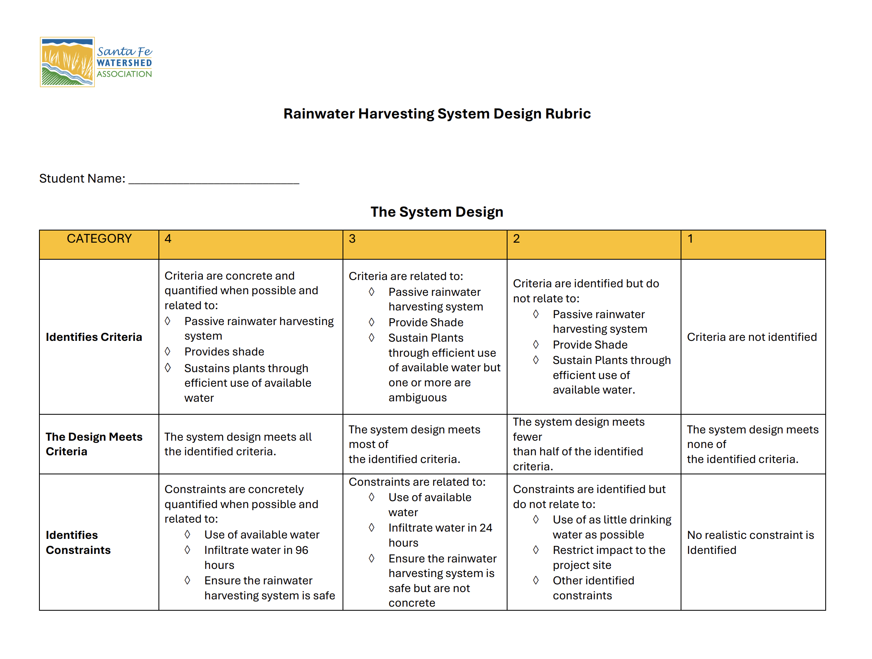
Design Rubric
Notes:
Use the Design Rubric to communicate to students the expectations and grade presentations.

Slide 8
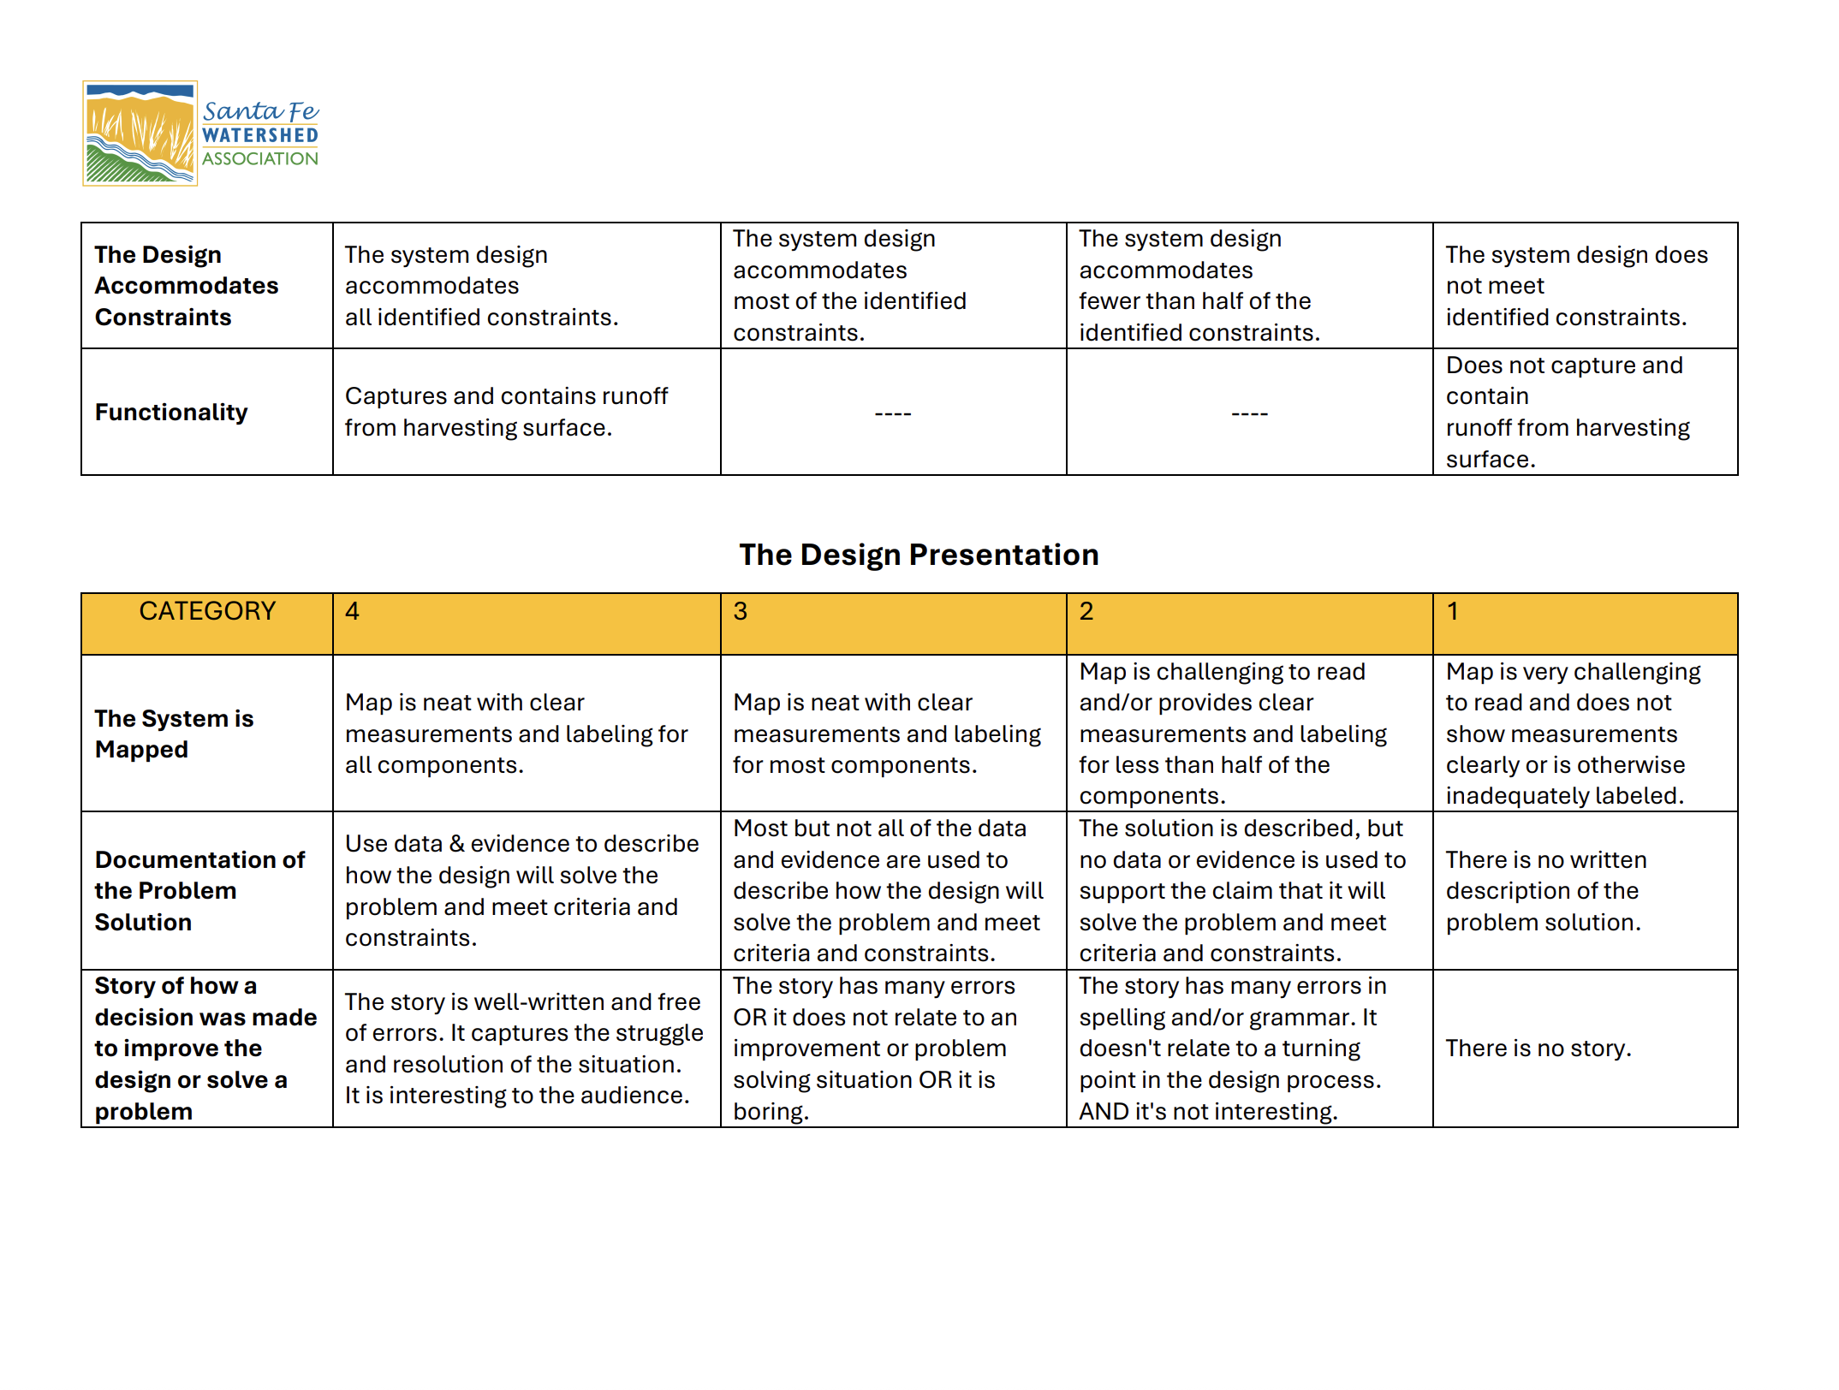
Design Rubric cont’d
Notes:
Use the Design Rubric to communicate to students the expectations and grade presentations.

Slide 9
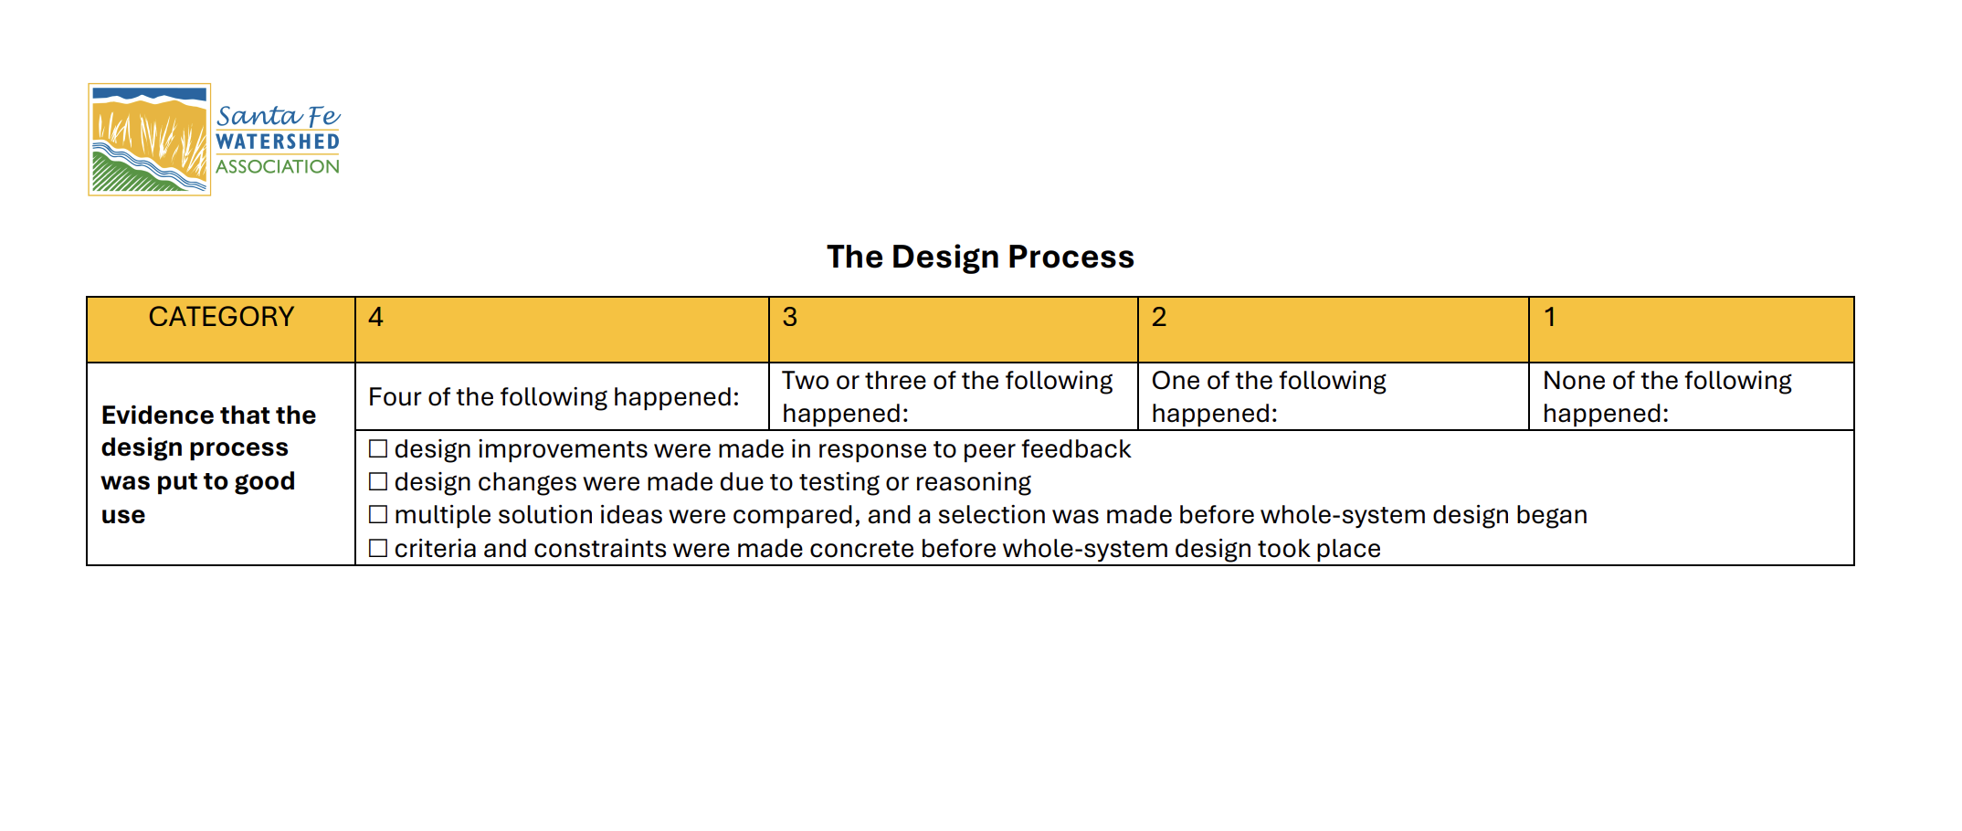
Design Rubric cont’d
Notes:
Use the Design Rubric to communicate to students the expectations and grade presentations.

Slide 10
Summary
RELATE Rainwater Harvesting to:
  Saving water
  Reducing water waste
  Drought
  Flooding
  Erosion
  Green Stormwater Infrastructure
TAKE A PERSPECTIVE:
From the perspective of water conservation and heat mitigation (since it’s projected to get hotter and more arid), what is rainwater harvesting?
Notes:
RELATE Rainwater Harvesting to:
Saving water
Reducing water waste
Drought
Flooding
Erosion
TAKE A PERSPECTIVE:
From the perspective of heat mitigation (since it’s projected to get hotter), what is rainwater harvesting?
It’s a viable tool to use water efficiently one building at a time to cool and help mitigate the heat island effect while beautifying the landscape. Added together, if it were done at all buildings and homes, it could have a huge effect in reducing municipal water use.
This is water that is generally not part of Santa Fe’s municipal water supply, since our water comes from surface water from the Santa Fe River and Buckman Direct Diversion (Colorado River Compact water via the Rio Grande) and groundwater. Use of rainwater reduces the use of treated potable water and lowers payment for that water. It also improves soil moisture and assists in recharging the groundwater system.

