Slide 1
RWH Design Report
Betsy Wilkening

Slide 2
Problem Statement
How will you design a passive rainwater harvesting system that will provide shade and sustain your plants year-round through the most efficient use of available water?

Slide 3
Design Summary
I have designed a 200 ft² rain basin that will support my new and existing plants with available rainfall 9 out of 12 months of the year, or 75% of the time. During the projected shortfalls (April 204 gals, May 296 gals, June 326 gals) I plan on monitoring and irrigating the plants with potable water when necessary. The system has the ability to infiltrate the annual rainfall of 2,681 gals/year.
My design supports the following plants
New/Existing | Plant | Quantity | Tree Canopy (ft)
Existing | Sweet Acacia | 1 | 15
Existing | Cholla | 2
New | Sideoats Grama grass | 3
New | Desert Milkweed | 4

Slide 4
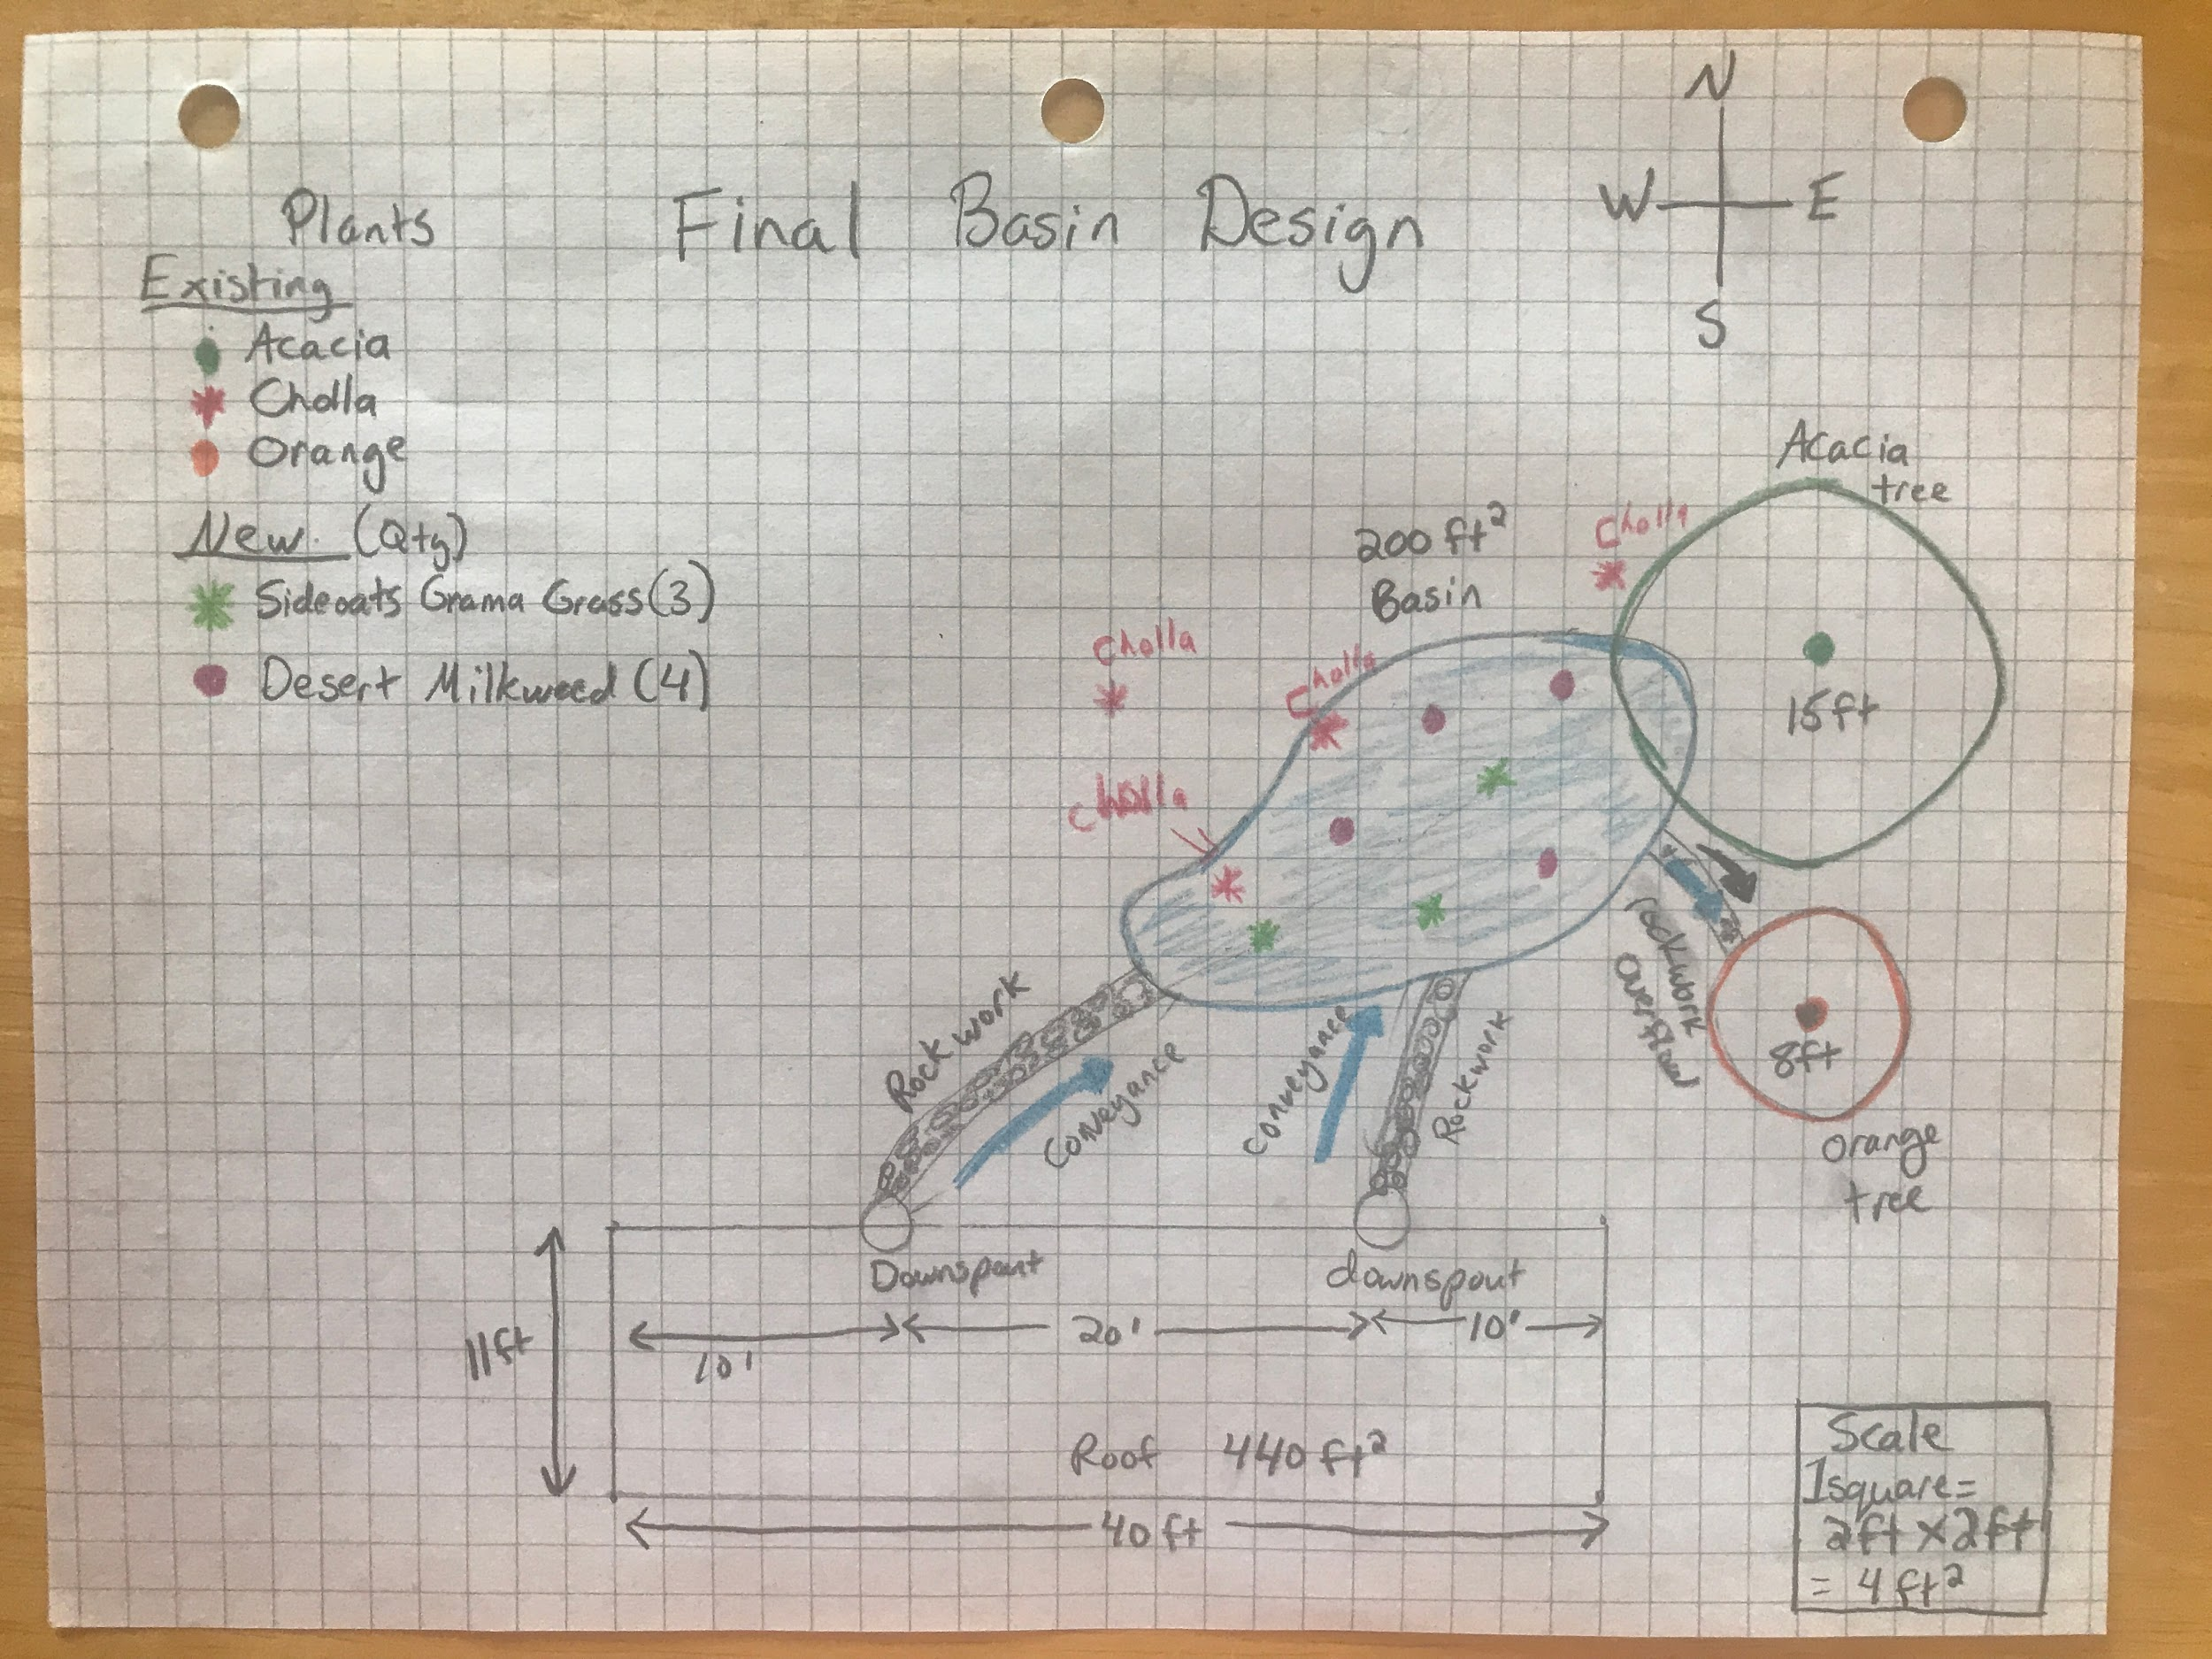
Basin Drawing

Slide 5
Meeting Criteria
Passive Rainwater Harvesting System - My system is 200 ft² rain basin that utilizes water from a 440 ft² section of the roof.
Provide shade by supporting a native acacia tree - An existing 15-foot canopy sweet acacia tree will receive water from the system.
Sustain existing and new plants through efficient use of water - 2,861 gallons of water will be harvested meeting 75% of my annual watering requirements. Supplemental water will be provided as outlined in my design summary for 3 months of the year.
Provide plants to encourage monarch butterflies and other pollinators - 4 Desert milkweeds will be supported to provide habitat and nectar for monarchs.

Slide 6
Meeting Criteria - Cont’d
Each element in design provides more than one function -
All plants sequester carbon.
Sweet Acacia provides shade, bird habitat, flowers for pollinators, and nitrogen fixing (returning nitrogen to soil).
Staghorn Cholla provides flowers for pollinators and fruit for wildlife.
Sideoats grama grass increases infiltration, provides nitrogen fixing.
Desert Milkweed provides habitat, nectar for monarchs.
Wood mulch decreases evaporation, provides carbon to the soil.
Rocks directs water to basins and overflow, decreases erosion.
Eliminate erosion alongside house - Rocks convey water from scuppers to garden decreasing erosion.
Provide for overflow - Overflow is directed to basin around orange tree.

Slide 7
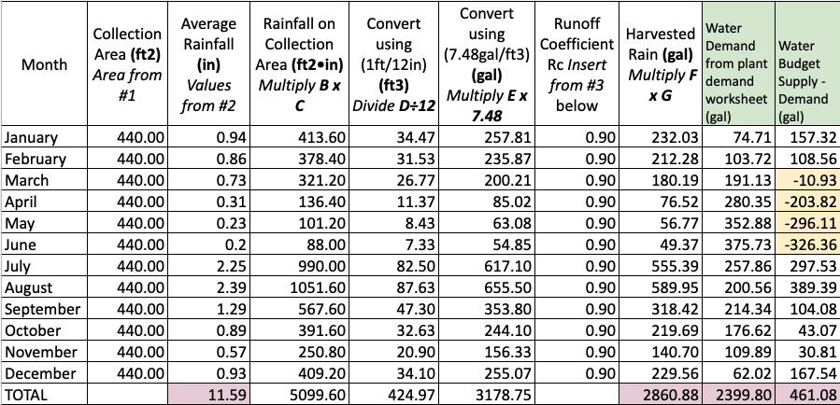
Water Budget Details
The column on the far right shows that my system can meet the water demands except during the highlighted months. The March value of ~11 gallons is not significant, but will be monitored. During April, May, and June, I will monitor and water plants as necessary. Since the cholla and acacia are established native plants, they may not need the calculated amount during those months.

Slide 8
Constraints
Utilize available rainfall while minimizing potable water use - The system has has the ability to infiltrate the annual rainfall of 2,681 gals/year. The plant needs are met through available rainfall 9 out of 12 months of the year, or 75% of the time. During the projected shortfalls (April 204 gals, May 296 gals, June 326 gals) I plan on monitoring and irrigating the plants with potable water when necessary.
Infiltrate water in 24 hours from a 2.5” 100-year storm event - The soil is sandy loam which has an estimated perc rate of 2-6 inches/hour. My basin depth of 0.5 feet spread over 200 ft² gives the capacity to infiltrate 100 ft³ of rain which is greater than the 92 ft³ that can be harvested in a 100-year storm event.
Ensure rainwater harvesting system is safe - The system is not in a heavily traveled area. The basin is only 6 inches deep which doesn’t create a tripping hazard.

Slide 9
Constraints - Cont’d
Basin depth must be between 0.5-0.67 feet - The basin is 0.5 feet deep.
Place basin on property within acceptable setback parameters - The edge of the basin is 9 feet from the house structure and the rock work to convey the water away from the house will be sloped towards the basin. There are no power lines or walkways in the area.

Slide 10
Strengths - Weaknesses of Design
Strengths
Plants are supported the majority of the year with rainwater.
New pollinator plants are added.
Existing plants will receive water to sustain them
Weaknesses
I would like to support more milkweed plants to reach the 10 needed for a monarch way station.

